Slide 1

Portal / Route 3.2.0
New Enhancements Webinar
Tuesday, May 3, 2022

Slide 2

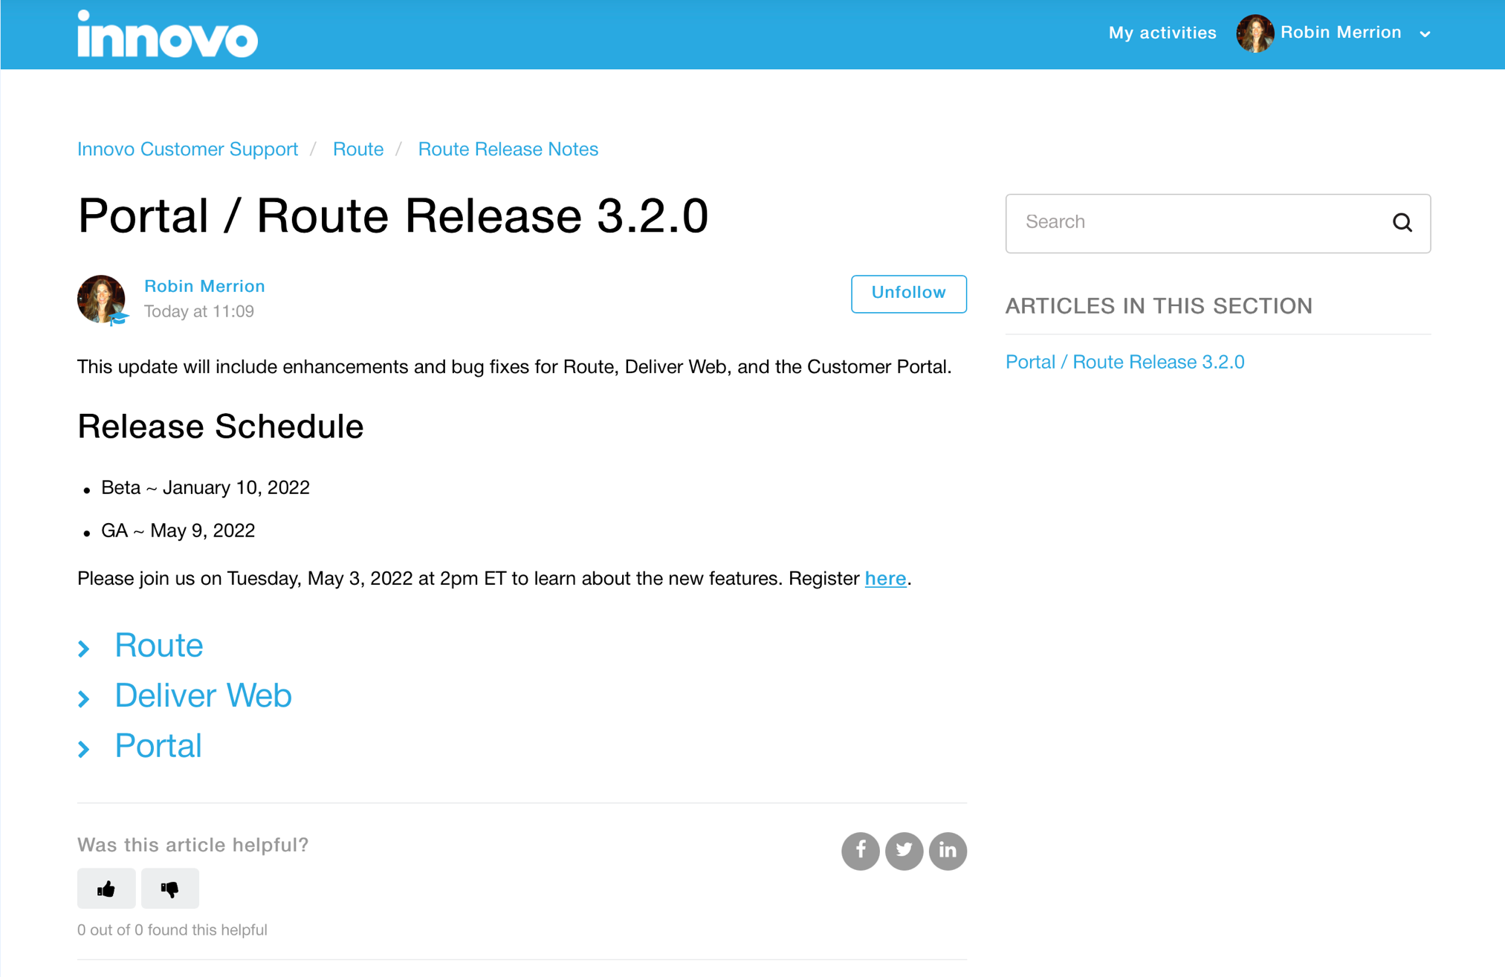
What’s New

Slide 3
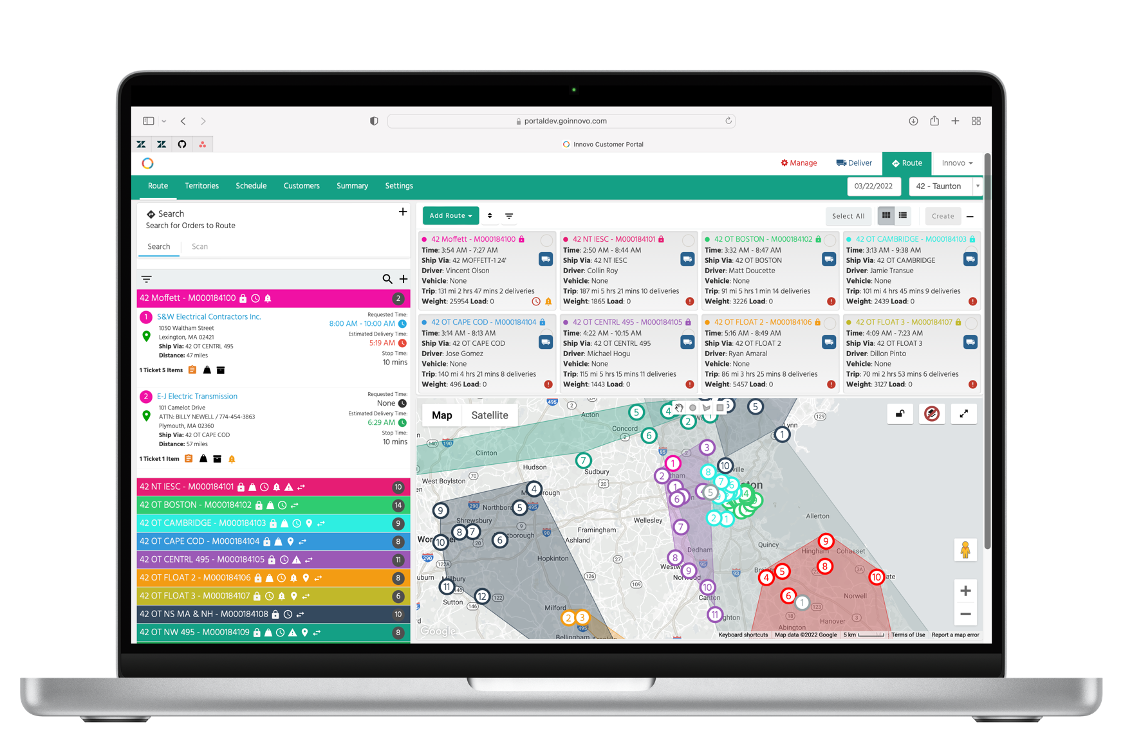
Route Overview
Innovo Route provides a quick and easy way to manage your daily deliveries

Slide 4
Route Overview
Pre-define routes based on geographic territory or ship via
Search for orders and build routes throughout the day
Route will automatically optimize orders based on fastest route or requested delivery times
Manage routes by moving stops from one route to another, drag/drop stops within the route, and create new routes on the fly
Route will create manifests in Eclipse with a single click
Route is completely integrated with Deliver

Slide 5

Route

Slide 6
Release Highlights
This release was built with efficiency and ease-of-use in mind, saving you time and giving your users more tools and options to streamline their workflow
Added a new Summary tab to Route to provide more insight and reporting into your delivery routes
Added a new overlay feature for Route customers to view the differences between the route suggested vs. the route taken

Slide 7
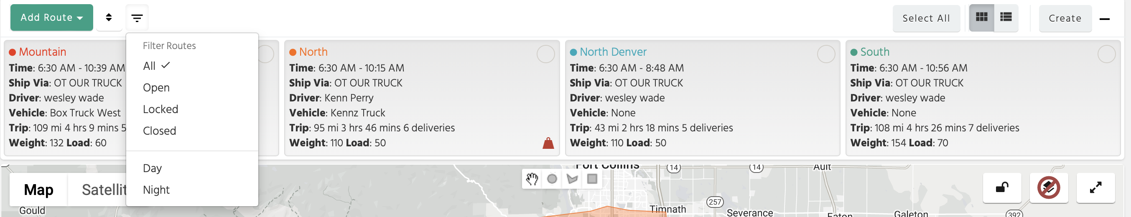
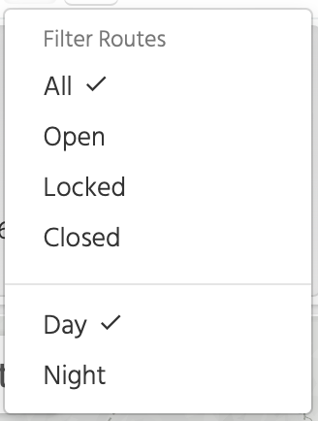

Filter Routes by Ship Via Template
Routes are filtered on Map, Overview, and Panel
Selected, click again to Unselect
Tip: you can also filter routes using both sections. For example, show me all my open, day routes.

Slide 8
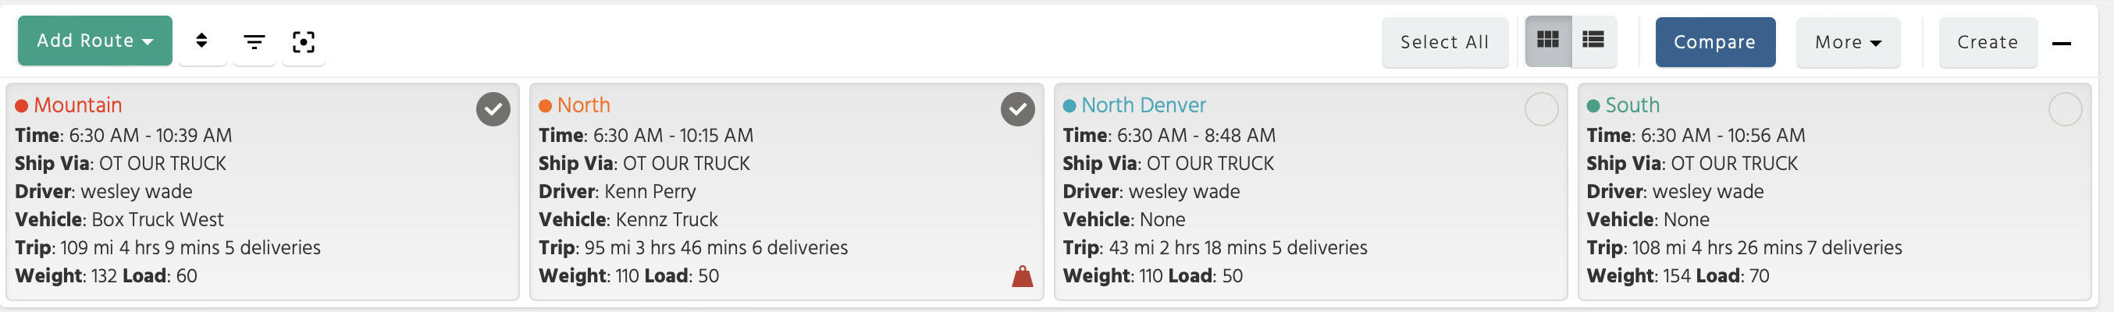
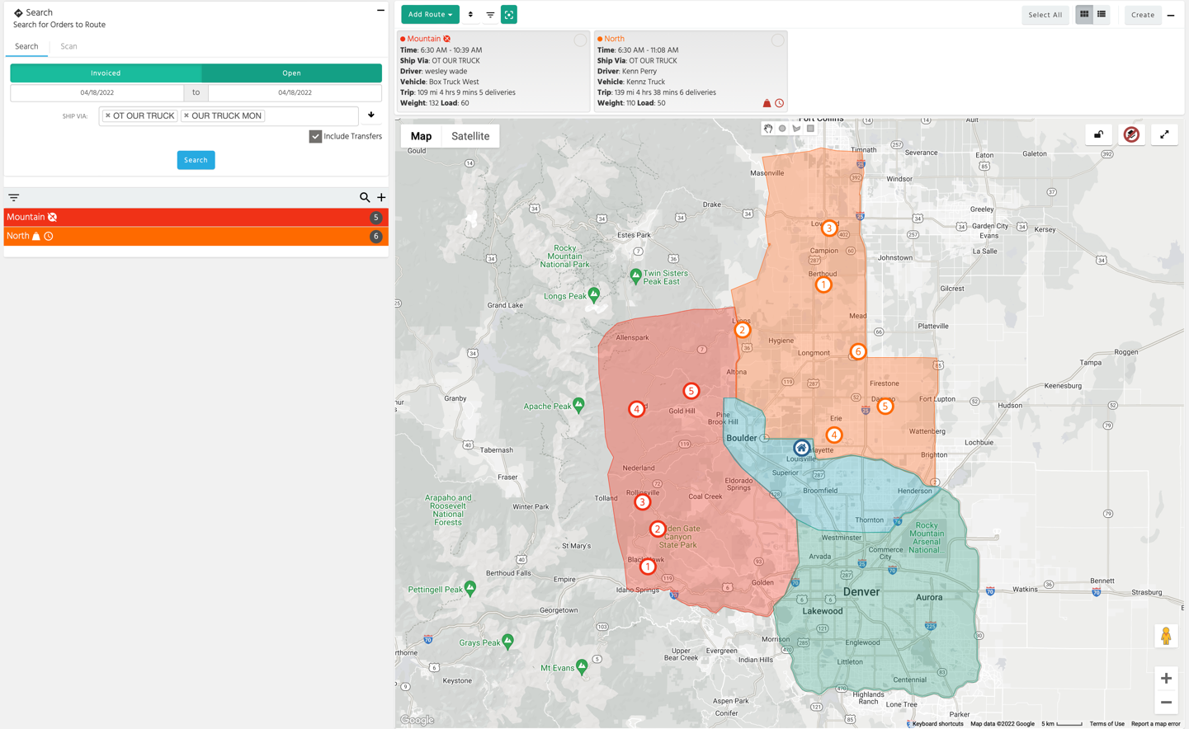
Filter Routes Using Focus Mode
Selecting two or more routes will display the focus icon
When you click on the focus icon, the panel, overview, and map will only display the selected routes
Click on the focus icon again to exit Focus Mode

Slide 9
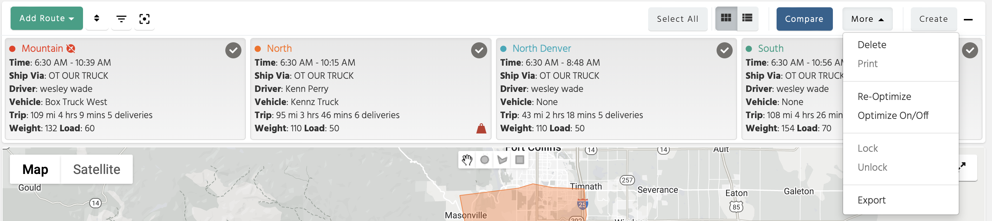
More Dropdown
Added Re-Optimize and Optimize On/Off options to More dropdown
Re-Optimize
Reset stops on one or more routes to either fastest or requested time
Optimize On/Off
By default, when you add orders to an existing route, all orders on the route are re-optimized (unless optimization is turned off or certain stops are locked)

Slide 10
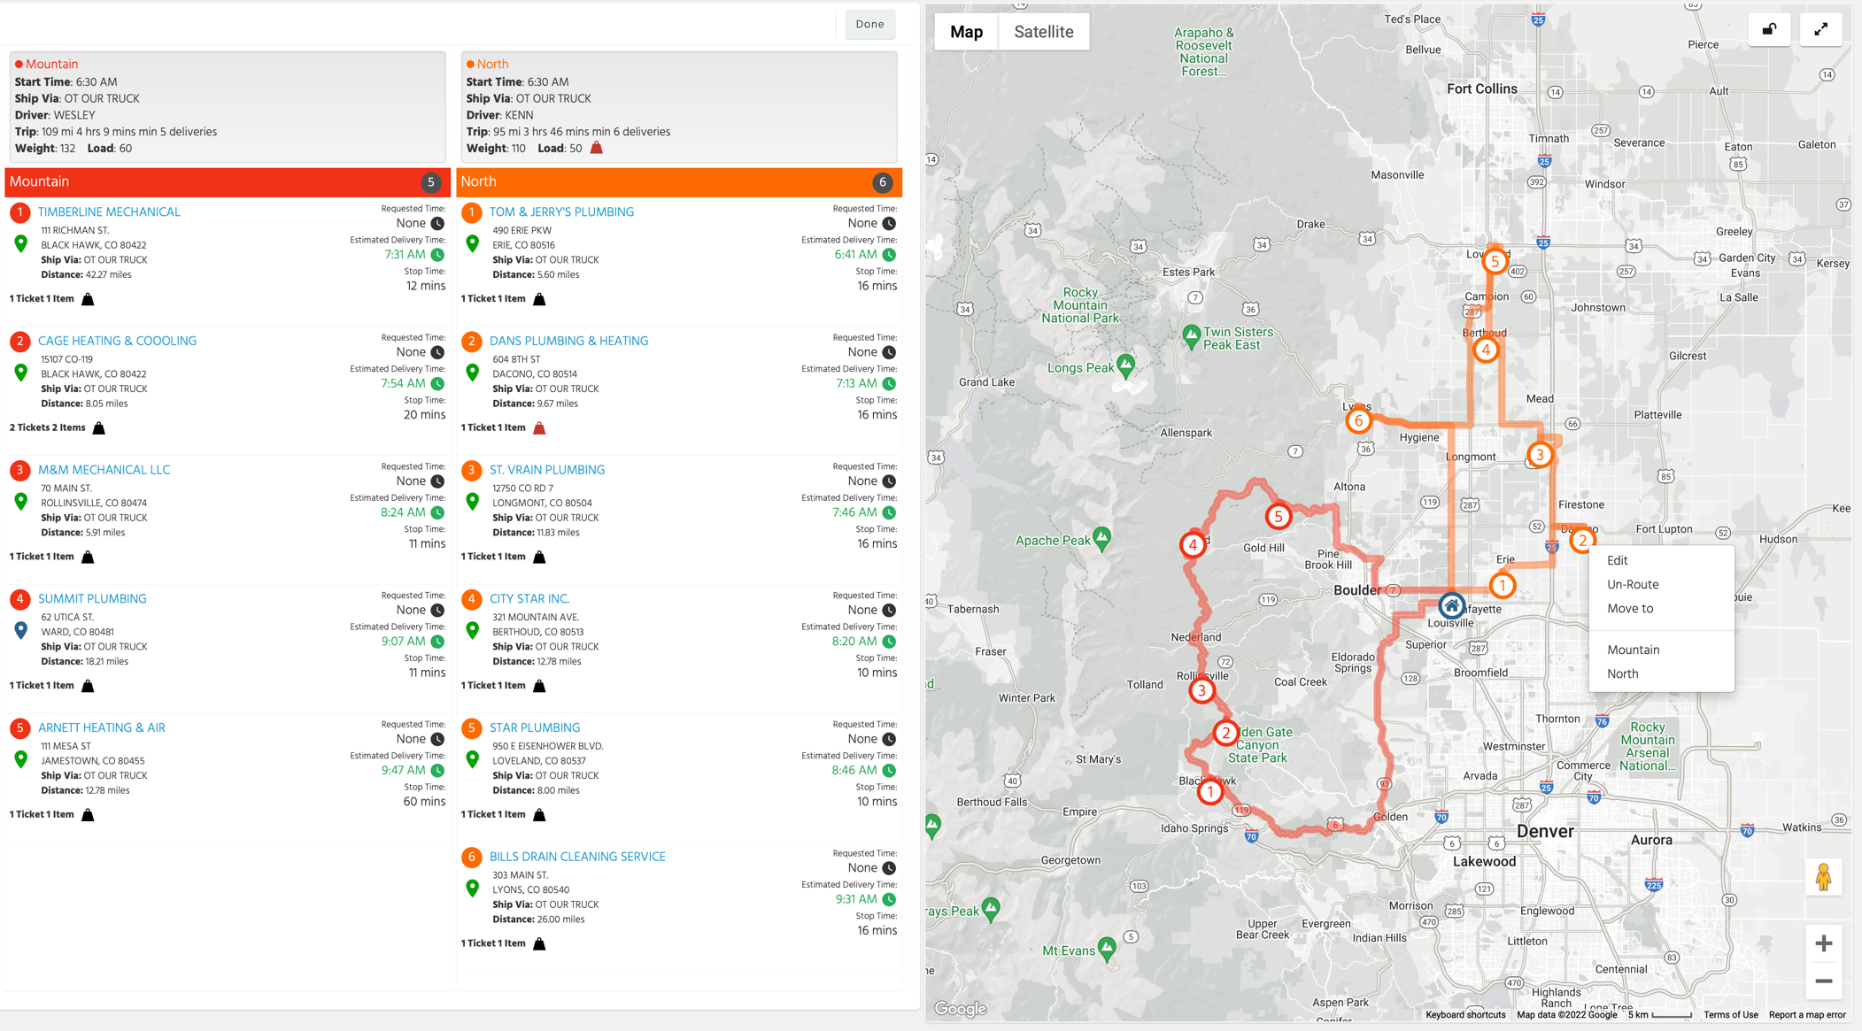
Compare Screen
Added right-click feature to Compare map

Slide 11
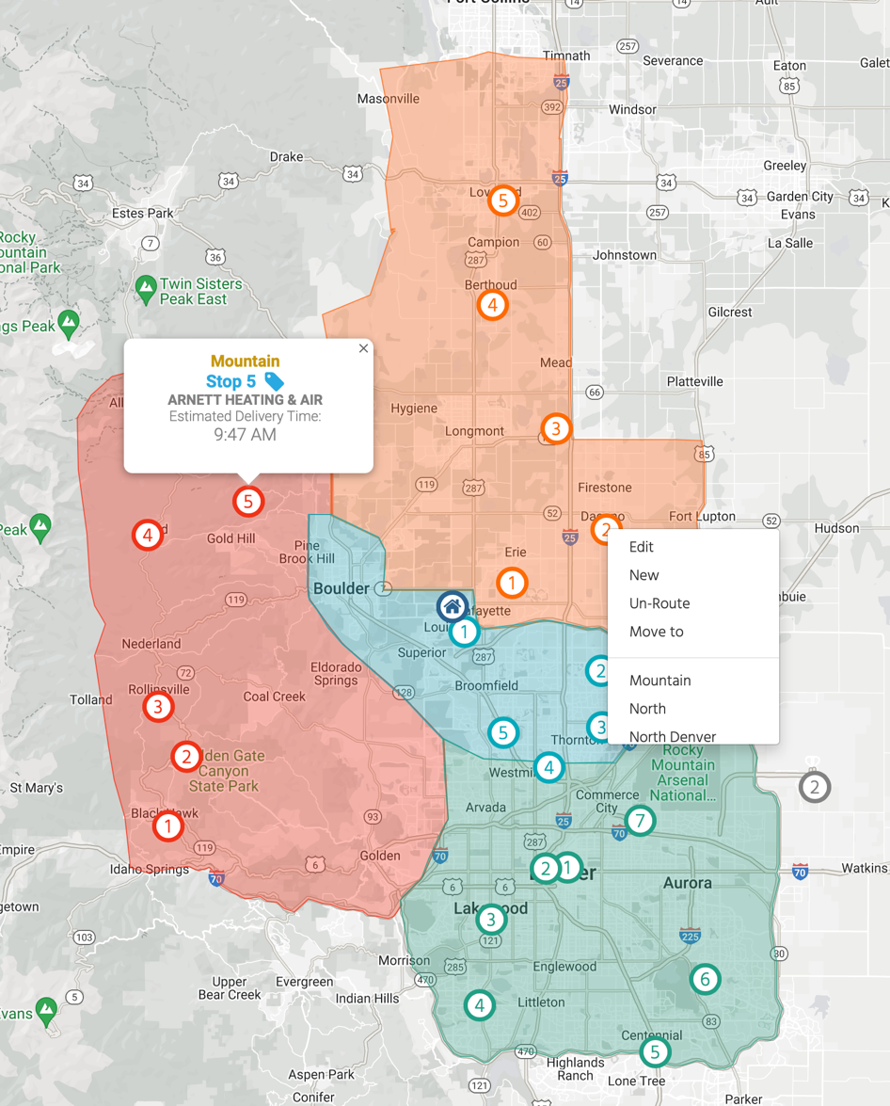
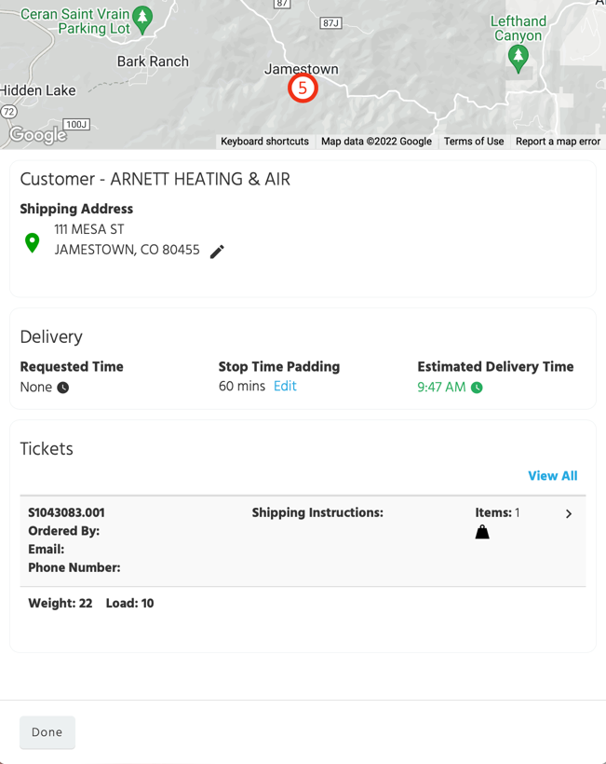
Full Screen Mode
Added right-click feature to map and the ability to view Stop Detail page
Click on stop number to display Stop Detail page

Slide 12
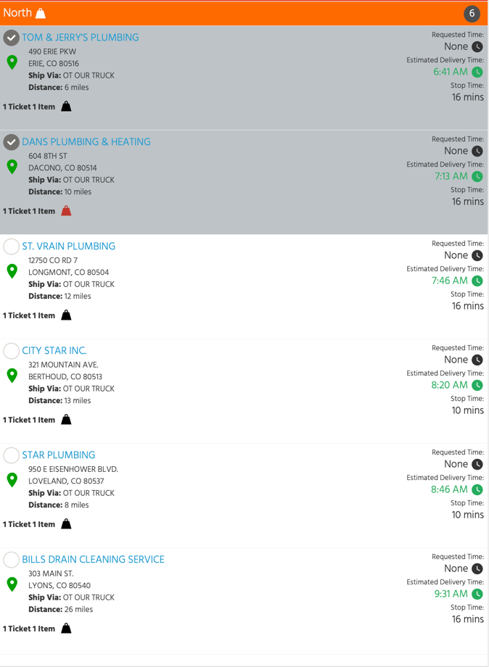
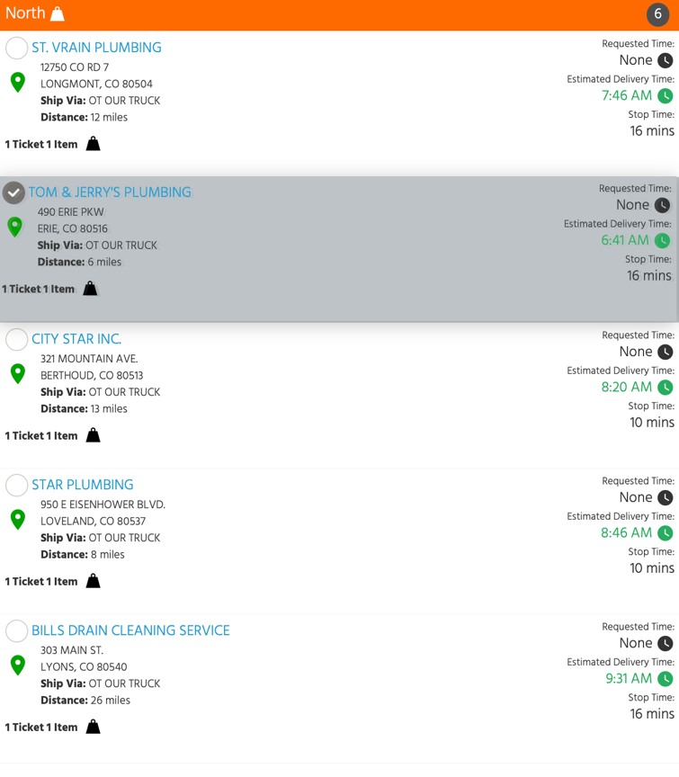
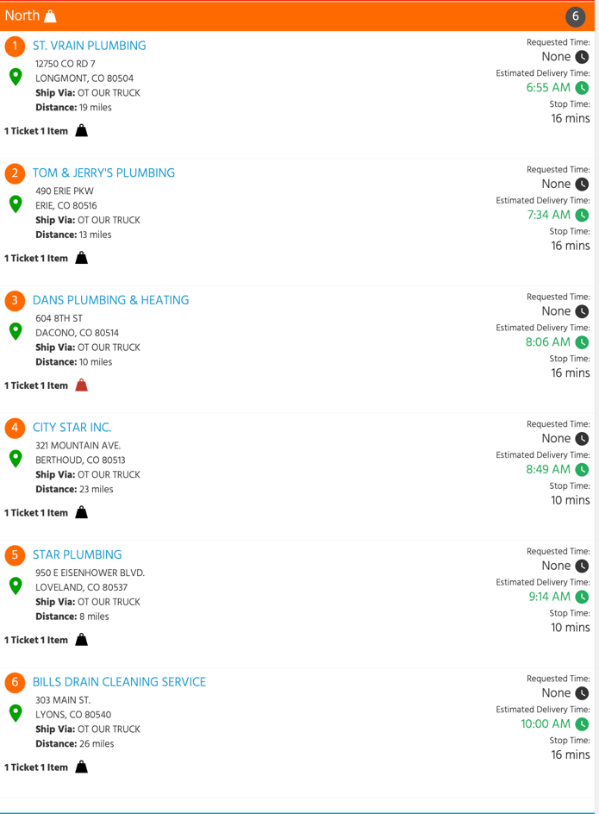
Enhanced Drag and Drop
Drag the first selected stop to desired position (all other stops will be collapsed)
Select multiple stops
All selected stops will be moved to the new position

Slide 13
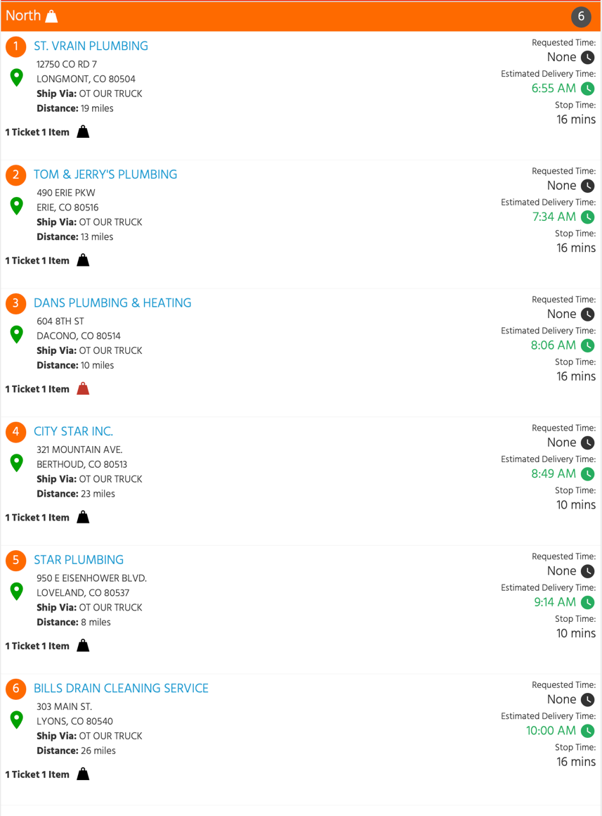
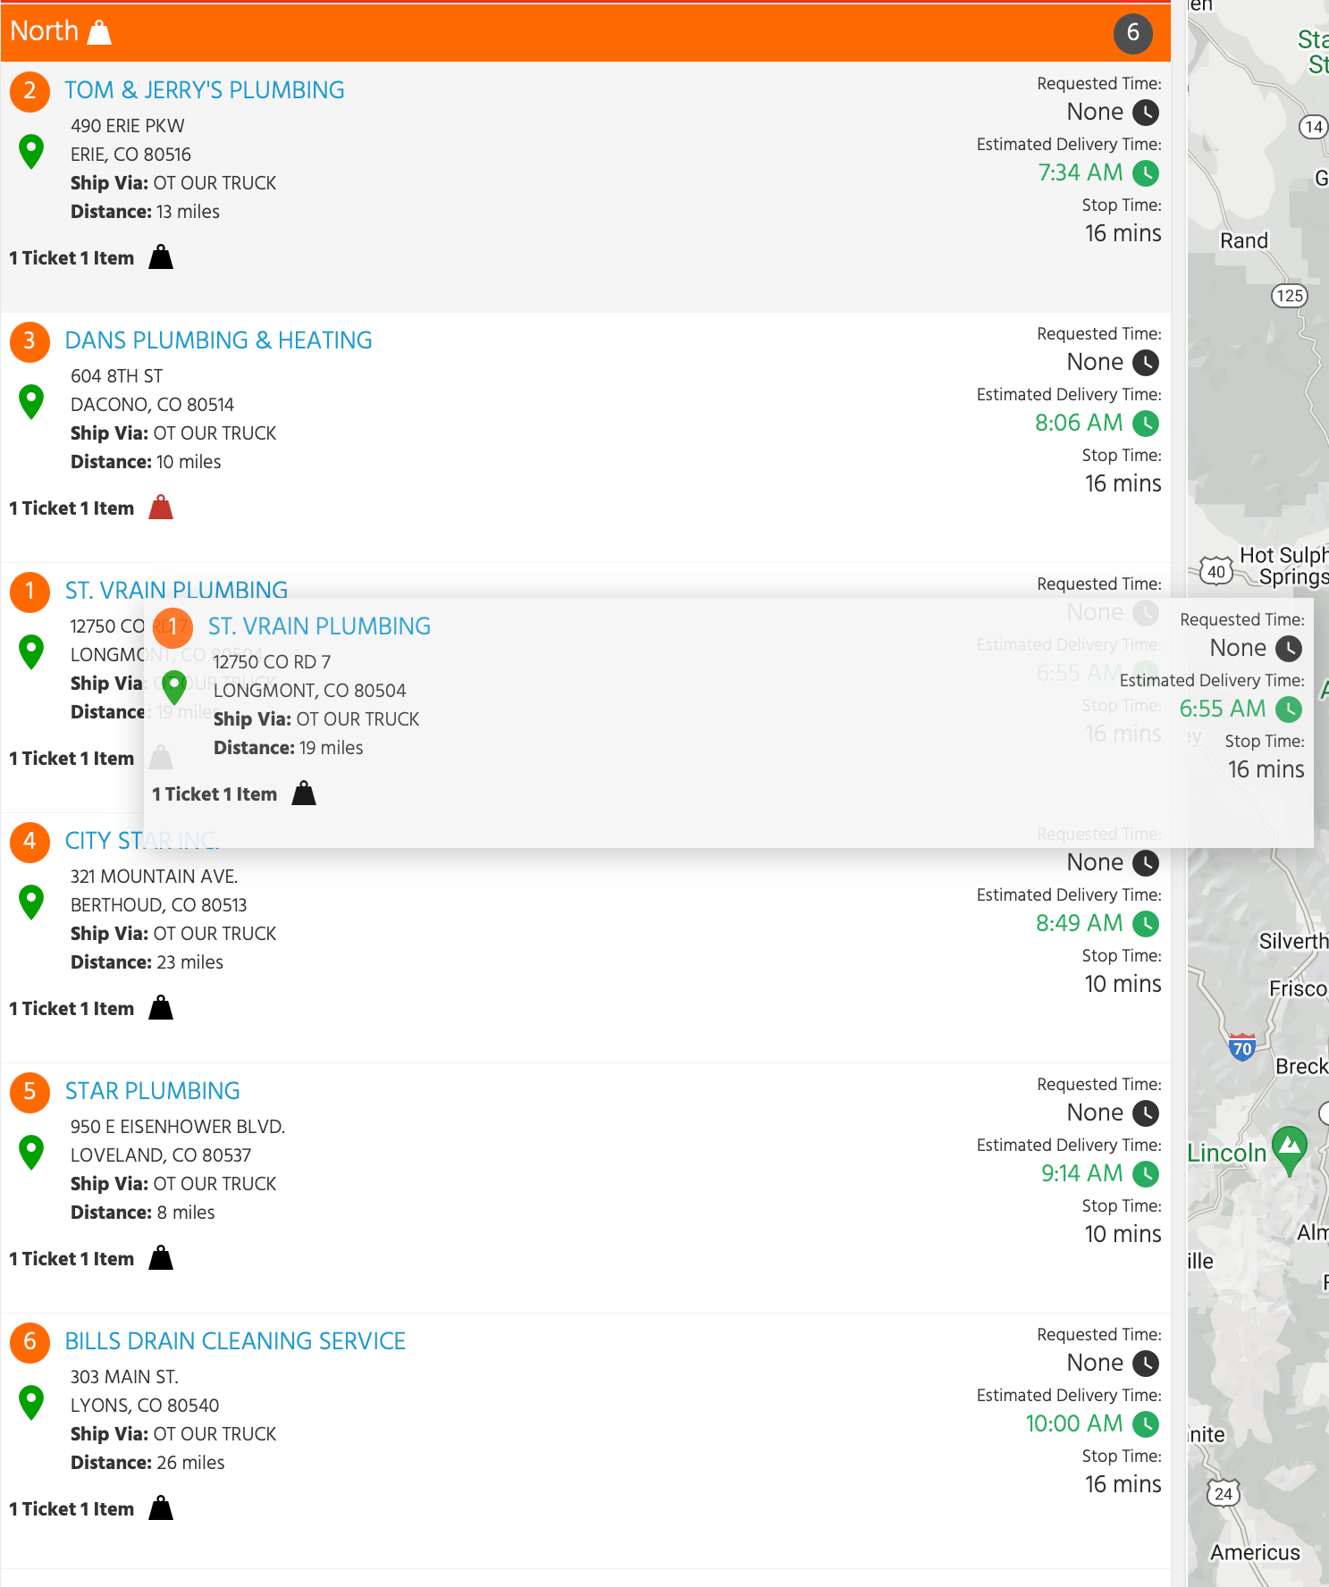
Enhanced Drag and Drop
As you drag-and-drop the stop, you will now see a preview of the route with the stop in the new position

Slide 14
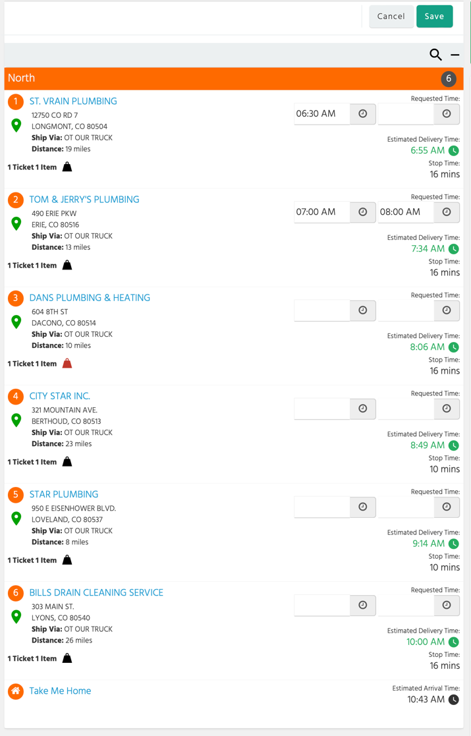
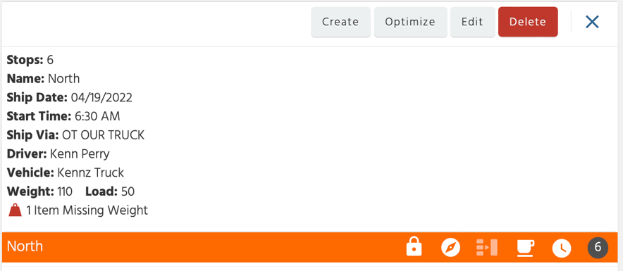
Requested Times
Enter requested times or windows for multiple stops at once on the Route Detail page

Slide 15
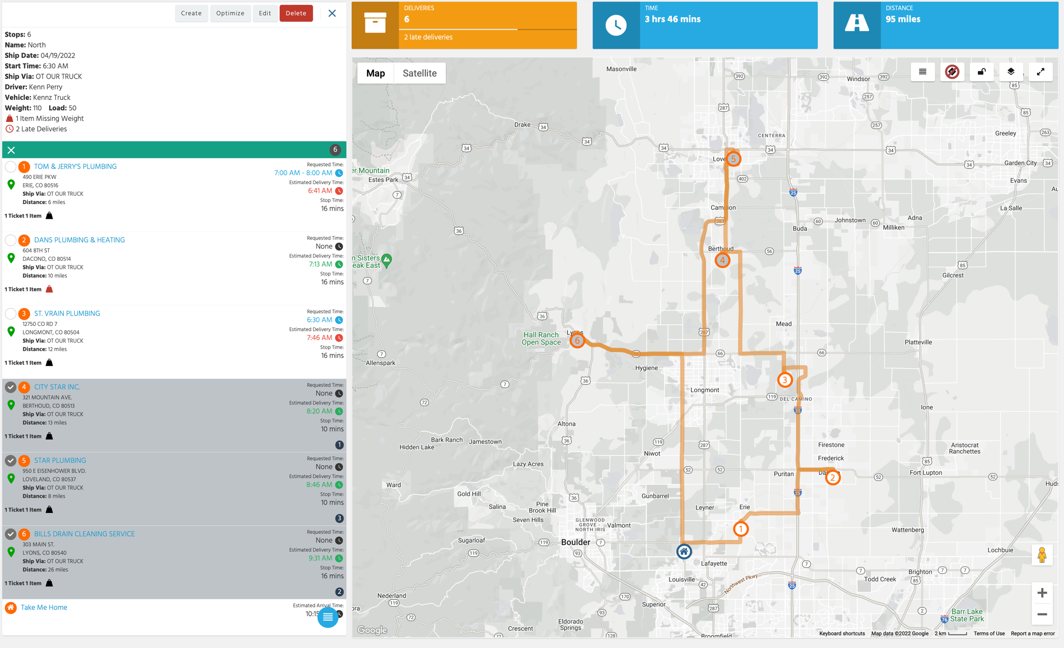
Re-order Stops
3
1
2
Select the stops in the order you want them to be delivered, from the panel or the map, and click the re-order icon

Slide 16
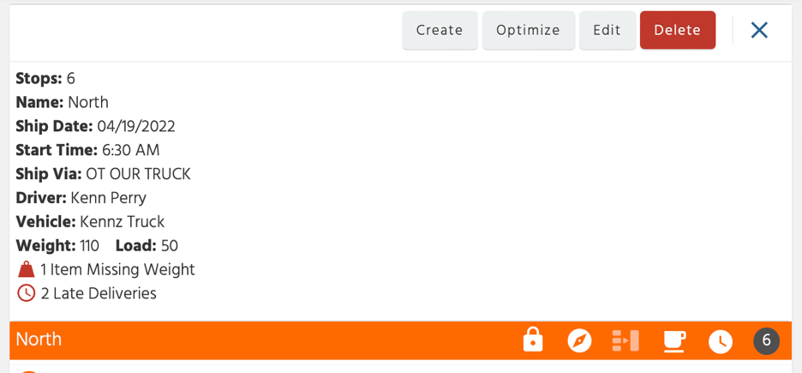
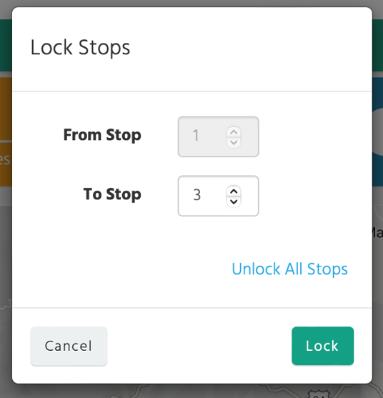
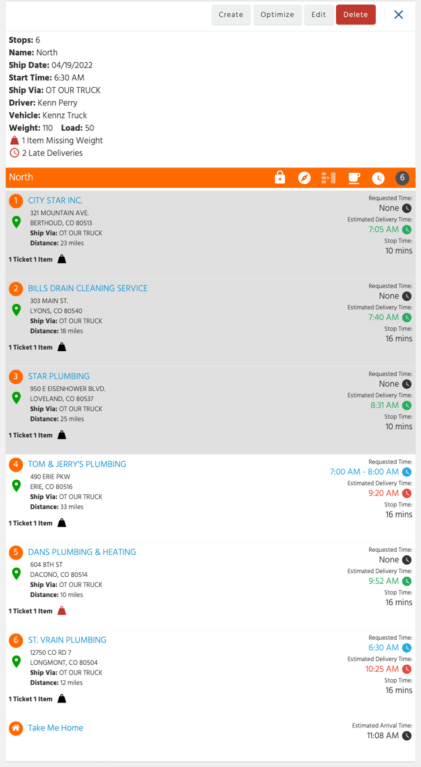
Lock Stops
You can lock stops at the beginning of the route, and they will not be moved or optimized automatically

Slide 17
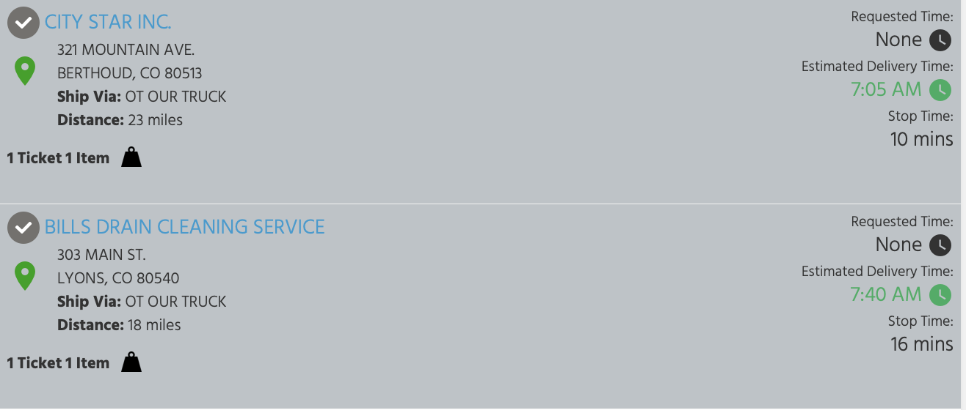
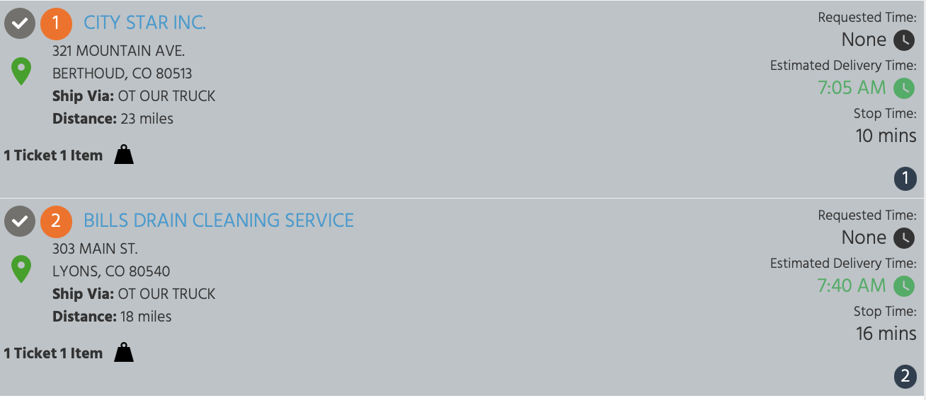
Display Stop Number
Currently when you select a stop, we do not show the stop number.
We will now show the stop number when the stop is selected.

Slide 18
Summary and Overlay
What routes took longer and why?
What drivers are consistently late or on-time?
Why are we driving so many more miles than expected?

Slide 19
Routes Table
Route
Start Time
Manifest
Driver
# Stops
# Late Stops (actual > requested)
Expected Distance / Total Distance / Distance Diff
Expected Time / Total Time / Time Diff
Filter routes by more miles than expected, more time than expected, and late stops

Slide 20
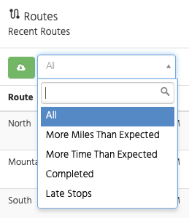
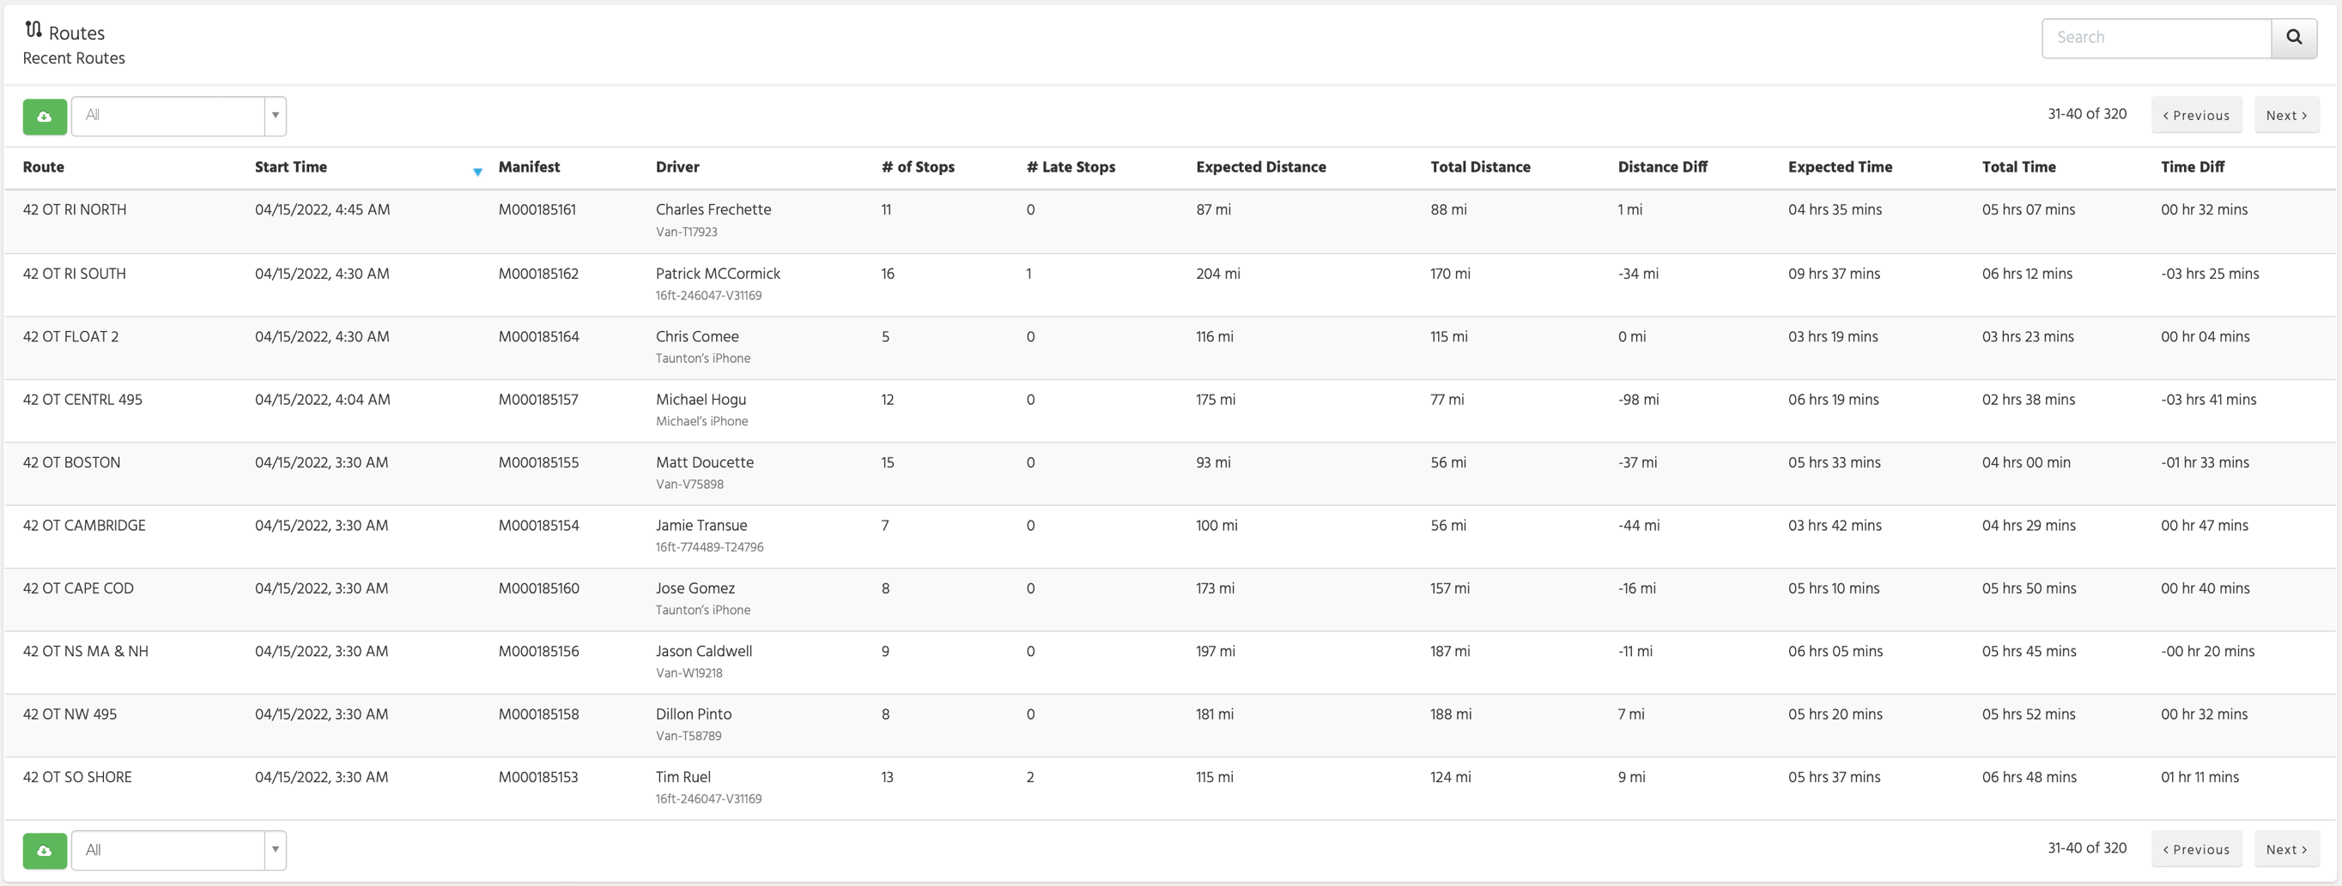
Routes Table

Slide 21
Daily Routes Table
Route Date
# Stops
# Tickets
Time Commitments (requested time set)
# Late Stops
Bad Addresses (red and yellow markers)
Pickups (vendor PO’s)

Slide 22
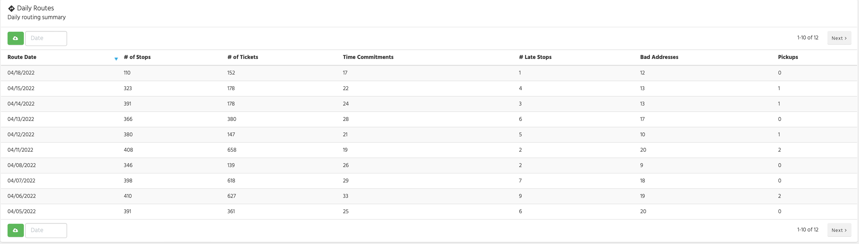
Daily Routes Table

Slide 23
Overlay Feature
Route suggested vs. route taken
Estimated time vs. Actual time
Estimated mileage vs. Actual mileage
Actual stop time taken (+/-) compared to padding
Order of stops delivered
The Overlay will display in both the Route Detail and Manifest Detail screens once the manifest and take-me-home has been completed on the device

Slide 24
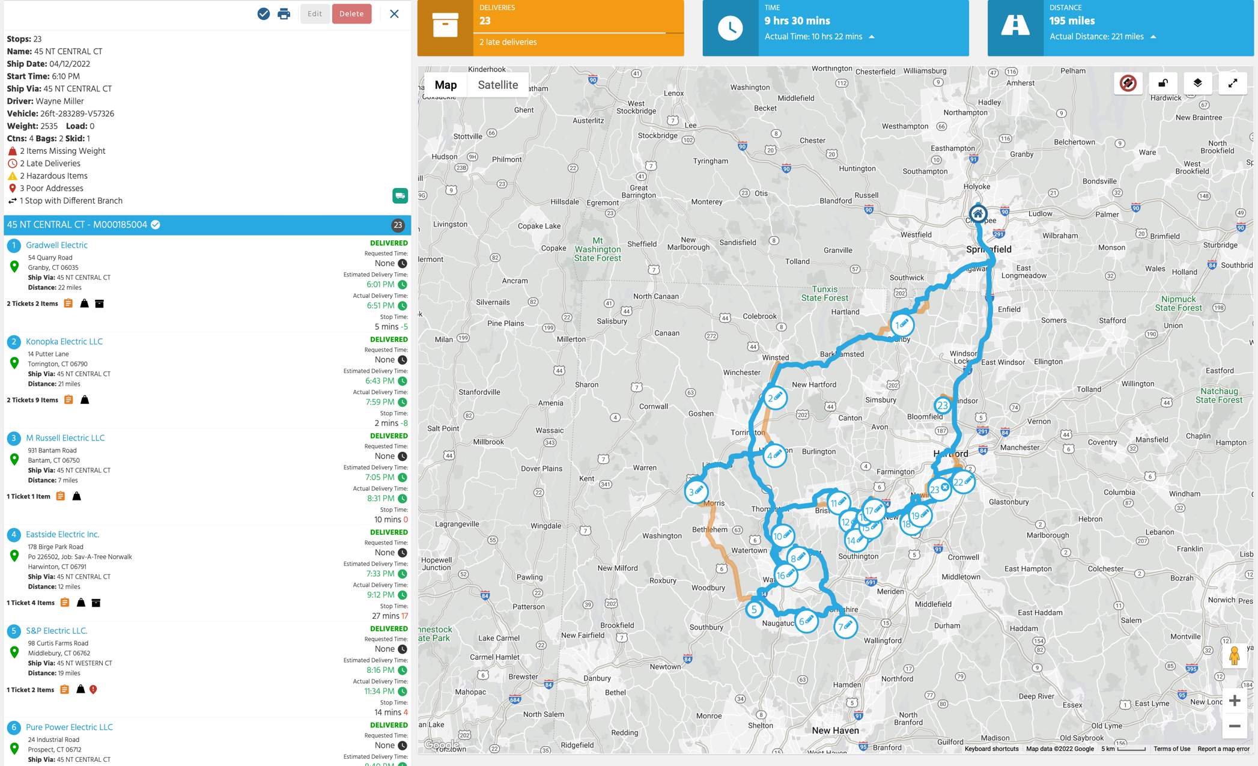
Overlay Feature
View route suggested vs. route driven

Slide 25
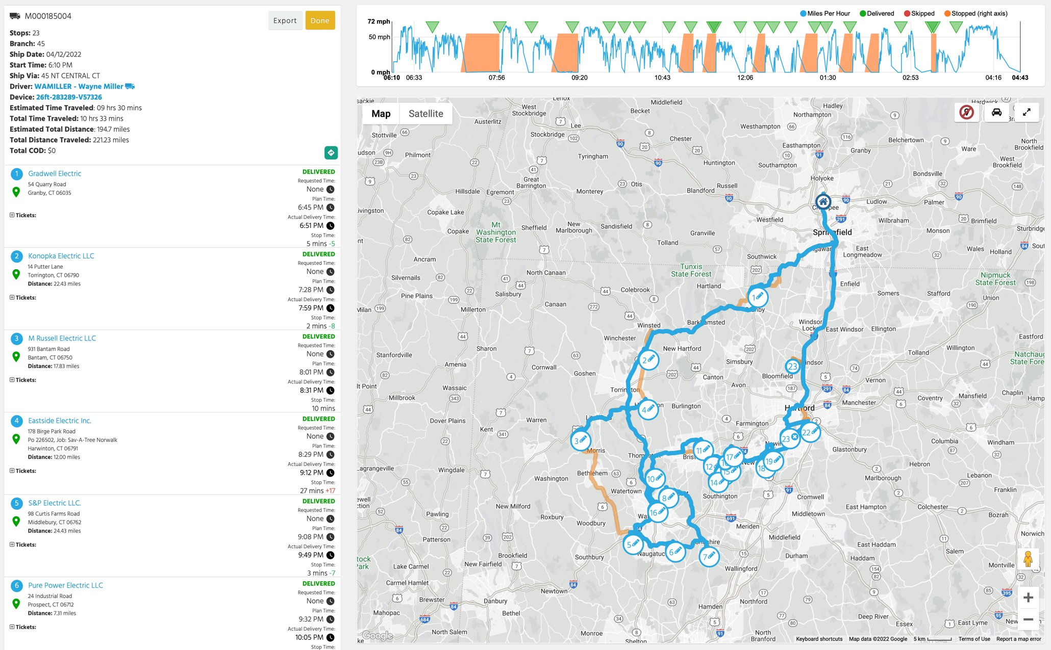
Overlay Feature
View Overlay direction from Deliver Web

Slide 26
Additional Features
Ability to edit two previous Route Dates
Display info when hovering over Shipping Instructions, Weight, and Branch icons eliminating the need to click
Ability to click on URLs in Shipping Instructions
Clicking outside Stop Detail window will now close, eliminating the need to click the Done button
Removed decimals on mileage

Slide 27
Full List of Features
Filter routes based on ship-via templates
Added Focus Mode to filter specific routes
Added optimize feature to the More dropdown
Added lock/un-lock route optimization to the More dropdown
Added right-click feature (to move stops, create a new route, etc.) to the Compare screen
Added right-click feature and stop detail view to full-screen map mode
Added ability to drag-and-drop multiple stops at once
Enhanced drag-and-drop to preview new position

Slide 28
Full List of Features
Ability to enter requested times for multiple stops at once
Ability to quickly re-order stops by the order in which they are selected
Ability to lock stops in place while optimizing remaining stops
Stop number is now displayed even when the stop is selected
Added right-click feature (to move stops, create a new route, etc.) to Route Detail page

Slide 29
Live Demo

Slide 30
Deliver Web

Slide 31
Deliver Web
Route customers will have access to the Overlay feature from the Manifest Detail page
Ability to open delivery photos in a new tab with a single click
Employee users will no longer be able to view the Reports tab on the Summary page
Added Customer ID# when searching for customers on the Notifications tab (as well as the Route Customers tab)

Slide 32
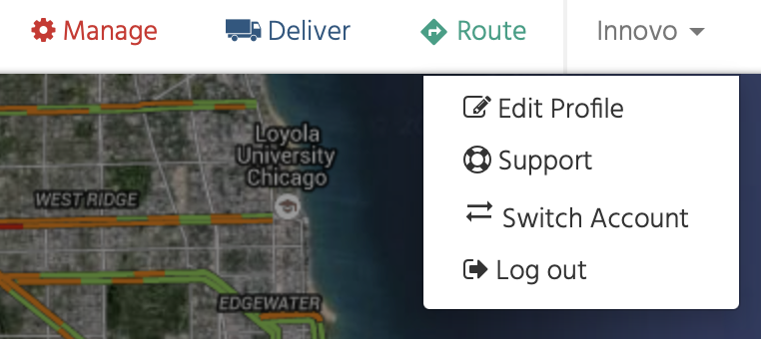
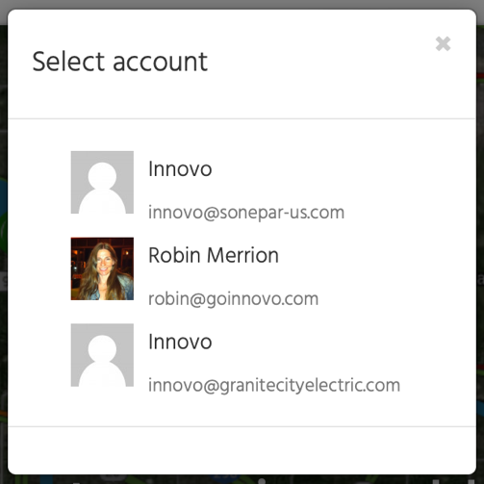
Innovo Portal
If you are managing multiple portals, you will now be able to easily switch accounts without having to log out
After 60 days of active sign-in, you will need to re-log (same as Google)

Slide 33
Future

Slide 34
Industrial Mapping
We are going into a customer beta with HERE
Routes based on
  Vehicle dimensions (height, length, width, weight)
  Hazardous type
  Speed profile
Smart Routing based on requested times built into the route
HERE can optimize larger routes (20+ stops)
No timeframe for GA / controlled rollout
Route & Deliver

Slide 35
Deliver
Ability to scan orders off the truck
Default to Internal Notes instead of Order Comment
Leave camera open to quickly take multiple photos
HERE in-app navigation
Idle truck alerts
Add support for Eclipse 9.2.0 geocode enhancements

Slide 36
Next Steps
Great news! No server updates needed!
All new features will be live on Monday, May 9
Please contact drew@goinnovo.com for more information on Route

Slide 37

Upcoming Events
Epicor Insights 2022
May 23-26
Nashville, TN
UFO Encounter 2022
Sept 11-13
Louisville, KY

Slide 38

Thank you!
This recorded webinar and power point will be posted on our support site later today

