Slide 1
Signature Touch 2.6.0
Innovate 2017

Slide 2
What’s New in 2.6.0
New User Interface (UI) Design
Larger signature box in all modes
Display your Terms & Conditions
Display the staging location in will-call mode
Ability to select printer when signing in will-call
Ability to consolidate stops in truck mode
Ability to add a lunch break
Ability to send a text message and/or email when delivery is complete

Slide 3
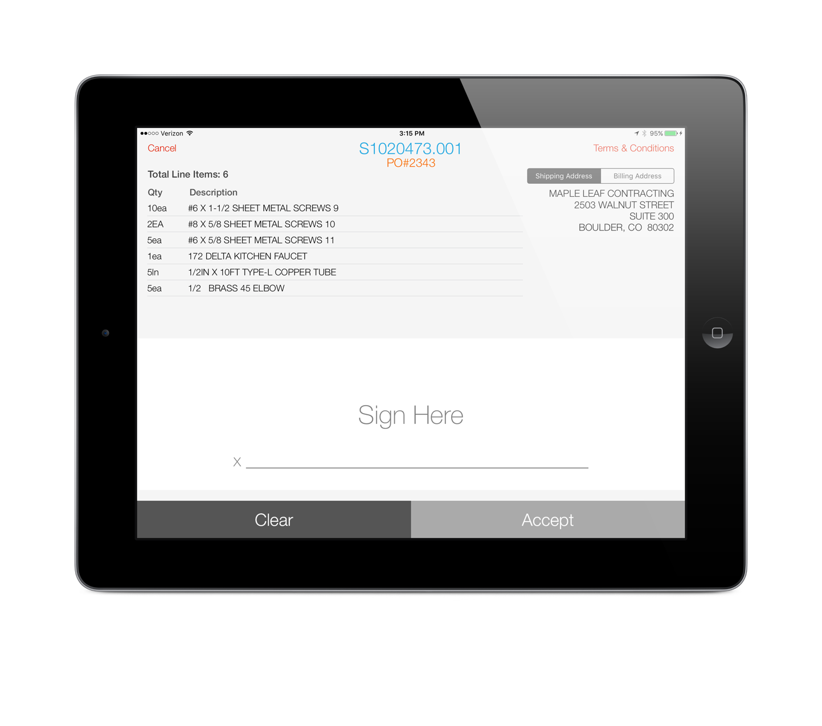
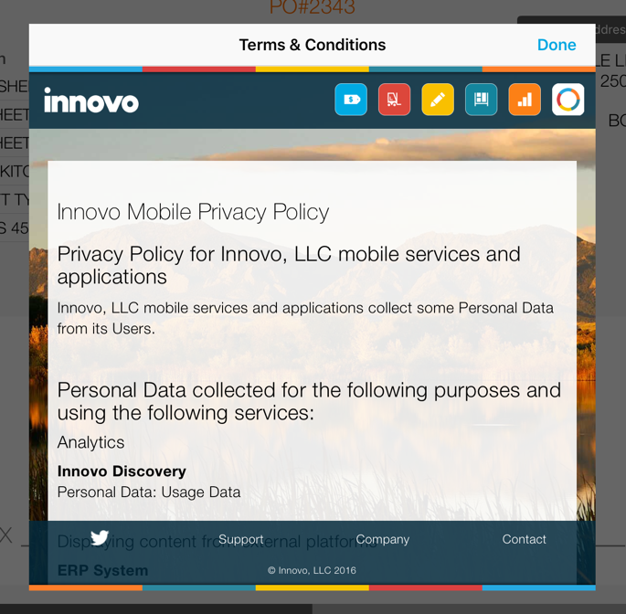
Counter Mode

Slide 4
Terms & Conditions URL
New branch specific control file, “Innovo SigTouch Terms & Conditions URL”
In Counter and Will-call modes we use the price branch of the order when checking the control file
In Truck mode we use the manifest branch

Slide 5
Banner Color Theme
New setting under Banner section
Applies to both Counter and Will-Call (if the Enable Banner setting is enabled for Will-Call)
If Banner Type is set to Text, the new banner color theme will apply to the background, the sign order button, and the settings button
If Banner Type is not set to Text, the new banner color theme will apply just to the sign order button and settings button

Slide 6
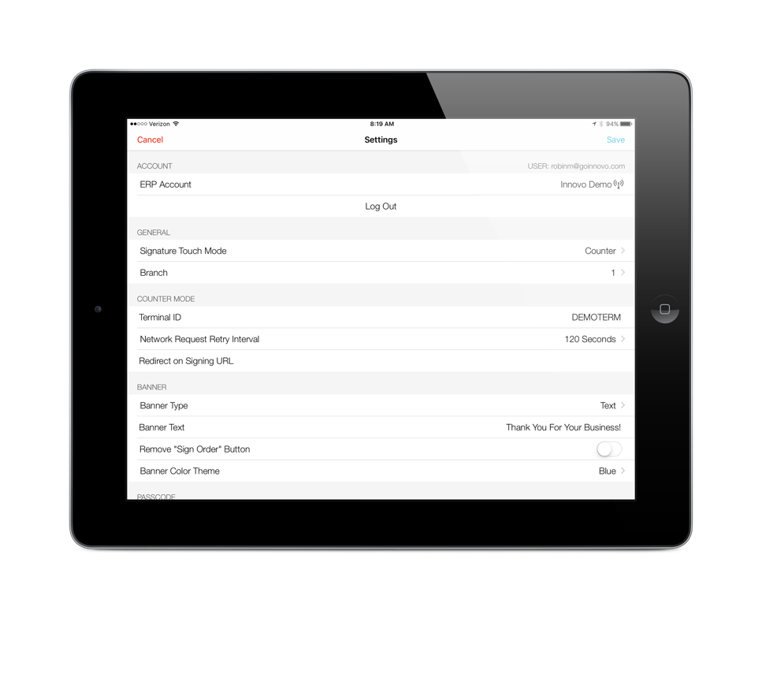
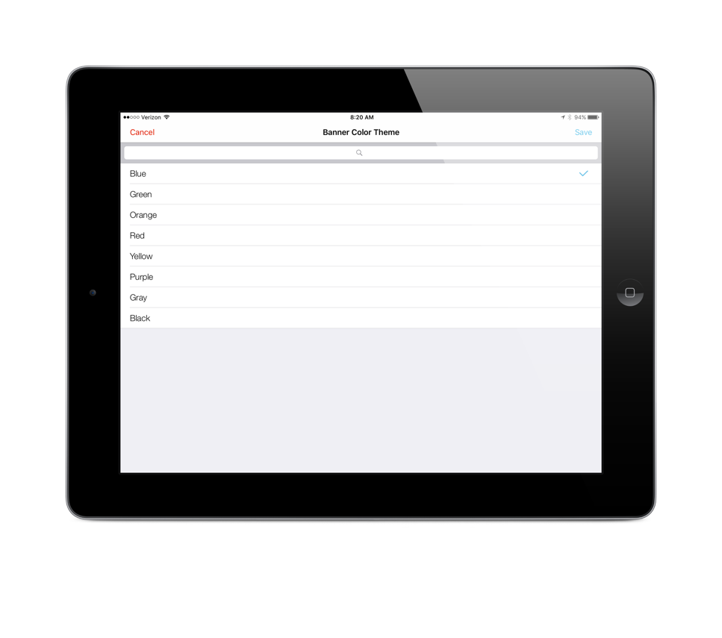
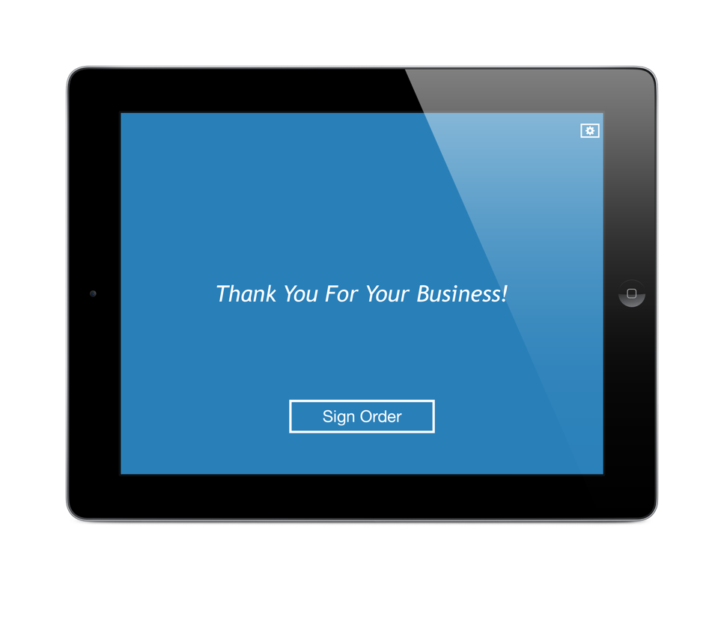
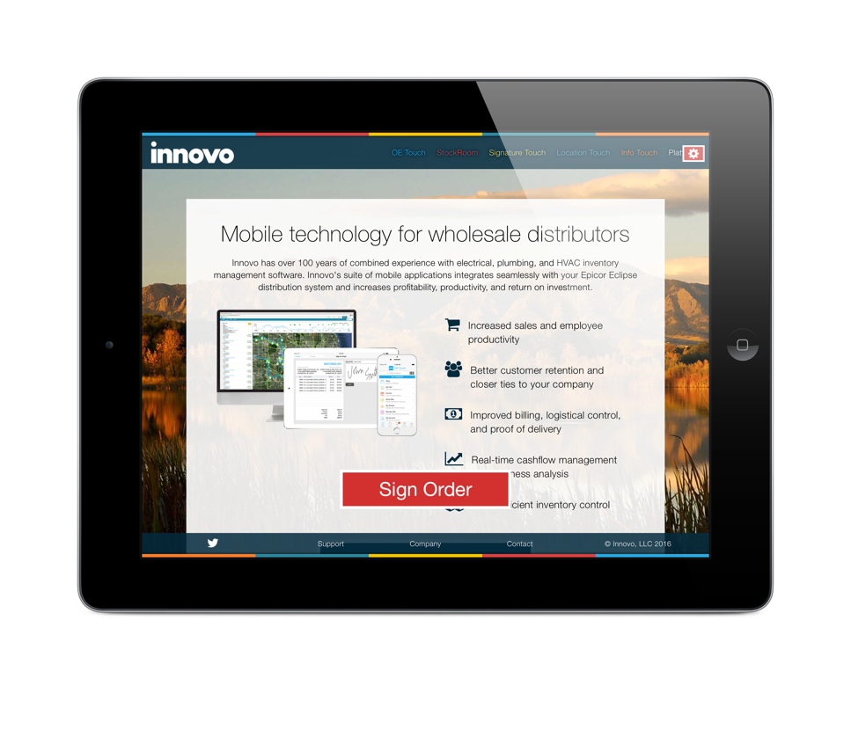
Banner Color Theme
Banner Type is URL and Color Theme is Red

Slide 7
Will-Call Mode
Ability to display staging location and package quantities for each order
New control file, “Innovo SigTouch Display Staging Location in Will-Call Mode”
Ability to select printer after customer signs
New setting, Enable Printer Select at Signing

Slide 8
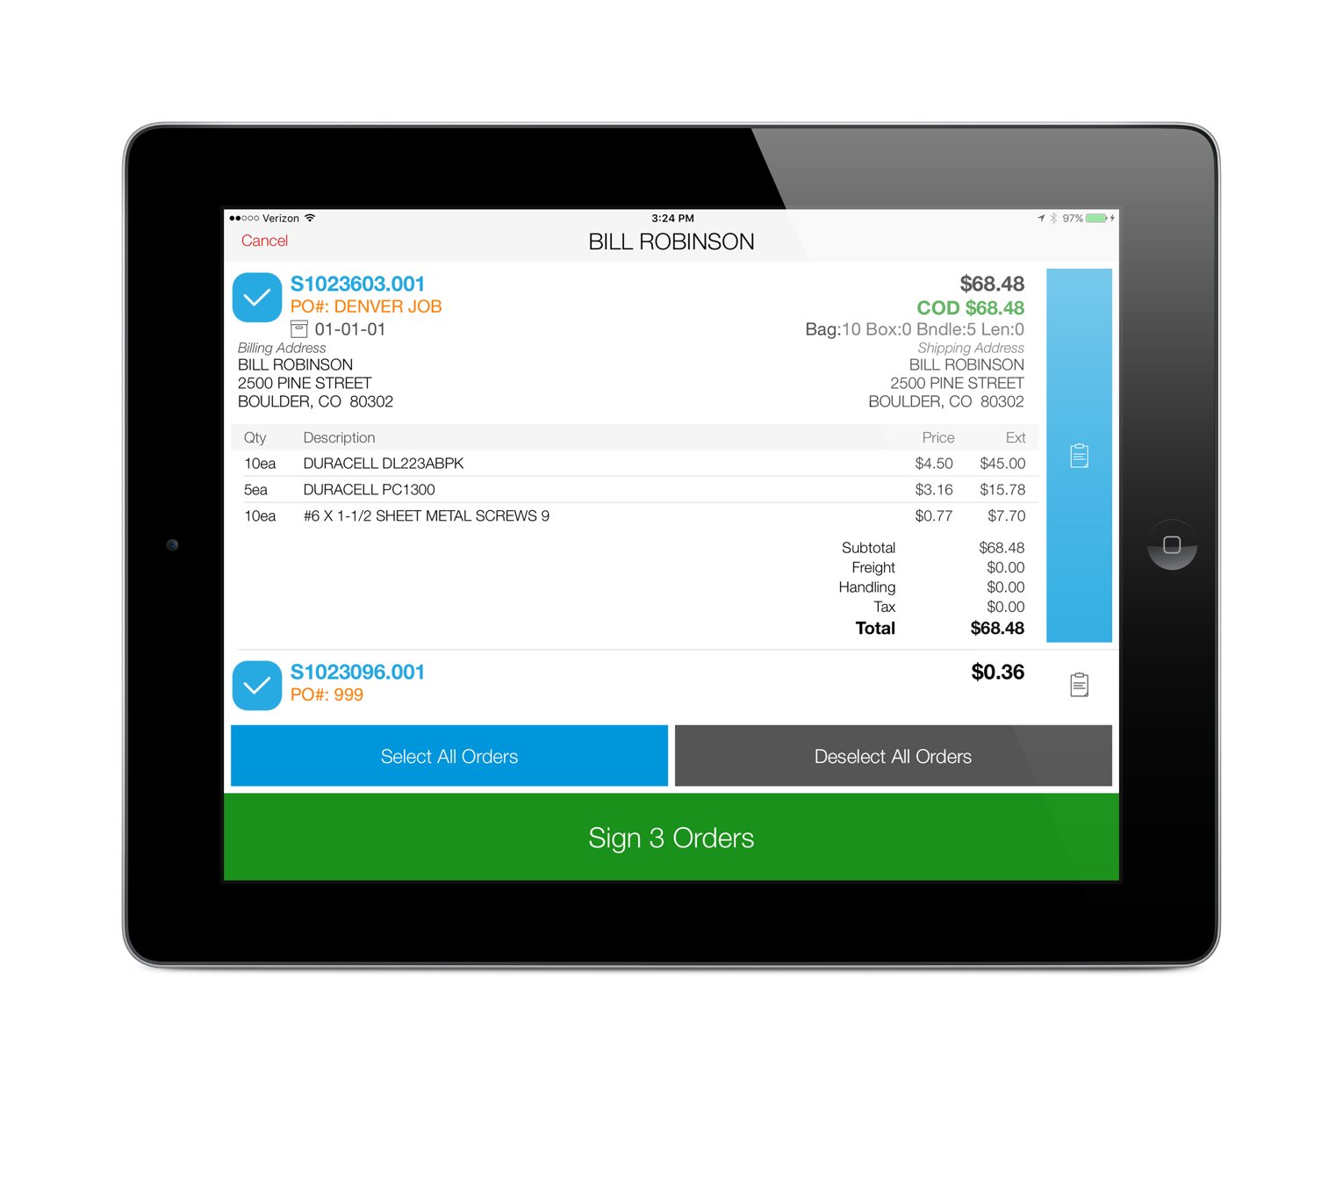
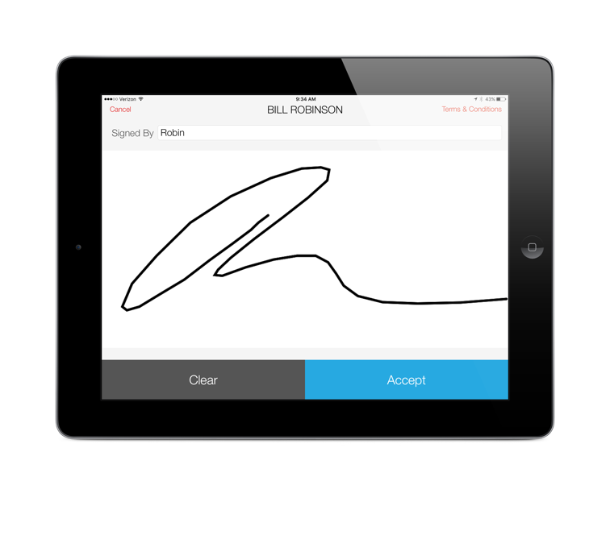
Staging Location
Here is an example of the large signing screen in will-call mode.
One change to note here, if you require a signed-by, the Accept button will not highlight from gray to blue until you enter in the signed-by

Slide 9
Enable Printer Select at Signing
The new setting is only available if current setting Enable Printing is set to either “Printing Enabled – Default Yes” or “Printing Enabled – Default No”
If you want users to have access to multiple printers within a single printer location, set the Printer Locations setting to that single printer location and set the Printer setting to the printer in that location used more often

Slide 10
Enable Printer Select at Signing
If you want users to have access to multiple printer locations, the Printer Locations setting now allows you to select multiple locations that the user will select from after the customer signs
You will still need to set a default printer in the Printer setting and printers across all of the printer locations selected will be available

Slide 11
Enable Printer Select at Signing

Slide 12
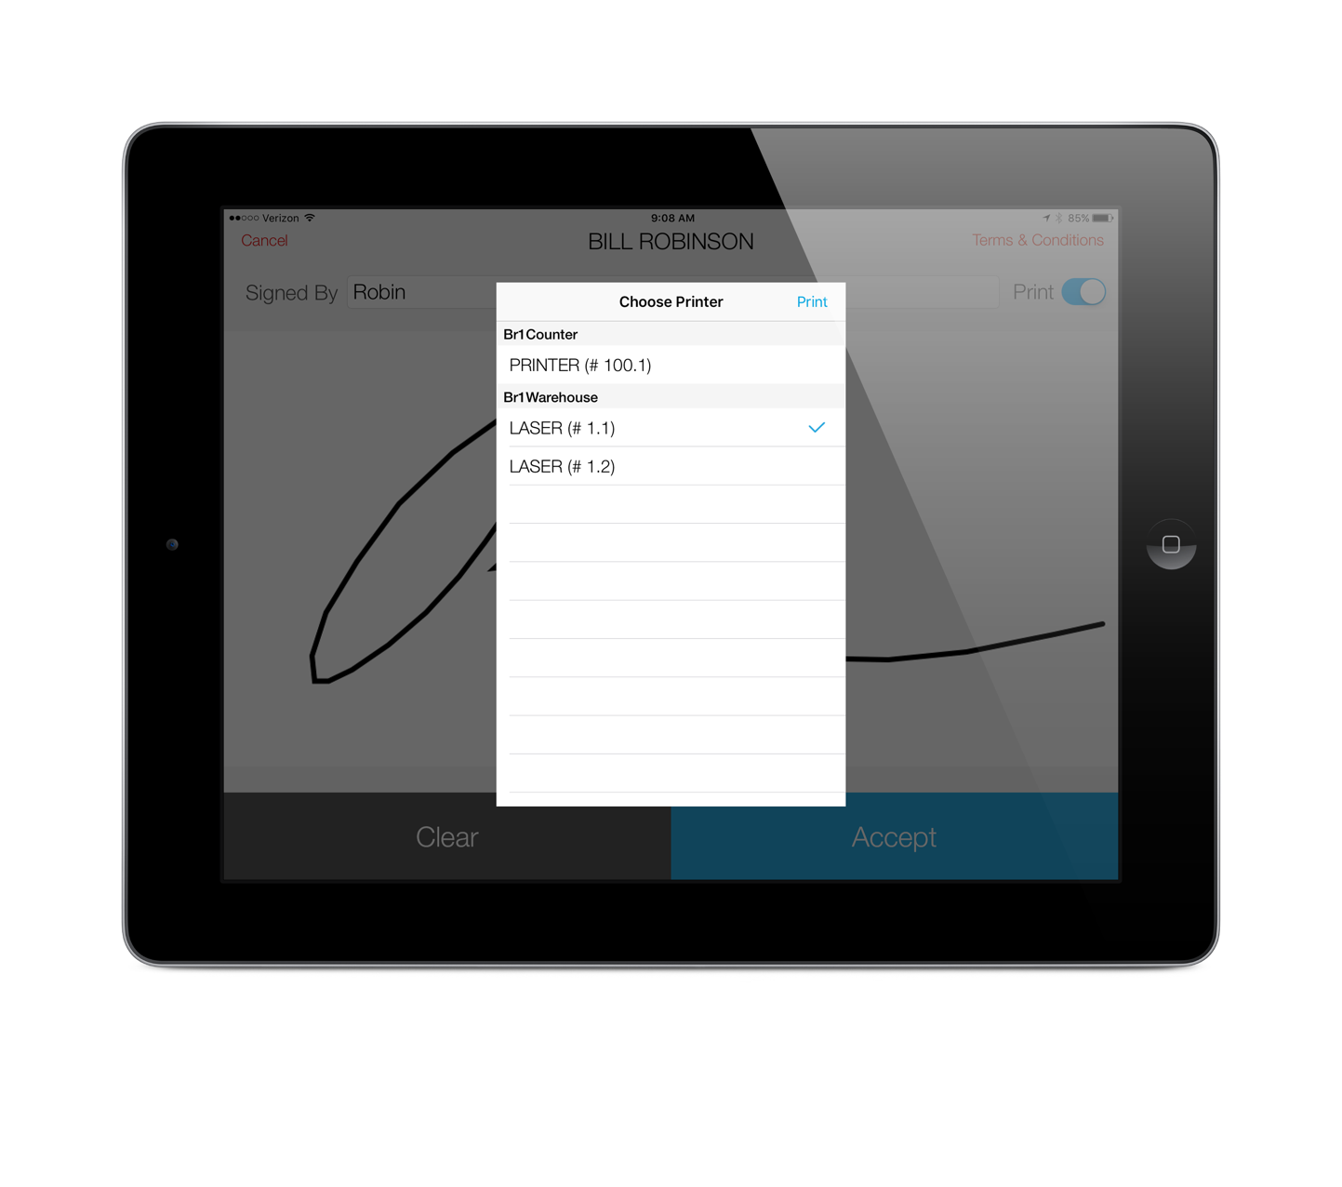
Enable Printer Select at Signing
The default printer will be selected – to use that printer, just press the Print button. To use a different printer, select that printer from the list and then press the Print button.
If the user does not press the Print button, the ship ticket will automatically print in 15 seconds and the next customer’s orders will be available for selection

Slide 13
Note on Settings
Some settings will not display by default. For example, if you do not enable printing in will-call mode, you will not see the settings to select a printer or printer location.

Slide 14
Truck Mode
New Settings
Use Login Account as Default Driver
Enable Log Out from Select Menu
Enable Stop Consolidation/Grouping
Enable Address Matching
Enable Break Times
Enable Take Me Home

Slide 15
Truck Mode
Use Login Account as Default Driver
If you have drivers share iPad’s
If each driver logs in with their own login
If the driver login is assigned to the driver’s eclipse user ID that is used on the manifest
If all of the above is true, enable this setting so when a driver logs in, only their manifests will display in the select manifest screen

Slide 16
Truck Mode
Enable Log Out from Select Menu
If the previous setting applies to you, also enable this setting so you don’t have to give the user access to settings to log out

Slide 17
Enable Stop Consolidation/Grouping
The Eclipse manifest will only place orders for the same ship-to customer with the same address on a single stop. This could result in your customer signing multiple times for their delivery.
This setting allows you to consolidate all stops across the manifest for those ship-to’s rolling up to the same bill-to

Slide 18
Enable Stop Consolidation/Grouping
Enable Address Matching
If you only want to consolidate stops for ship-to’s rolling up to the same bill-to that have the same shipping address
By same shipping address, we literally mean the address must match exactly.
Example: ST does not equate to STREET
The next version of Sig Touch will allow the driver to manually group stops

Slide 19
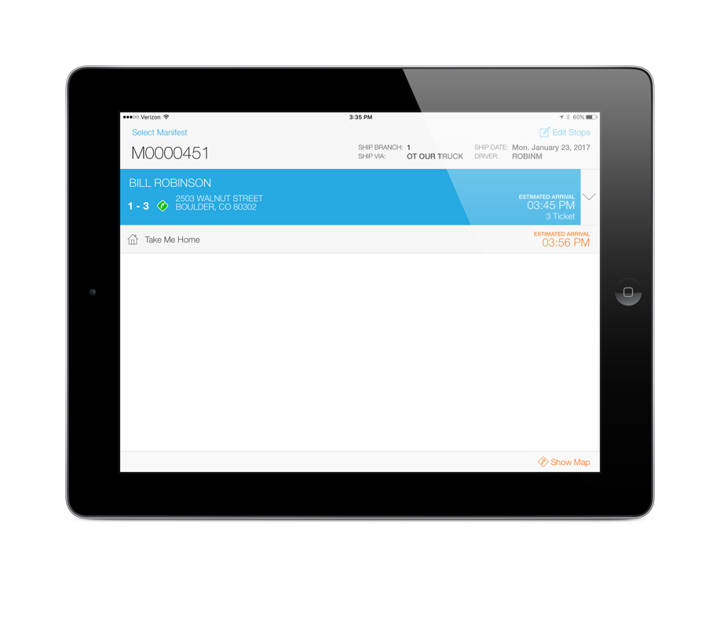
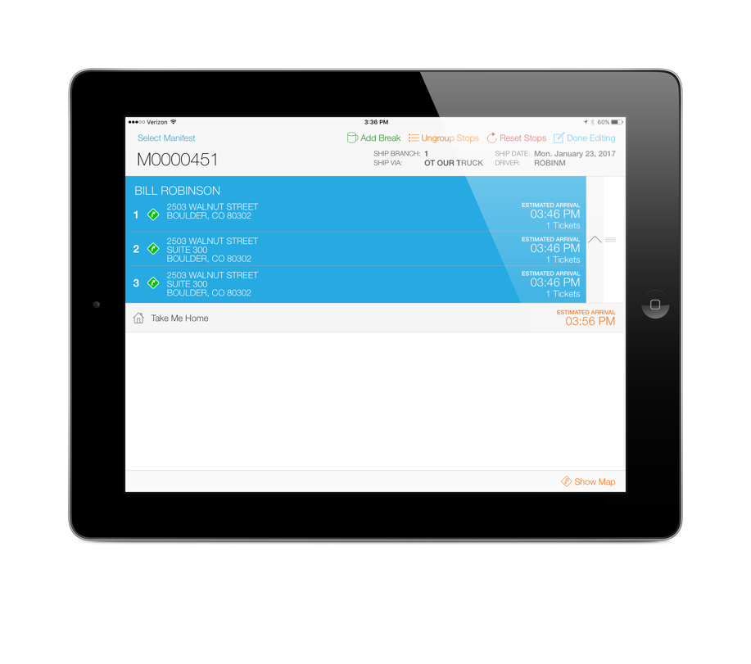
Enable Stop Consolidation/Grouping
In this example, all three stops roll up to the same bill-to and have similar but not exact addresses.
The Eclipse manifest shows these as three separate stops.
Enable Address Matching is not currently set so all three stops will be consolidated, by default.
If Enable Address Matching was set, only stops 2 and 3 would be grouped.
Also note when stops are grouped, the estimated delivery times do not include stop time padding.

Slide 20
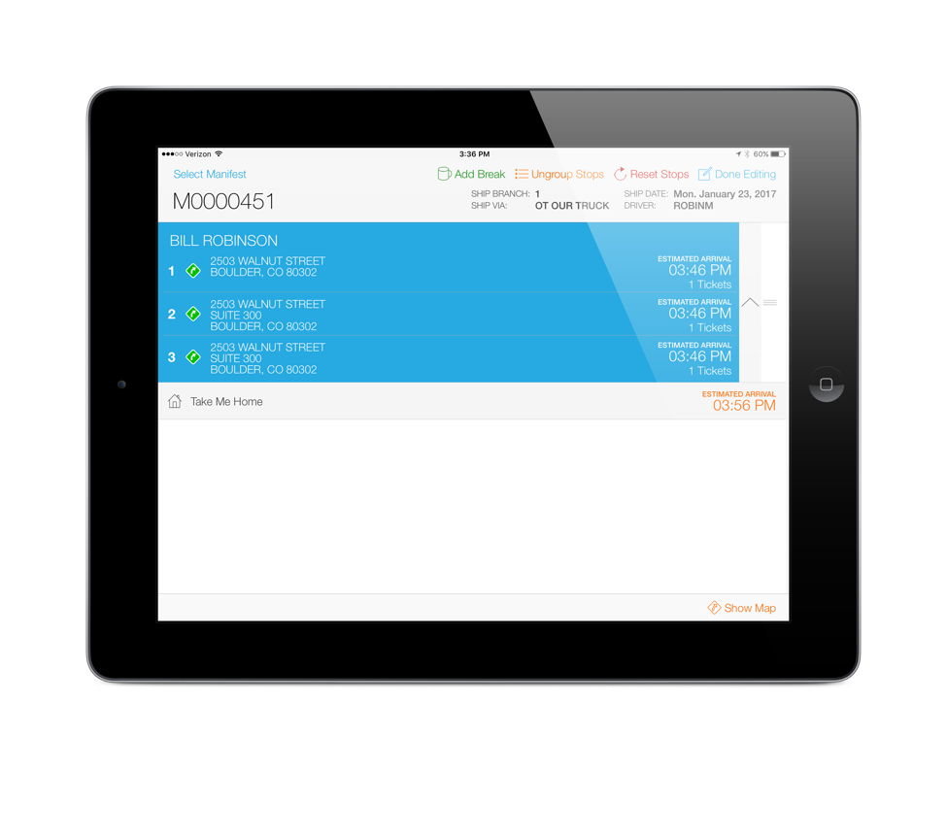
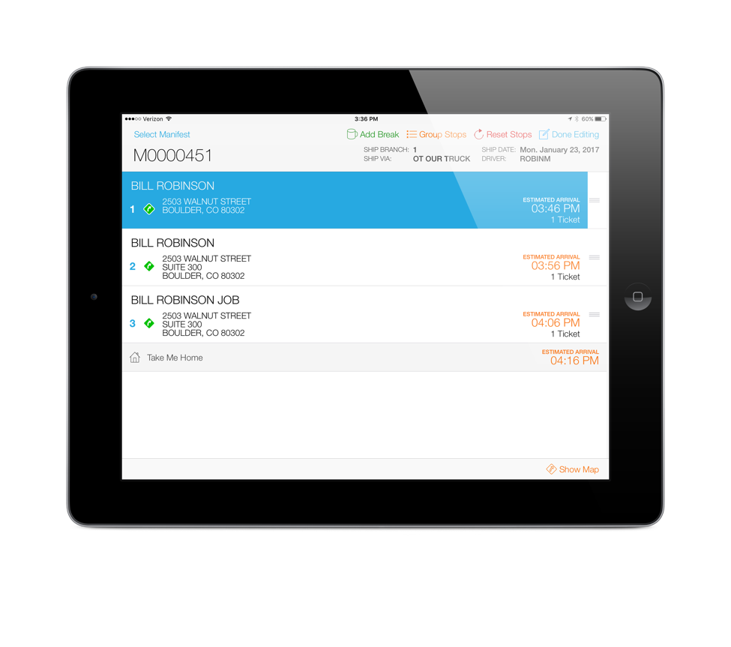
Enable Stop Consolidation/Grouping
The Edit Stops button has a new option, Ungroup Stops.
If the driver chooses to ungroup the stops, the stops will be ungrouped and the padding times will be added back to each stop.
Note, to ensure the stops match the Eclipse manifest exactly, have the driver press the “Reset Stops” button after ungrouping.

Slide 21
New Mapping Features
In order to provide better estimated delivery times per stop and on the entire route, we’ve added two new settings:
Enable Break Times
Enable “Take Me Home”
In order to take advantage of all the mapping features, including the calculation of estimated delivery times, you must be subscribing to our Google API service

Slide 22
Enable Break Times
Setting Enable Stop Editing must be enabled
Pressing the Edit Stops button will display a new button called Add Break
You can add multiple break times during the route or a break before returning back to the branch
Break times default to 30 minutes but can be adjusted and will be calculated into the estimated delivery times

Slide 23
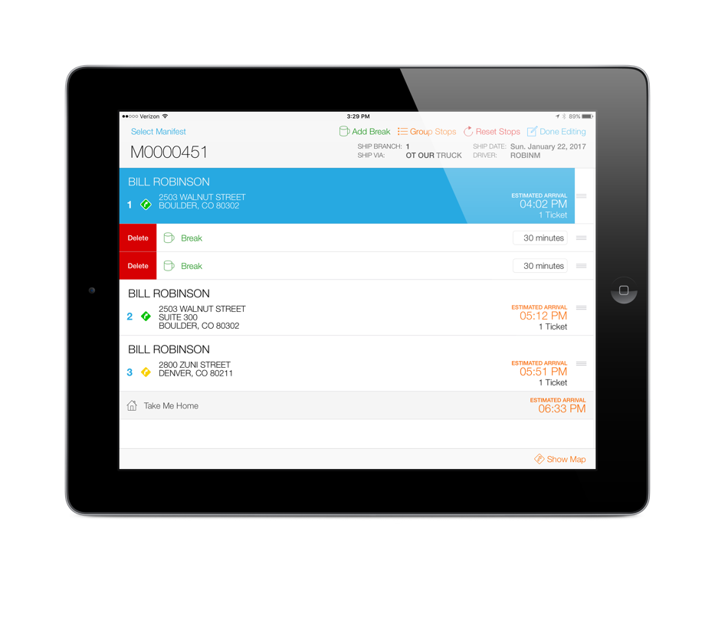
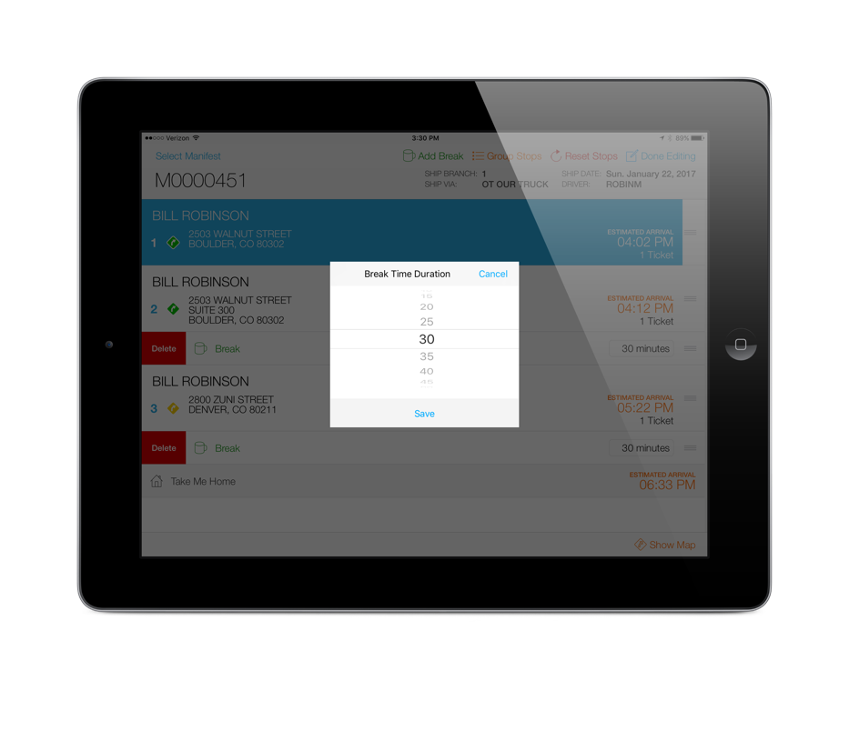
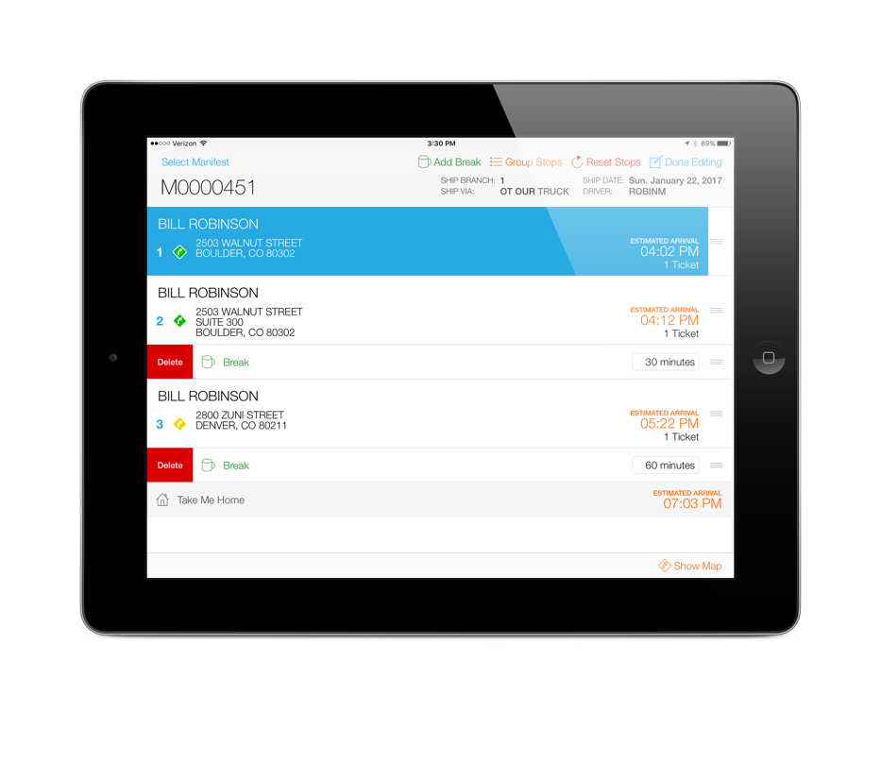
Enable Break Times
When a break is added, it will be inserted below the current stop but can be moved to the appropriate stop position
To change the duration of a break time, tap on the break time label in Edit mode

Slide 24
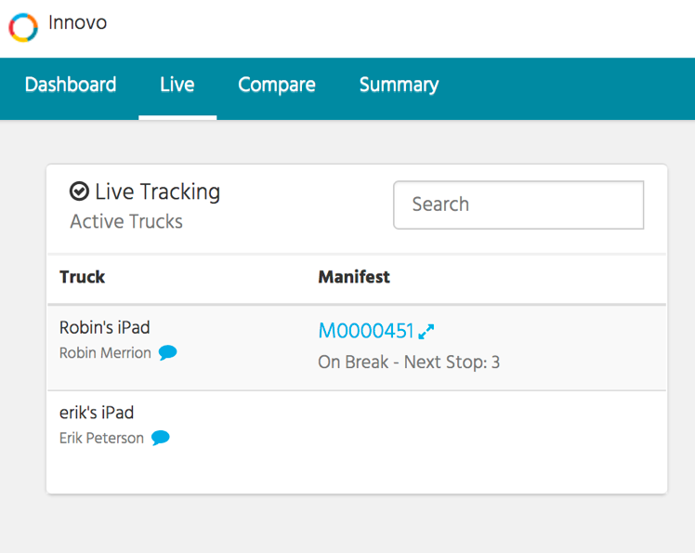
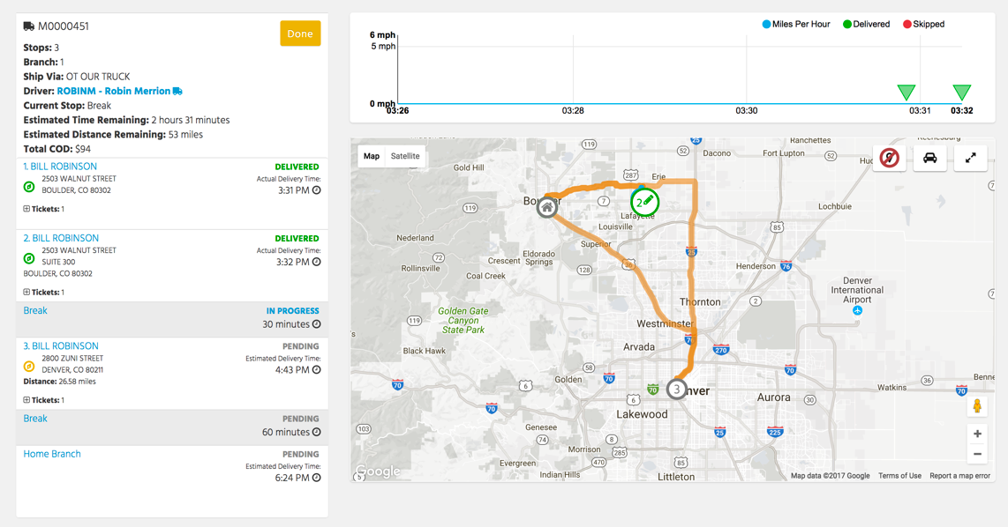
Enable Break Times
During the break, Deliver will display the break in progress

Slide 25
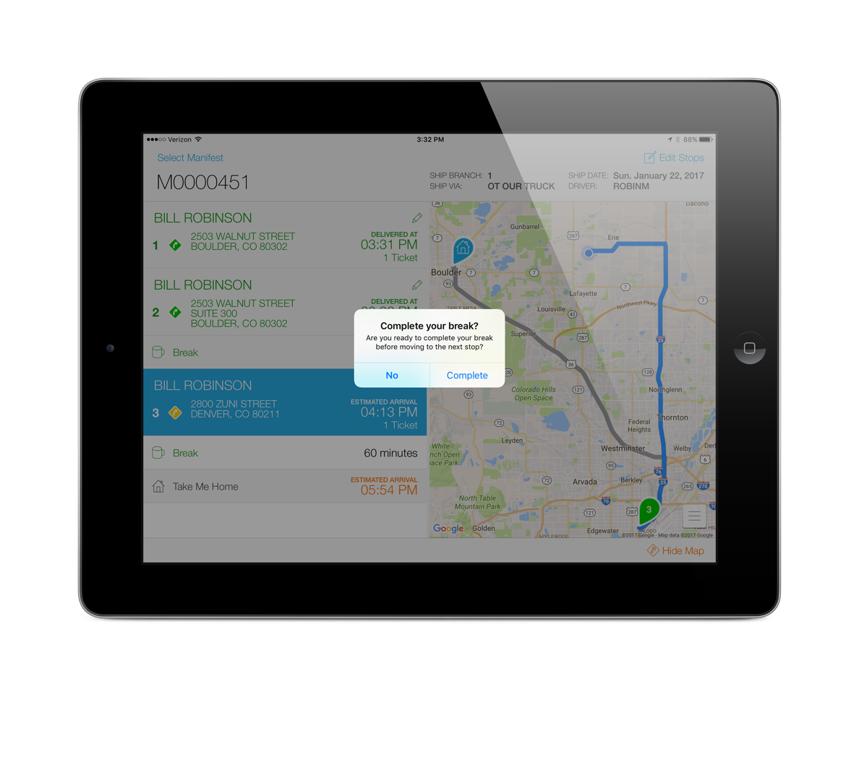
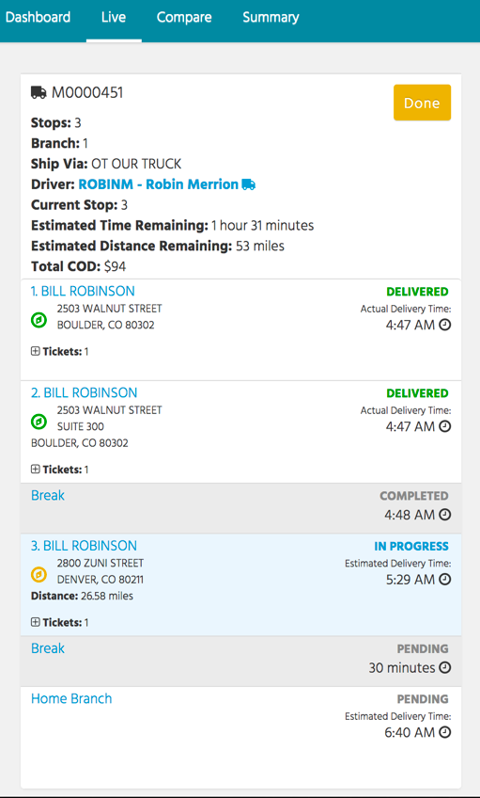
Enable Break Times
To complete the break, tap on the next delivery and you will be prompted to complete. If you answer No, the break will auto-complete once the next stop is completed.
The completed delivery time will display in Deliver

Slide 26
Enable “Take Me Home”
The current app store version does not automatically track the truck on it’s way home unless the driver waits to complete the manifest when he returns home
And, Deliver does not currently include the estimated miles and time remaining for the trip back to the branch
This setting attempts to address those issues

Slide 27
Enable “Take Me Home”
When this setting is enabled, a new stop will be added to the end of each route and just like a regular stop, will provide the driver turn-by-turn directions back to the originating branch
Some drivers may want to even add a break before returning back to the branch
Note, the driver will be prompted to complete and close the manifest after the last actual delivery

Slide 28
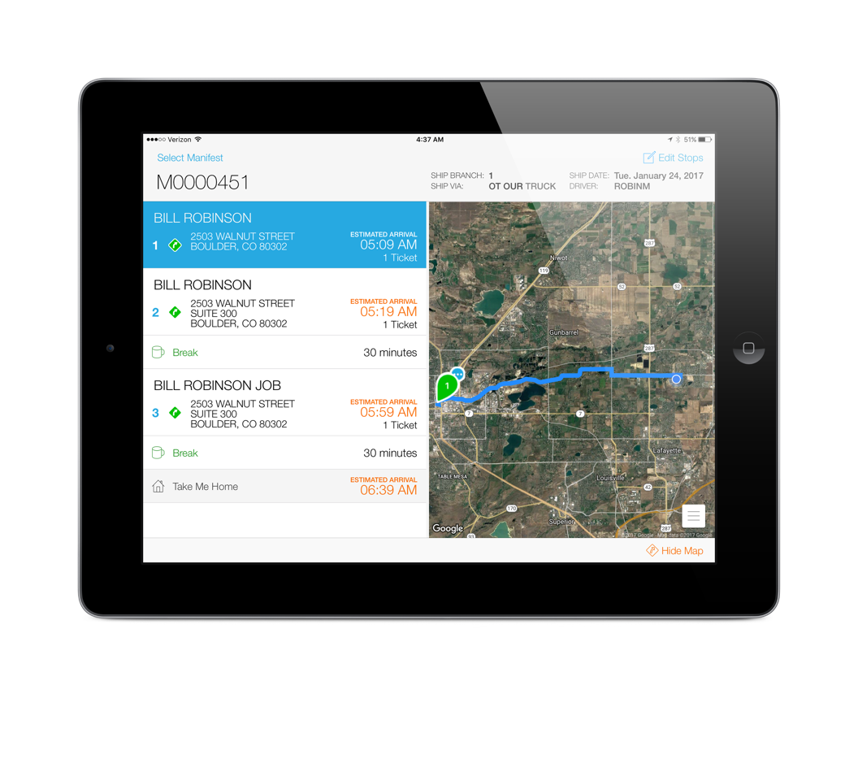
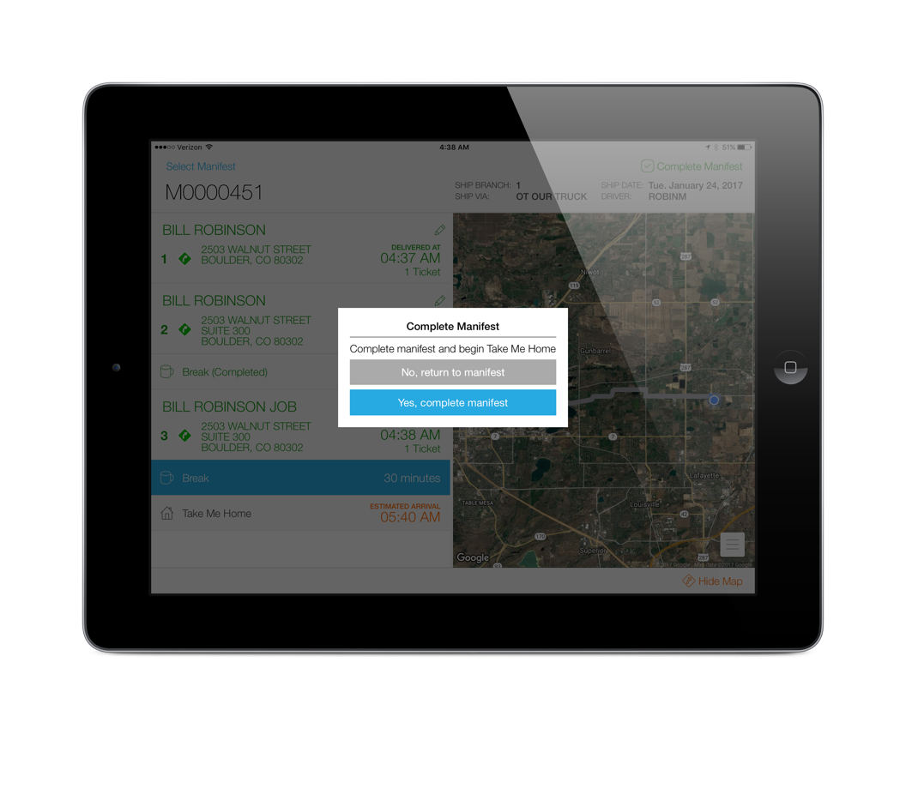
Enable “Take Me Home”
A new stop will be added to each manifest
The last delivery is stop 3 so when that is completed, the driver will be prompted to complete the manifest

Slide 29
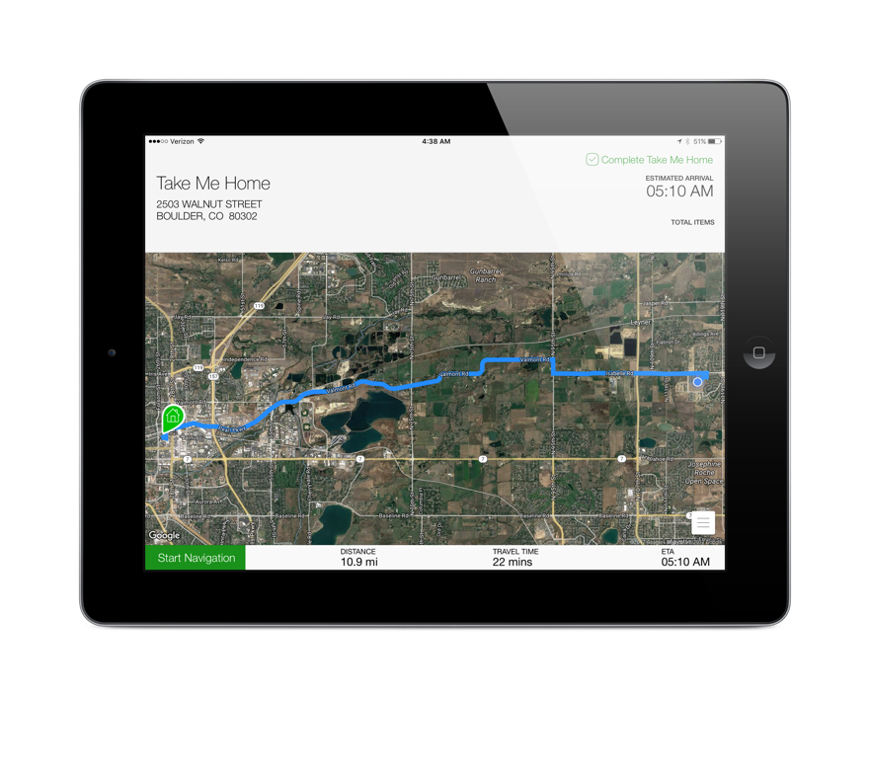
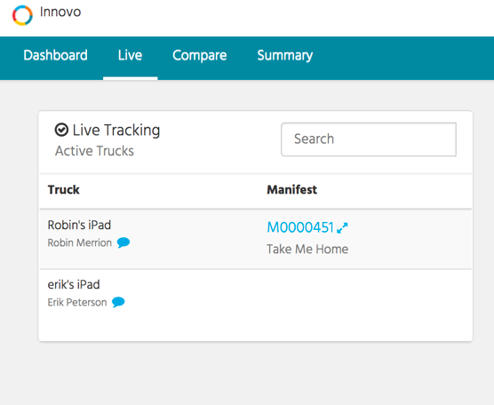
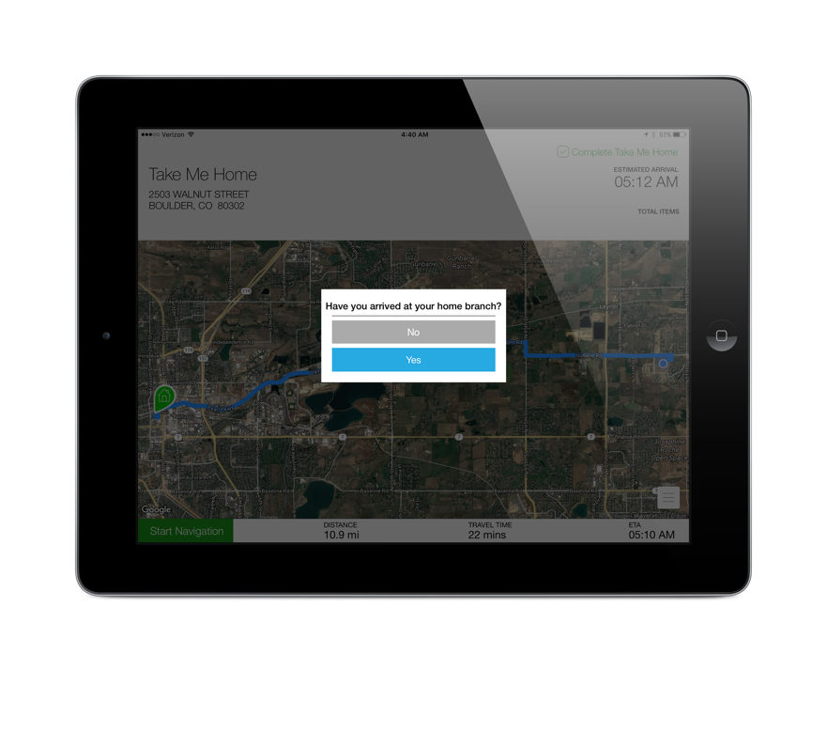
Enable “Take Me Home”
Deliver will show the driver is on their way home
After the last delivery / break, the driver will be taken to the “Take Me Home” map that provides turn-by-turn directions back to the originating branch
When the driver is back at the branch, they will press the “Complete Take Me Home” button

Slide 30
General Notes
In order to troubleshoot connectivity, we’ve added an icon next to the account name in settings that will show you if the iPad is able to reach our service
Connected
Not Connected

