Slide 1
Signature Touch 2.6.0 Delivery Notifications
Innovate 2017

Slide 2
Delivery Notifications
There are now three types of notifications you can enable once a stop has been completed
Push
Text
Email
You can set up your customers to receive all three, a combination, or only their preferred type
Push notifications are only available to those customers that have OE Touch

Slide 3
Push Notifications
To send your customer a push notification when their order has been delivered,
Enable the contact to receive ”Delivery Notifications”
Ensure device is enabled for Push Notifications

Slide 4
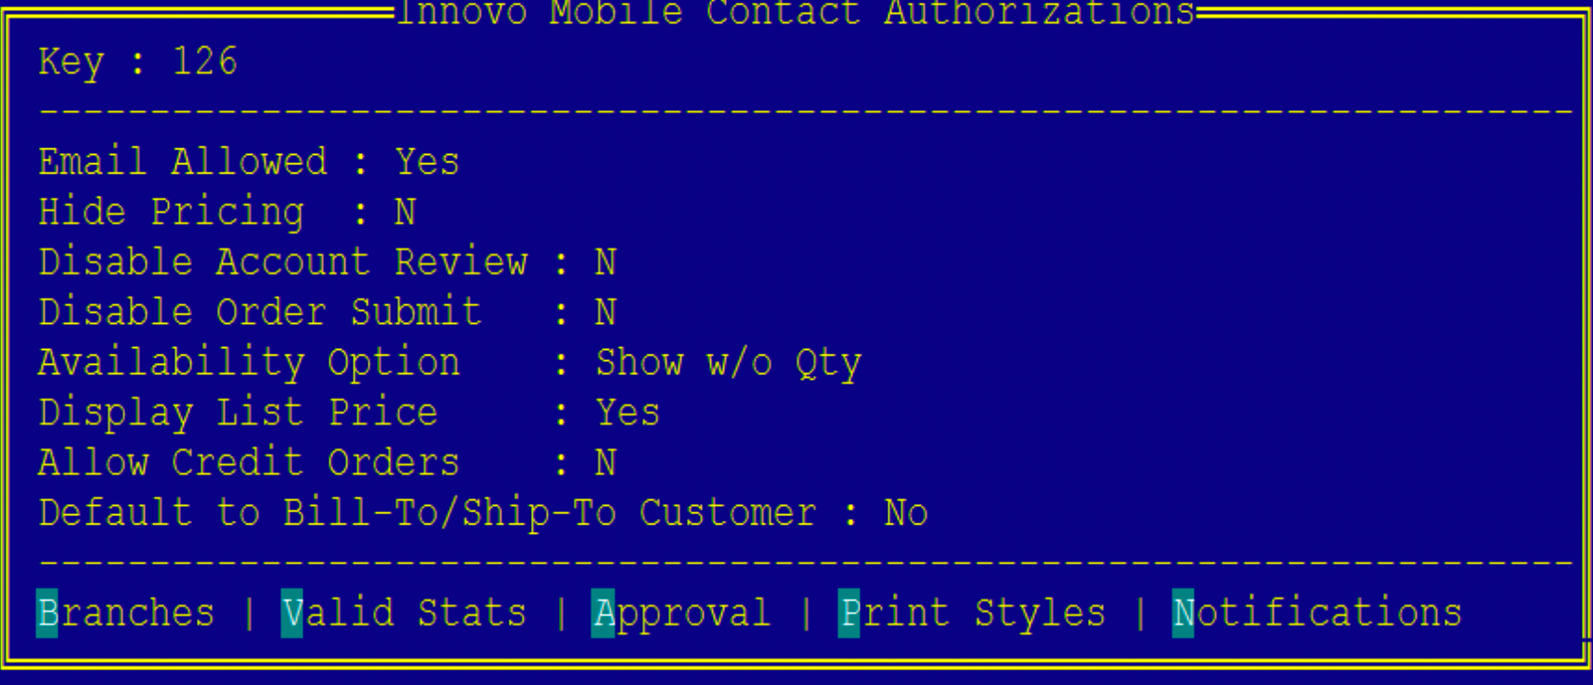
Push Notifications
Enable the contact to receive ”Delivery Notifications”

Slide 5
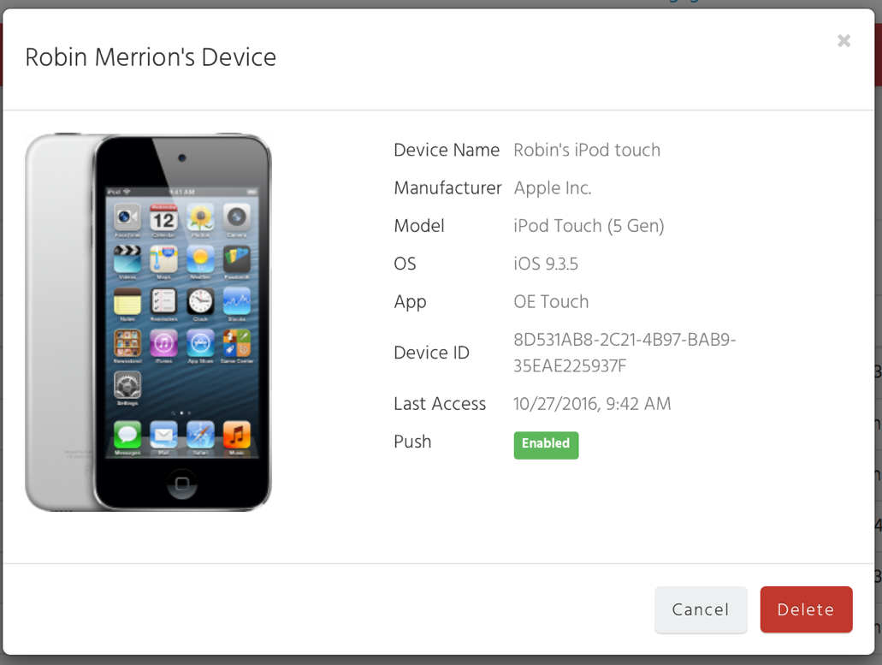
Push Notifications
Ensure device is enabled for Push Notifications in the Customer Portal
Manage > Devices

Slide 6
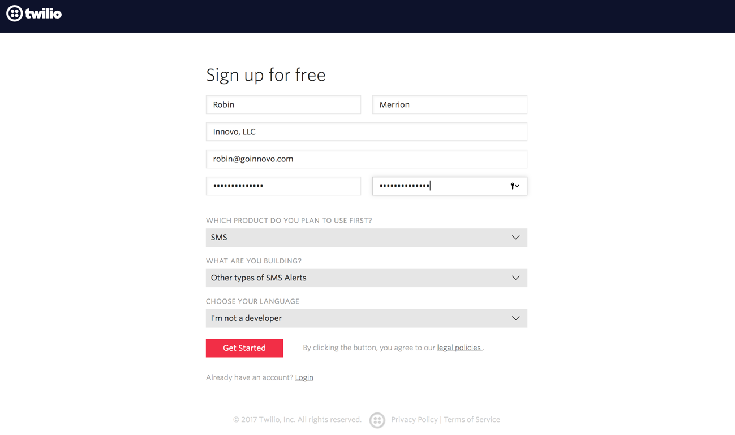
Text Notifications
In order to send text notifications, you will need to create a Twilio account
https://www.twilio.com/try-twilio

Slide 7
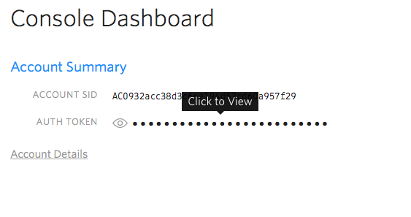
Text Notifications
Get Started with SMS
Get your first Twilio number and follow steps
From your Console Dashboard, find your Account SID and Auth Token

Slide 8
Text Notifications
Then go to Phone Numbers in Twilio and press The “Get your first Twilio Phone number” button. Enter your location and you be given a number.

Slide 9
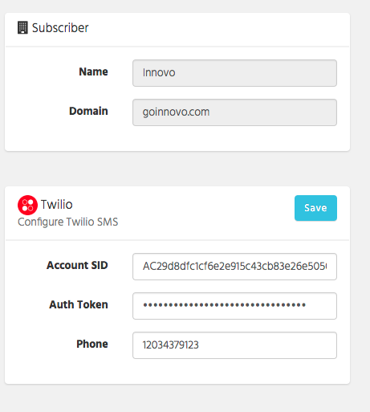
Text Notifications
You will enter the Account SID, Auth Token, and phone number in the Customer Portal
Manage > Settings

Slide 10
Pricing
$1.00 / month per local phone number
$.0075 per SMS message
$.02 per MMS (picture – future)
If you have branches across multiple area codes, you may want to set up multiple local phone numbers in Twilio
There is no restriction in use of a single number but your customers may like to receive the notification from an area code they recognize

Slide 11
Pricing
If you want to utilize a different phone number per branch or territory, use new control file, ”Innovo SigTouch SMS Override for Delivery Notification”
We use the ship branch of the order to determine if there is an override
You must still enter a phone number in the Customer Portal – this can be the most frequently used number

Slide 12
Pricing
Monthly fee = $1.00
If you had 10 trucks & 25 deliveries, that would equal 10 * 25 * .0075 = $1.875 / day
If you deliver 22 days of the month, that would equal 22 * 1.875 = $41.25 + $1.00 = $42.25 / month
If you had 4 trucks, the cost would be $17.50 / month

Slide 13
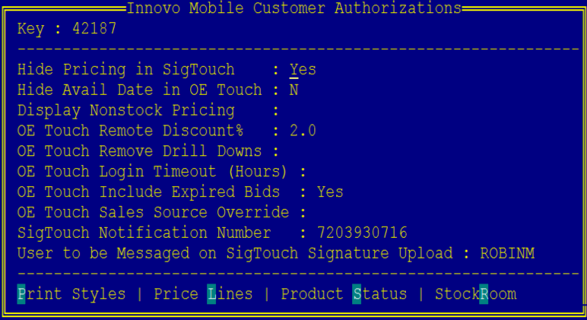
Text Notifications
In Eclipse, you will store the customer’s cell phone number in the Innovo Mobile Customer Authorization UD screen located in Customer Maintenance

Slide 14
Text Notifications
We do provide a UD screen that you can assign to Sales Order Entry to allow users to override the customer’s cell number at the order level
You will need to manually add this to an F-Key in Eterm or Solar
From the SOE screen (body, status, or header), invoke the Alt-F12 (Eterm) or Ctrl-F12 (Solar) keys and assign the UD screen and Pass ID

Slide 15
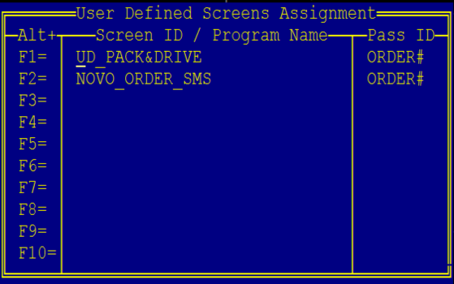
Text Notifications
In this example, the user will invoke Alt-F2 (Eterm) or Ctrl-F2 (Solar) while in the order
Enter the phone number (you can enter the 1 but it is not required)
You can also disable an order from text messaging if the customer has a default cell assigned

Slide 16
Email Notifications
New Activity Trigger, Innovo Delivery Notification that you will assign at the customer level (normal hierarchy rules respected for checking ship-to and then bill-to)
Enter in all email header information
To, CC, BCC, Subject
Body of email will be defined in the portal

Slide 17
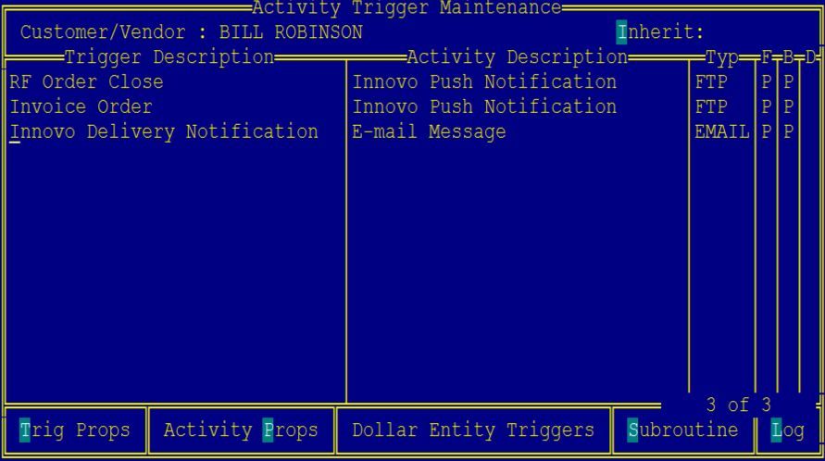
Email Notifications

Slide 18
Email Notifications
Define body of email in the Customer Portal
Manage -> Content
Create an Email Template called DeliveryNotification that will be used for all notifications unless you have a branch override
If you want to create branch / territory specific override templates, define the template names in new control file, “Innovo SigTouch Template for Delivery Notifications”

Slide 19
Email Notifications
If the system cannot find the appropriate template name defined in the Customer Portal, a delivery notification email will not be sent.
We use the ship branch of the order to determine if there is an override.

Slide 20
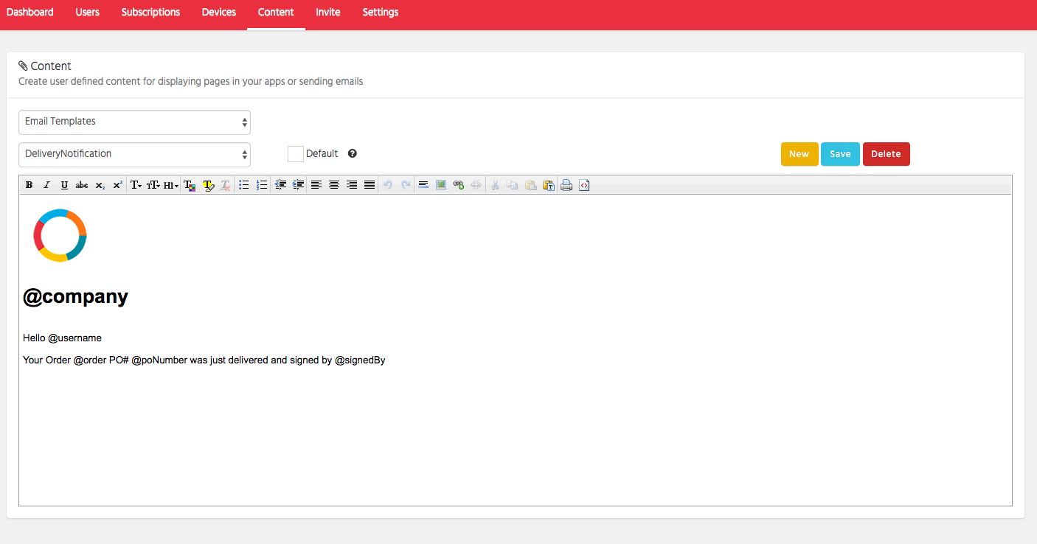
Email Notifications
The following tokens are supported in the template:
@company (name of your company)
@username (name of the ship-to customer defined in Eclipse)
@order (order.invoice)
@poNumber (purchase order number)
@signedBy (signed by user entered in Signature Touch)
@signedAt (address where the order was signed, if connected at signing)

