Slide 1
Innovo Customer Portal
Innovate 2017

Slide 2
Innovo Cloud Platform
Consists of three main areas:
Mobile Device Management (Manage)
Mobile App Engagement (Engage)
Mobile App Analytics (Discover)
Invite, monitor & manage mobile devices
Engage your customers through push notifications
Increase adoption through analytics

Slide 3
Manage
Dashboard – overview of app activity
Users – view and manage invited users
Subscriptions – manage user subscriptions
Devices – view and manage all active devices
Content – create custom content and email invite templates
Invite – invite employees and customers to use your apps
Settings – view account settings and update email notifications

Slide 4
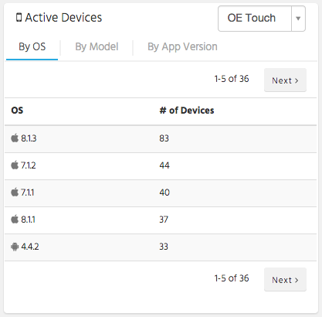
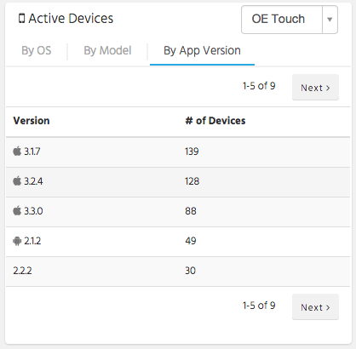
Manage - Dashboard
View graph of total App Installations (not users)
View active device summary
Try to get everyone on latest and greatest version!

Slide 5
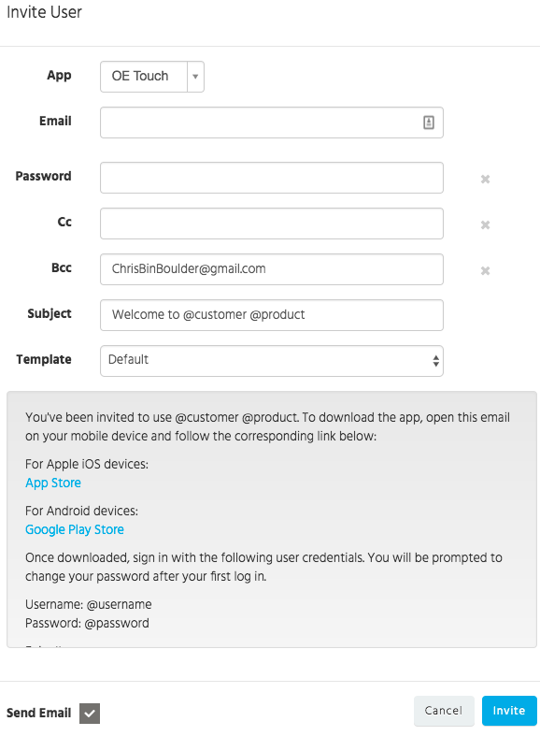
Manage - Invite
Invite employees and customers to use your app
Set specific password
CC yourself or manager
Create custom subjects
Set default template
NEW! Can use same email in multiple customer portals!

Slide 6
Manage - Invite
Invite employees using Users tab
Invite customers using Contacts tab
WOE credentials are required
OE Touch & Stockroom
Invite customers using Customers tab
For OE Touch they can use customer WOE credentials
For StockRoom, they will use Portal credentials
Will not associate with a contact ID in Eclipse
User icon – WOE credentials are in place in contacts tab
Star icon – User has already been invited – click on star to go to the existing user’s page

Slide 7
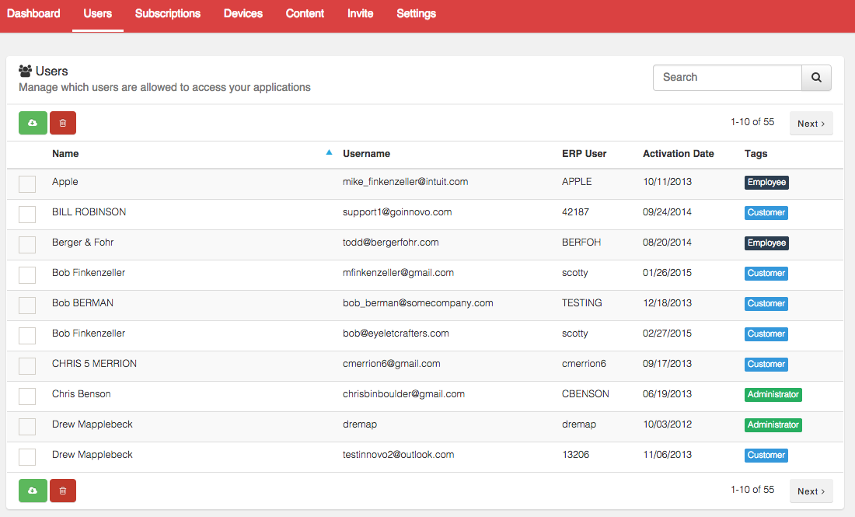
Manage - Users
Users tab displays all Invited users
Troubleshooting tip: If a contact is not picking up UD settings, make sure their ERP user matches WOE login in Eclipse

Slide 8
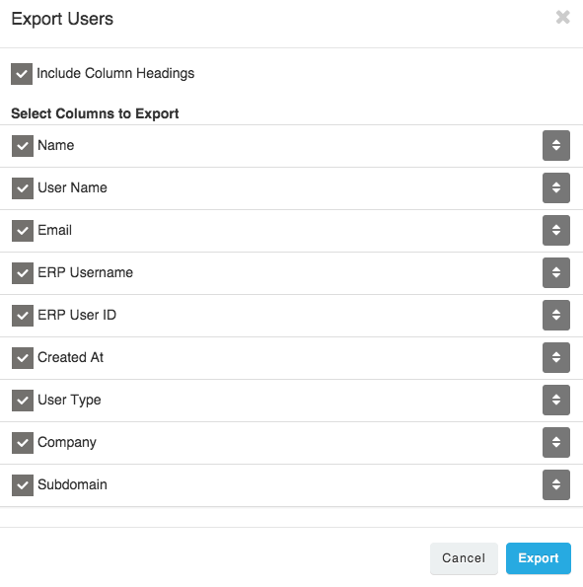
Manage - Users
Delete user by clicking on check box and red button
Flag No Logon in Eclipse for employees
Remove WOE credentials for contacts
Export user list to Excel by clicking on green button
Uncheck box to not include in download
Reorder columns using arrows on right

Slide 9
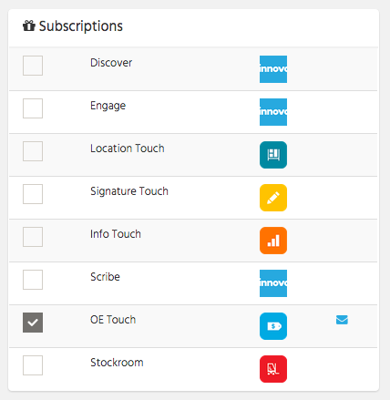
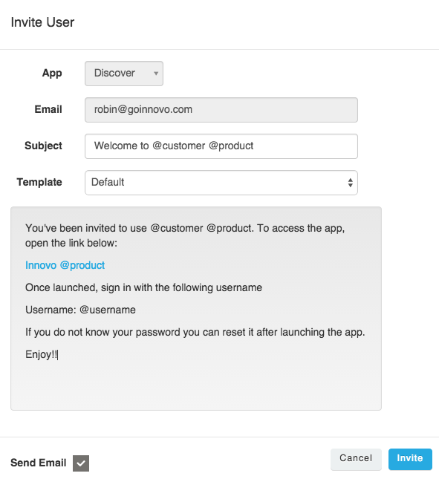
Manage - Users
Click on user to view User Detail page
Add / Remove Products to Existing Users
Option to send email with app link (no password)
OE Touch customers will now see Engage & Discover
Give your employees access to these tabs in portal
Only Administrators have access to Manage

Slide 10
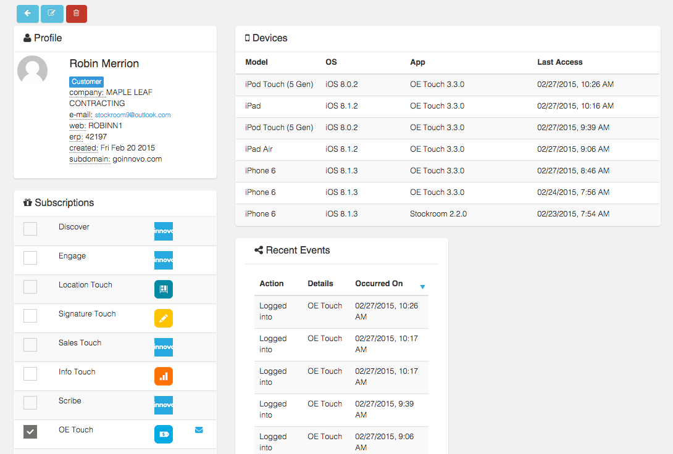
Manage - Users
Use Edit Profile button to send a password reset email
You will be bcc’d on the password reset email
View device list with last accessed date
View recent app events – logged in and order created

Slide 11
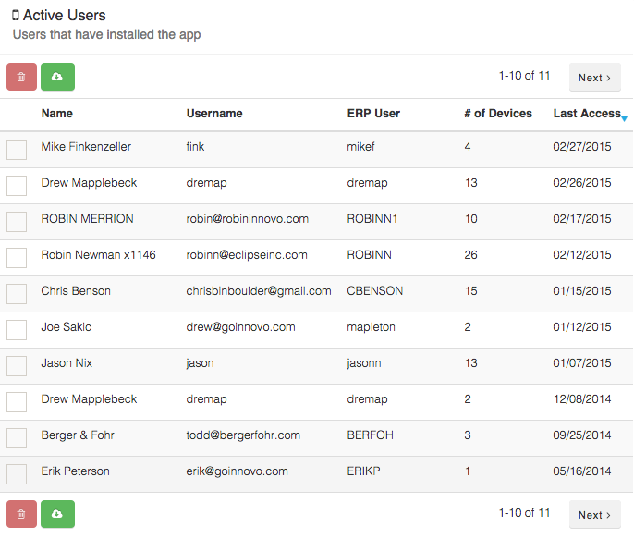
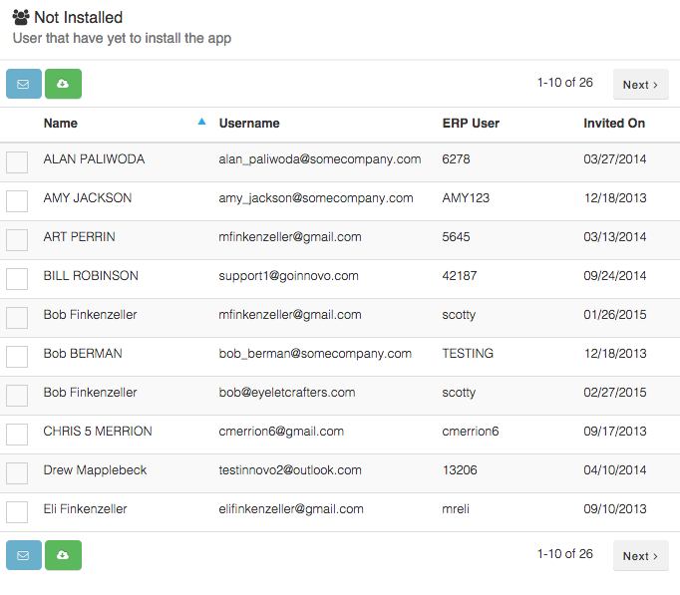
Manage - Subscriptions
View your current subscriptions (device licenses, branches)
See all active users – users that have installed the app
See all users that have not yet installed the app
Send them a reminder invite email

Slide 12
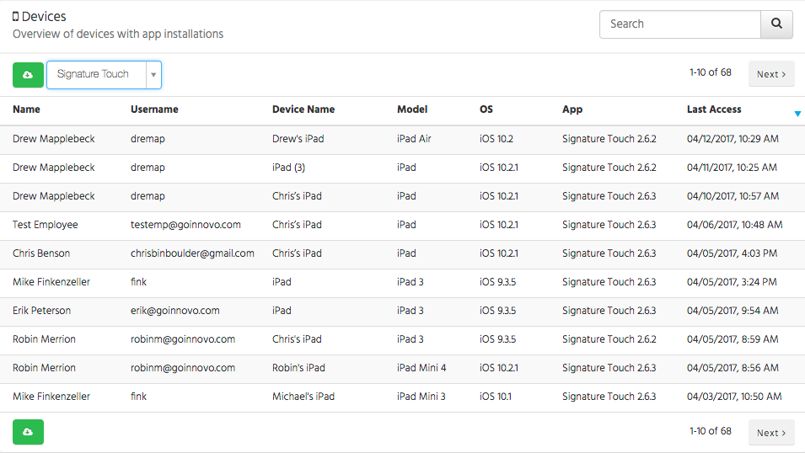
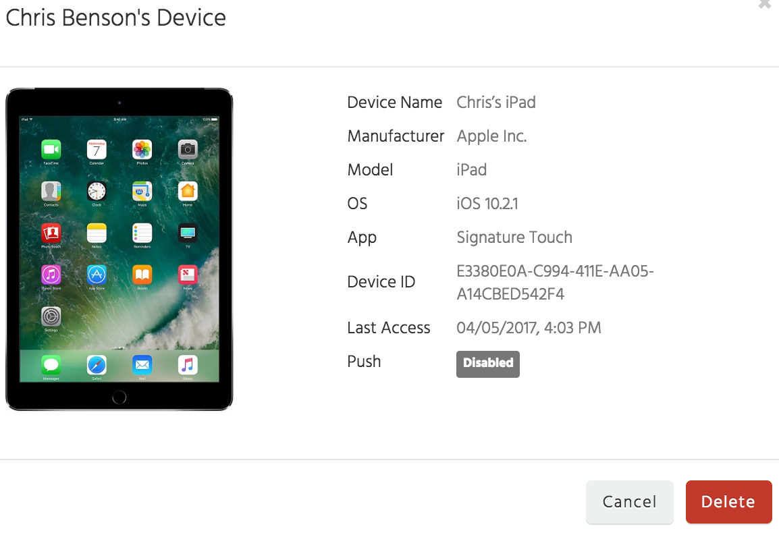
Manage - Devices
View active device list
Shows real-time device name, model, OS & app version
Sort by last accessed date
Download devices
Delete device to free up device license
See if push notifications are enabled

Slide 13
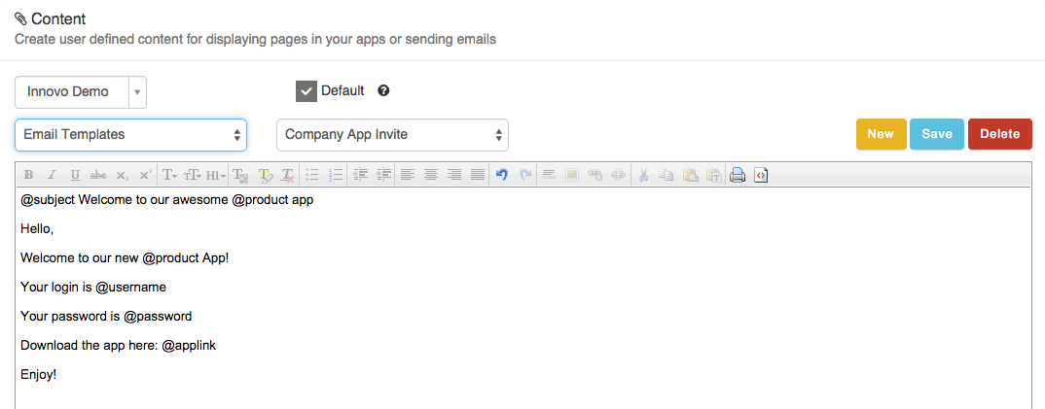
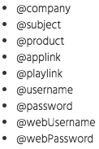
Manage - Content
Create Custom Email Templates
Flag default template using Default check box
Add custom subject line by starting with @subject
Supported tokens found by clicking on ? icon

Slide 14
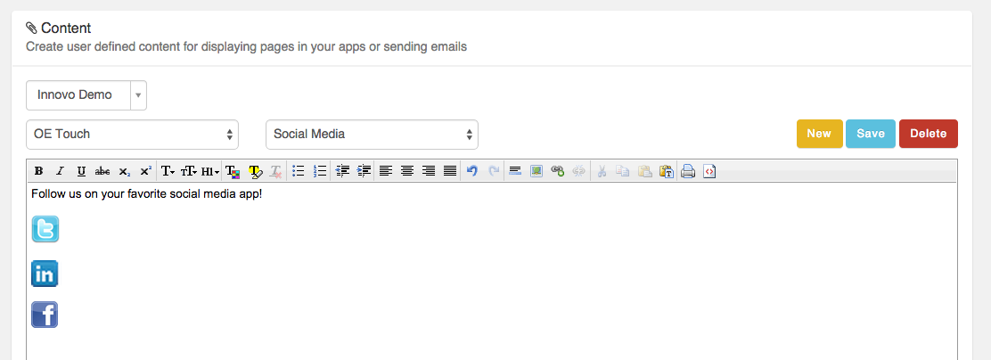
Manage - Content
Create custom OE Touch Resource content
Updated FAQ is posted on support site
Updated for 3.3.0
Preparing for OE Touch Launch

Slide 15
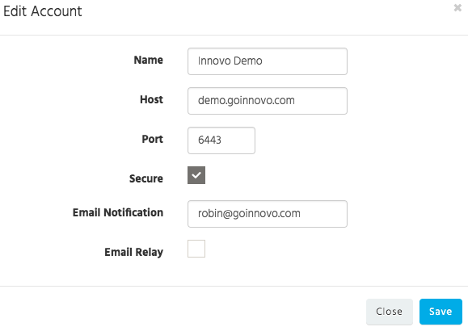
Manage - Settings
View active accounts
Update email notification for OE Touch

Slide 16
Engage
Summary – overview of campaign success & live feed
Segments – target specific groups of customers
Campaigns – create marketing campaigns
New Notification – create new Push Notification
Smart Notifications – automated activity triggers

Slide 17
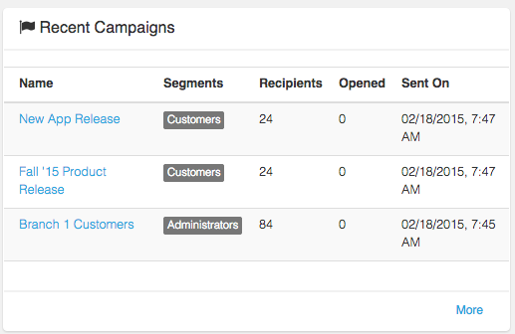
Engage - Summary
View all recent campaigns with open rates

Slide 18
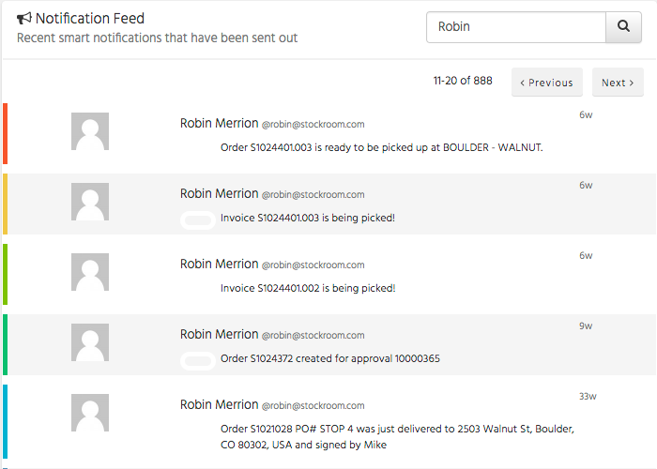
Engage - Summary
View Live Smart Notification Feed
Automated Activity
Trigger
OE Touch Order approval notification
Delivery Notification from
Signature Touch

Slide 19
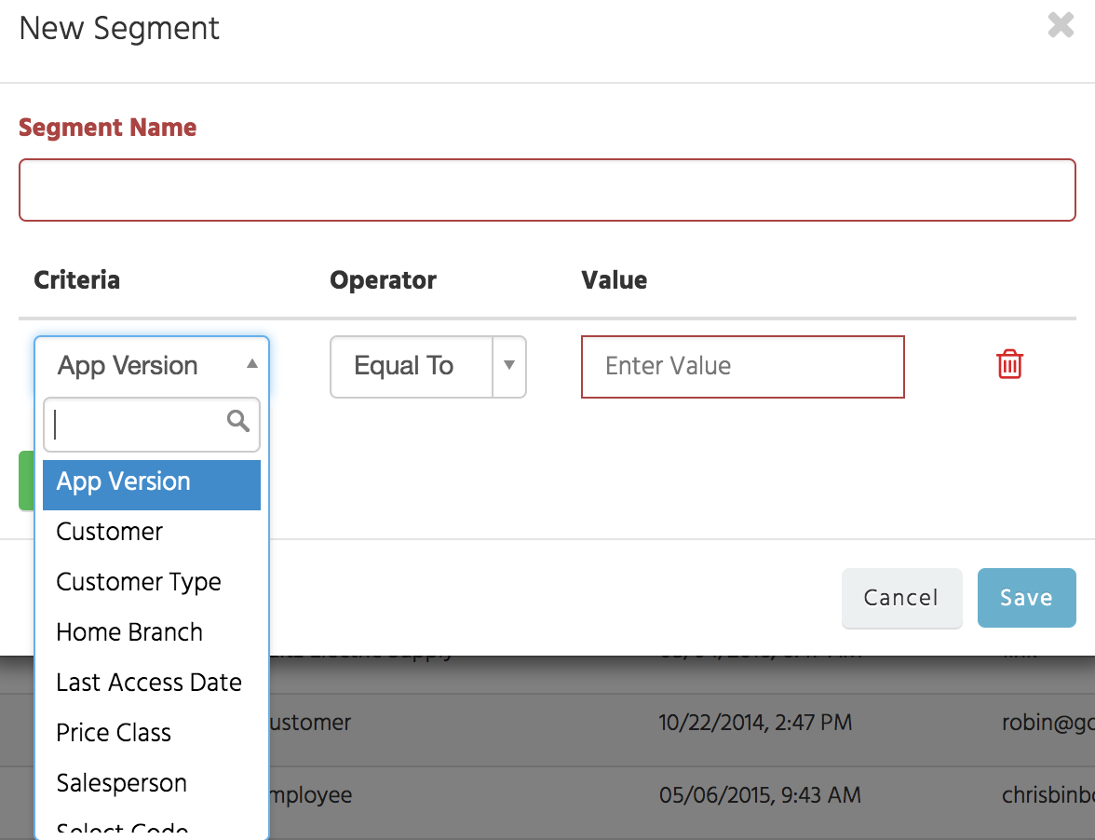
Engage – Segments
Target specific groups of users and customers
App Version
Customer
Customer Type
Home Branch
Last Access Date
Price Class
Salesperson
Select Code
Territory
User Type

Slide 20
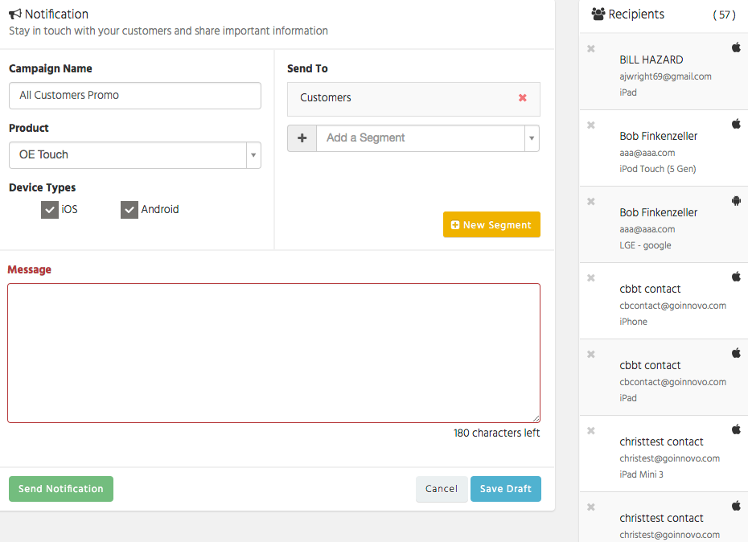
Engage – Campaigns
New Push Notification
Can see list of all users devices to receive the campaign
Send to Apple, Android or Both
180 character message

Slide 21
Engage – Smart Notification
3-step Process for setting up automated activity trigger
Create Recipe on Smart Notification Page
Add corresponding trigger to Customer File in Eclipse
Flag Contact to receive Smart Notifications

Slide 22
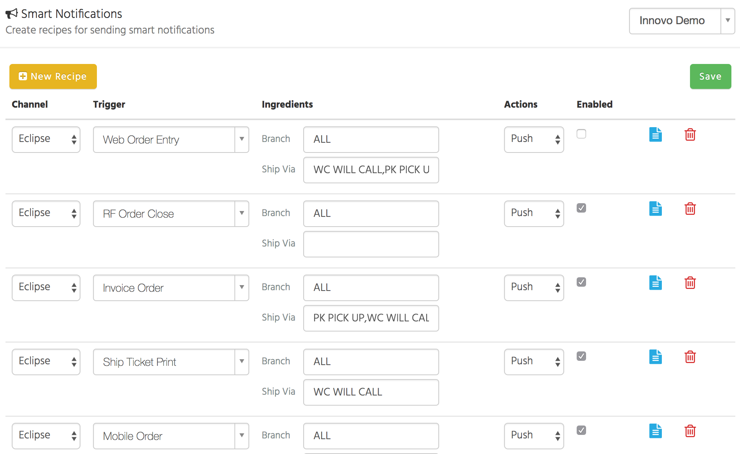
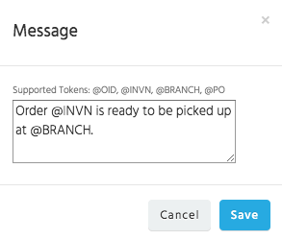
Engage – Smart Notification
Create Recipe on Smart Notification Page
Select Trigger
Select Ingredients: Branch & Ship Via (comma delimited)
Select Push & Enabled
Add User Defined Message

Slide 23
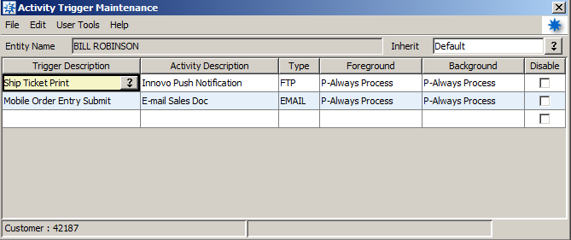
Engage – Smart Notification
Add corresponding trigger to Customer File in Eclipse
Activity Description = Innovo Push Notification

Slide 24
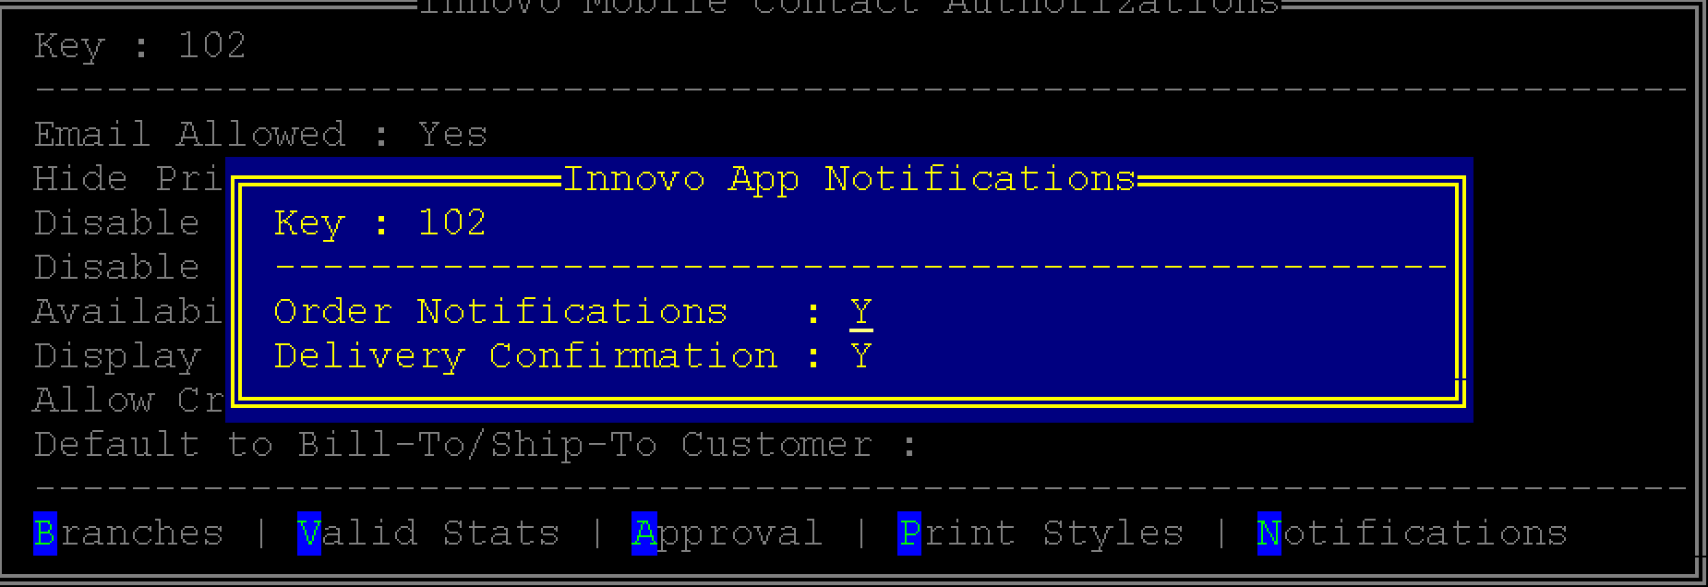
Engage – Smart Notification
Flag Contact to receive Order Notifications
Innovo Mobile Contact Authorizations UD Screen
Alt-F1 (Eterm) / Ctrl-F1 (Solar)

Slide 25
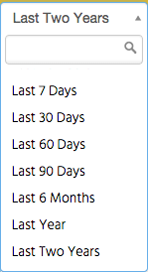
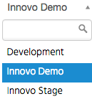
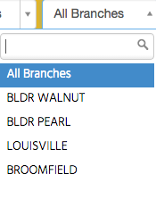
Discover
Dashboard – overview of app usage
Customers – customer sales & customers not placing orders
Products – see what your customers are searching for
Salespeople – see orders your sales reps are placing
All data broken down by time, account, & authorized branch list

Slide 26
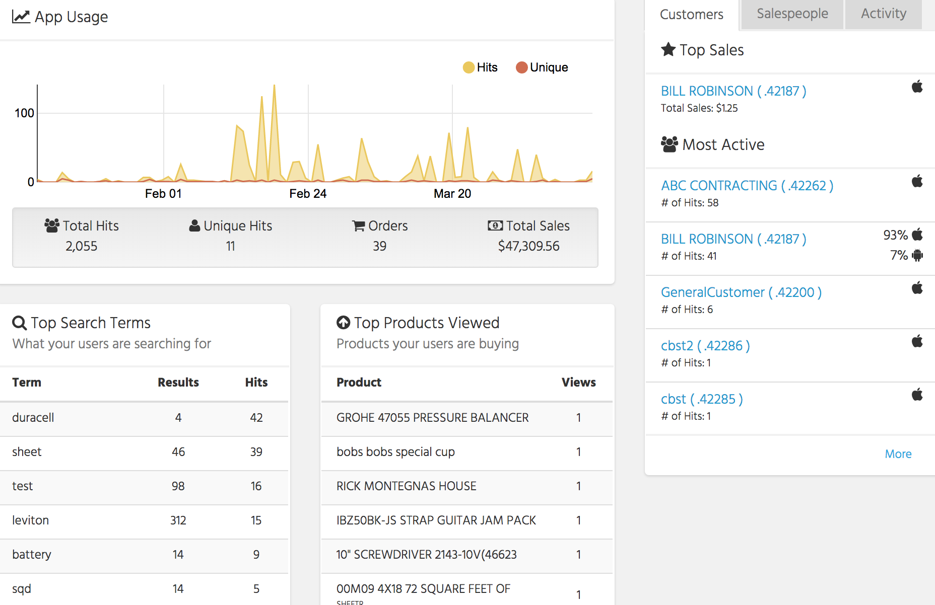
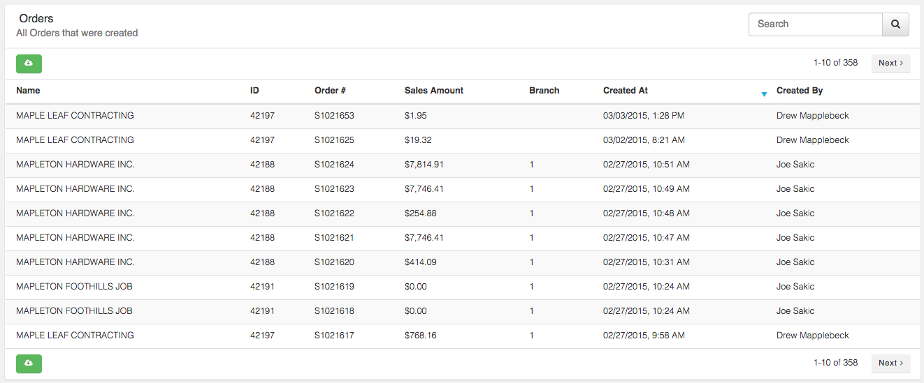
Discover - Dashboard
App Usage Graph
Total Hits (product search, product viewed, order placed)
Unique Hits (unique users during time period)
Orders – Click on Orders to see all Orders placed
Download all orders placed
See Top Sales / Most Active customers & employees
Activity tab shows real-time users logging in & placing orders

Slide 27
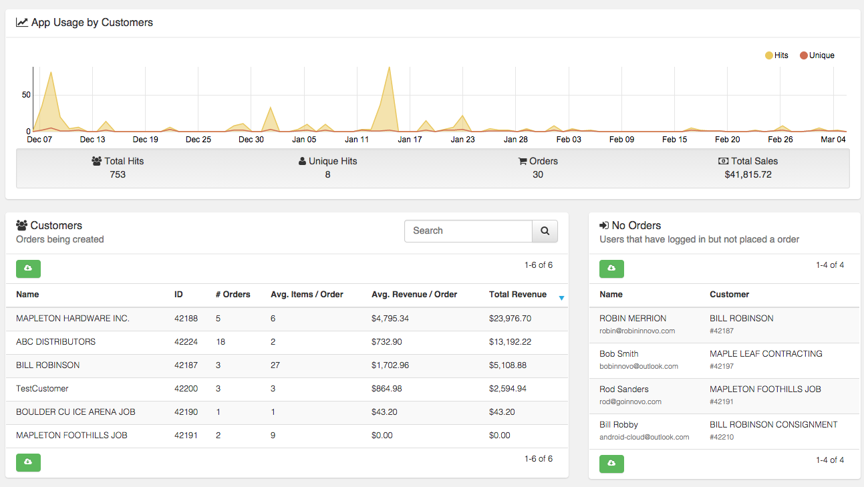
Discover - Customers
Customer Sales
# orders
Avg. items per order
Avg. sales per order
Total Sales
See all customers that have logged in but never placed order
Download customers / email addresses

Slide 28
Discover - Customers
Click on Customer to see Customer Specific Stats
See what they’ve been searching
See what products they’ve been viewing
See what products they have bought
See what products they are viewing but not buying
See all contacts that have logged in for customer and breakdown stats by contact
All data is downloadable

Slide 29
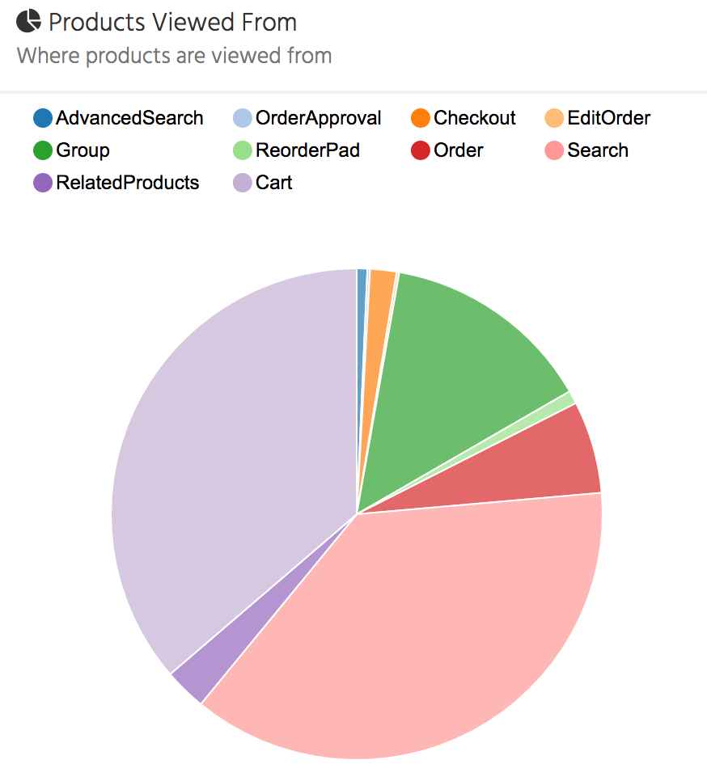
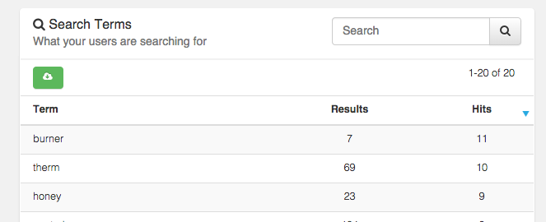
Discover - Products
Search Terms
Results & # times searched (Hits)
Sort by 0 results – product file opportunity
Top Products Viewed
Top Products Sold
Products viewed but not purchased
See source of products viewed

