Slide 1
OE Touch 4.0 New Features
Innovate 2017

Slide 2
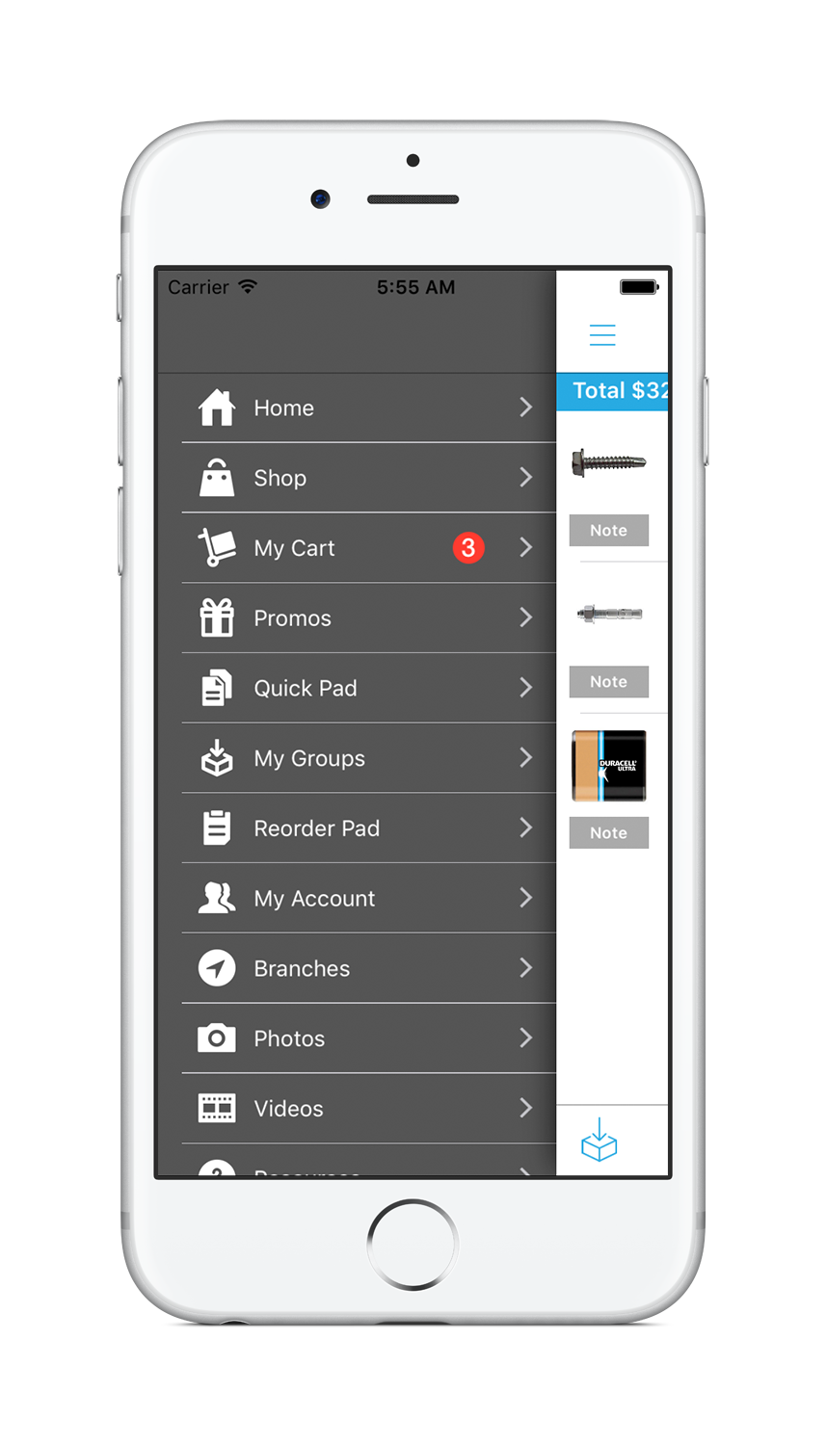
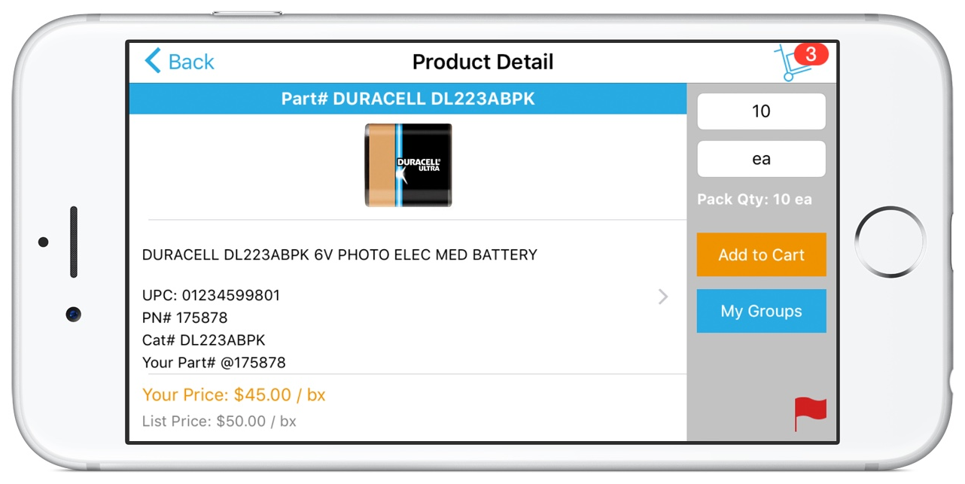
OE Touch 4.0
New Menu Navigation
Landscape Support

Slide 3
OE Touch 4.0
Ability to display Related Products / Substitutes in Product Detail
Easily add-to-order

Slide 4
OE Touch 4.0
New Features
Ability for a customer to “approve” a quote (i.e. add PO# and notify order writer)
Ability to flag contacts as “view-only” for product groups
Ability to re-sort products in product groups and save
Ability to see product groups for all related ship-to’s (currently we only show groups for the active ship-to)
Ability to warn user if item being added is already in cart with option to just add to quantity or add another item

Slide 5
OE Touch 4.0
New Features
Ability to show default ship branch availability along with the current network availability
Touch ID support
Automatically open order detail from smart push notification
Ability to display price flag in shopping cart (i.e. +, #, *) in salesperson mode
Respect multiple PO#’s setting in customer maintenance
Ability in salesperson mode to take picture from app when there is no image and store on imaging server

Slide 6
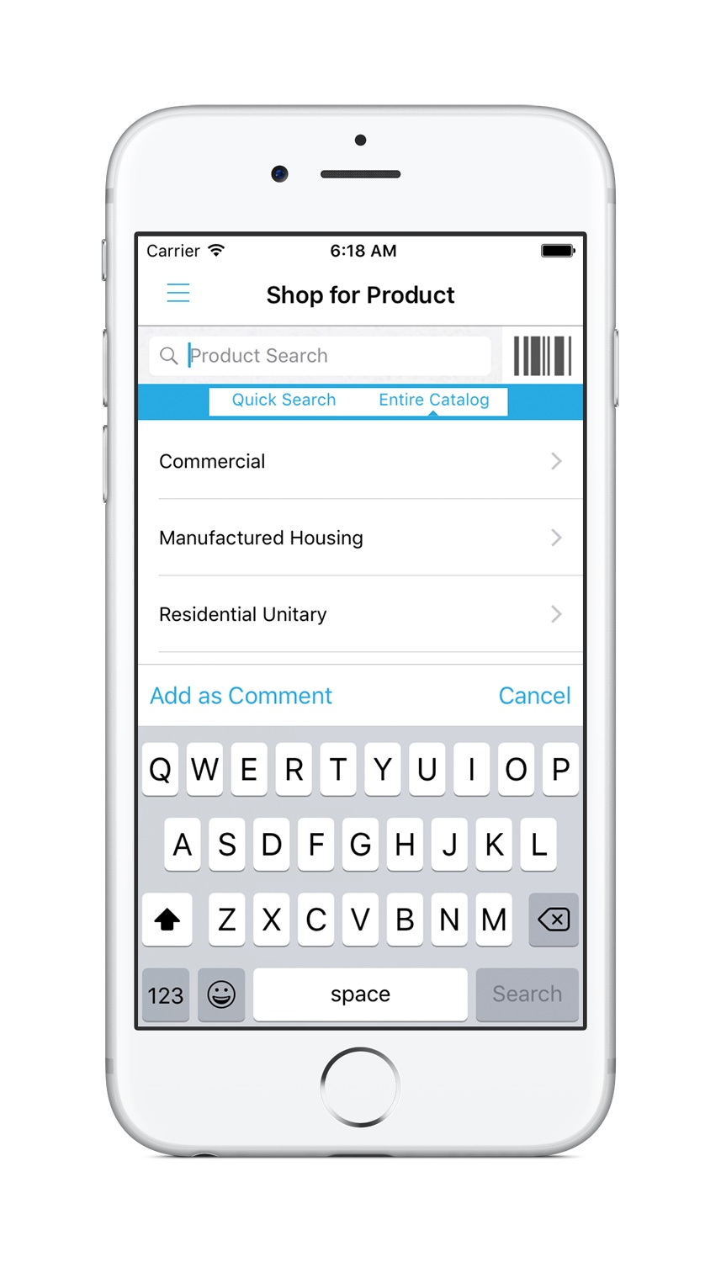
Oe touch 4.0
PDW support in salesperson mode
Ability to search PDW
Product created when order is submitted

Slide 7
OE Touch 4.0
Kiosk mode
Add timeout setting to make customer re-enter password
Auto-logout after order creation
Process available items via pick-up-now and show any items that were backordered

