Slide 1
OE Touch Order Approval
Innovate 2017

Slide 2
OE Touch Order Approval
Eclipse Settings
App Flow
Manager Flow
Push Notifications

Slide 3
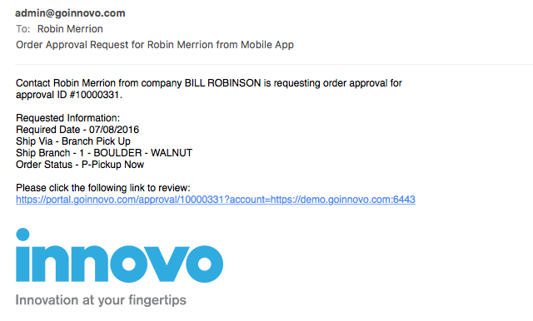
OE Touch Order Approval
Order Approval allows a contact to build a shopping cart and submit to their manager for approval before the order is created in Eclipse
To enable Order Approval for a contact, use the Approval hotkey off of the Innovo Mobile Contact Authorizations UD screen and enter the email address of their manager
When the contact submits the approval, the manager receives an email with a link where they can approve, deny, or edit
Use control file, “Innovo OE Touch Order Approval Email Template” to set up the email subject and body
You can set the ”from” email by setting the outgoing email (additional -> email) on the INNOVO user from User Maintenance
You can use tokens in the subject and body of the email to personalize the approval message. Please see our documentation for more information.
OE Touch > Eclipse Settings > Order Approval

Slide 4
OE Touch Order Approval
When the manager clicks on the link in the Order Approval email, they will be taken to a website where they can do the following
Approve the order “as-is” which will create an order in Eclipse
Deny the order which sends a push notification to the contacts’ device with the reason for denial (contact must have smart notifications enabled on the UD screen)
Modify the order by changing quantity on items, deleting items, or adding “free-form” items* before approving
Download the approval into a CSV file
A “free-form” item will be added to the order when approved as a line item comment to a miscellaneous charge item
The miscellaneous charge item must be set in control file, “Innovo OE Touch Product Not Found for Order Approval"

Slide 5
Eclipse Settings
Innovo OE Touch Order Approval Email Template
@CONTNAME
@CUSNAME
@APPROVAL
@DATE
@VIA
@BRANCH
@STATUS
Innovo OE Touch Product Not Found for Order Approval
Innovo Contact UD Setting – Approval hotkey

Slide 6
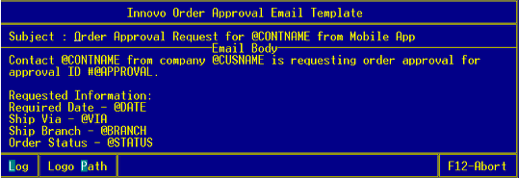
Eclipse Settings
Configure the Innovo Order Approval Email Template control file

Slide 7
Eclipse Settings
The following tags can be used in the subject and email body to personalize the email message:
@CONTNAME - Replace text with contact first and last name
@CN - Ship-to customer ID
@CUSNAME - Ship-to customer Name
@APPROVAL - Approval ID
@DATE - Required date selected
@STATUS - Order status selected
@VIA - Ship via selected
@BRANCH - Shipping branch either selected or default
The email will also contain a link with the order details in order to approve or deny the order request

Slide 8
Eclipse Settings
Innovo OE Touch Product Not Found for Order Approval control file
Allows Manager to add free form products to the order
Usually a miscellaneous charge product used as a placeholder
Request Details are added as line item comment

Slide 9
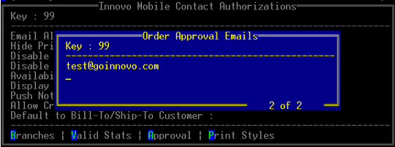
Eclipse Settings
Innovo Contact UD Setting – Approval hotkey
This is the email the order approval request will be sent to when created in the app

Slide 10
Eclipse Settings
If using Eclipse Forms, we need to set up a control file on your site for old email – NETMAIL.OUT
Order approval email from address
Set up the INNOVO user Email address
We add your company logo to order approval email

Slide 11
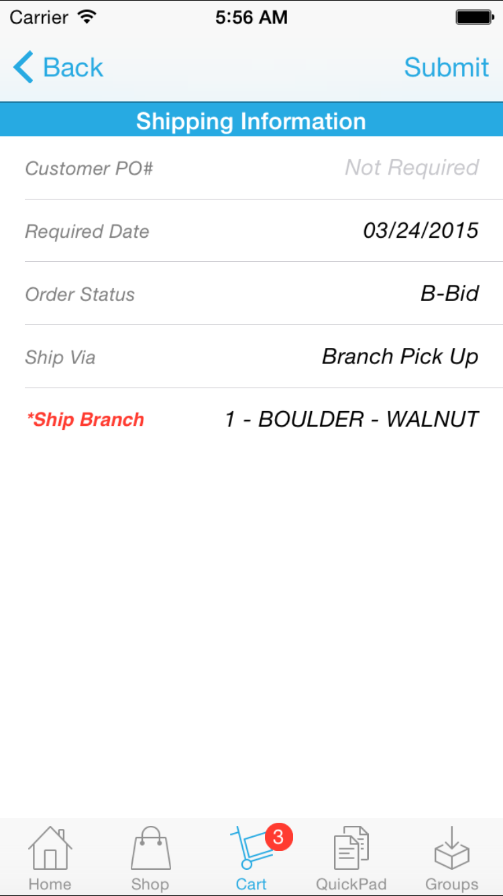
App Flow
Checkout Process
* Customer PO not required
* Add Release Number
* Add Shipping Instructions

Slide 12
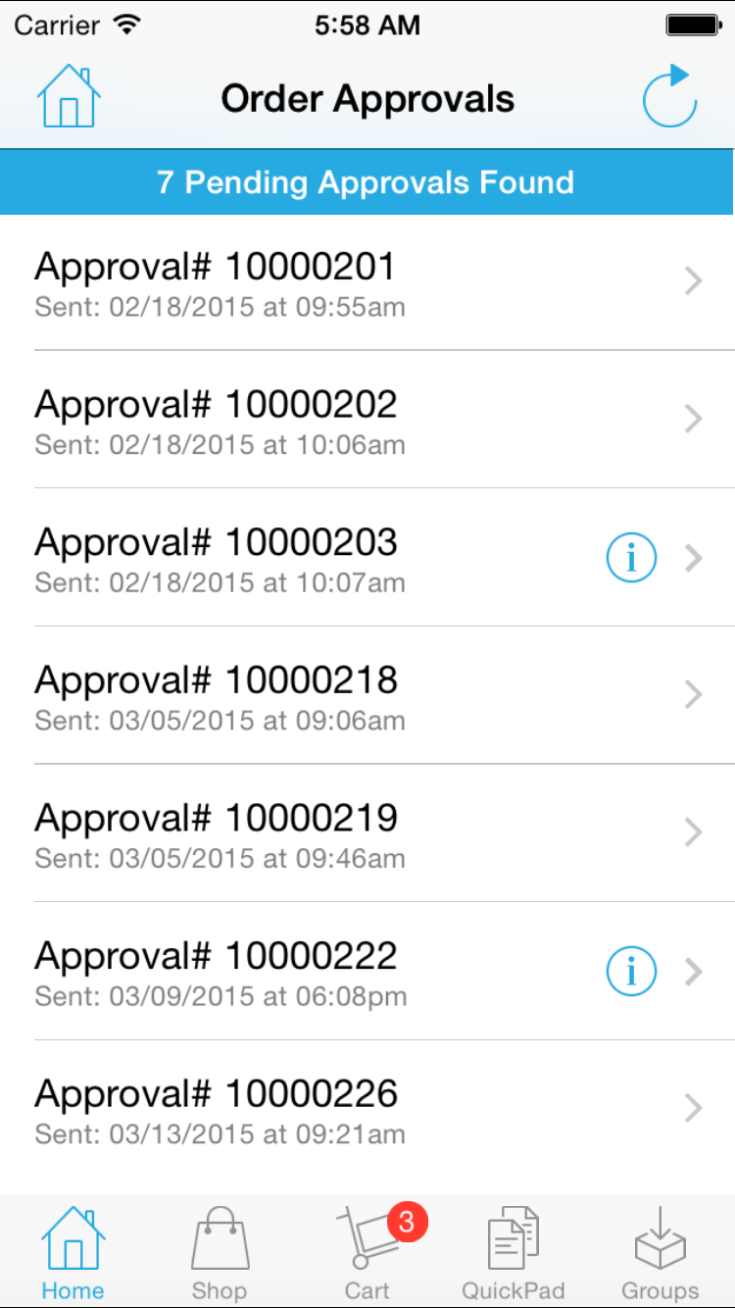
App Flow
Order Approval Page
* View Denial Reason
* Delete Approvals
* Only display Pending
* Drill into Approval Detail

Slide 13
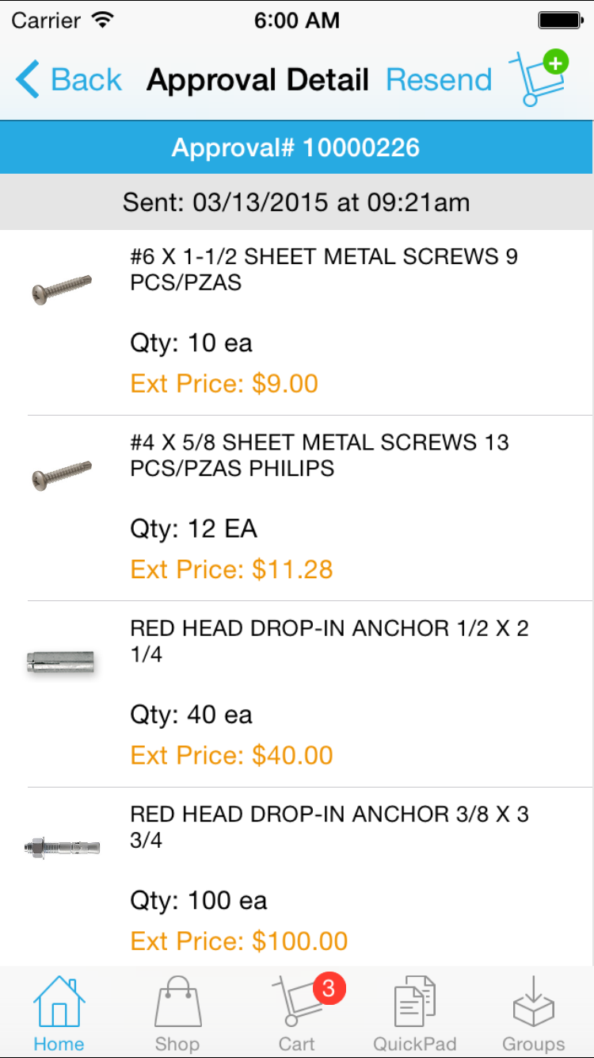
App Flow
Order Approval Detail
* Resend Approval Email
* Add Products to Cart

Slide 14
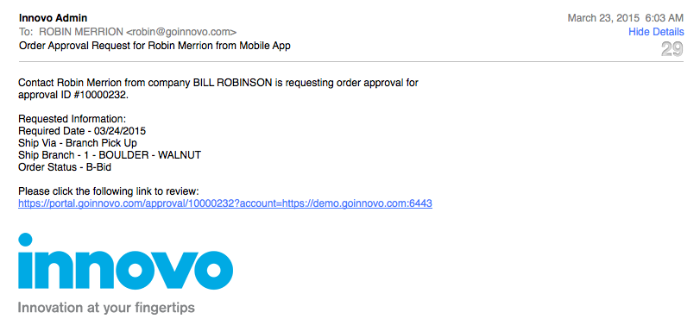
Manager Flow
Email (based on your email template)

Slide 15
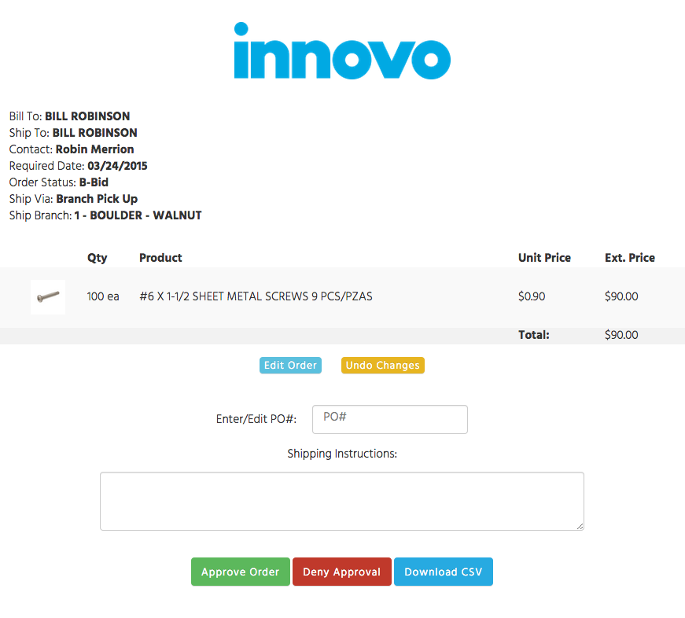
Manager Flow
Order Approval Web Page

Slide 16
Manager Flow
PO# required when manager approves order
Default to anything contact entered
Shipping Instructions optional
Edit quantities (respects forced sell pack quantity)
Delete products
Add free-form products
Added as line item comments to product set in control file
Deny reason required when manager denies order

Slide 17
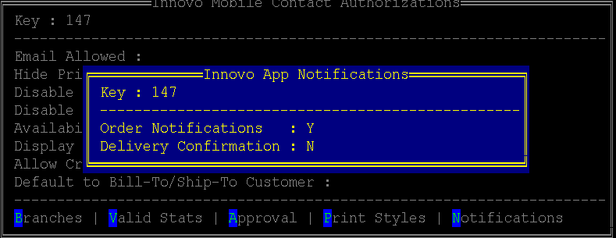
Push Notifications
Enable contact to receive Order Notifications
Receives push when order is approved
Receives push when order is denied

Slide 18
Questions?
Enhancement Ideas?

