Slide 1
OE Touch 3.4.0
Innovate 2017

Slide 2
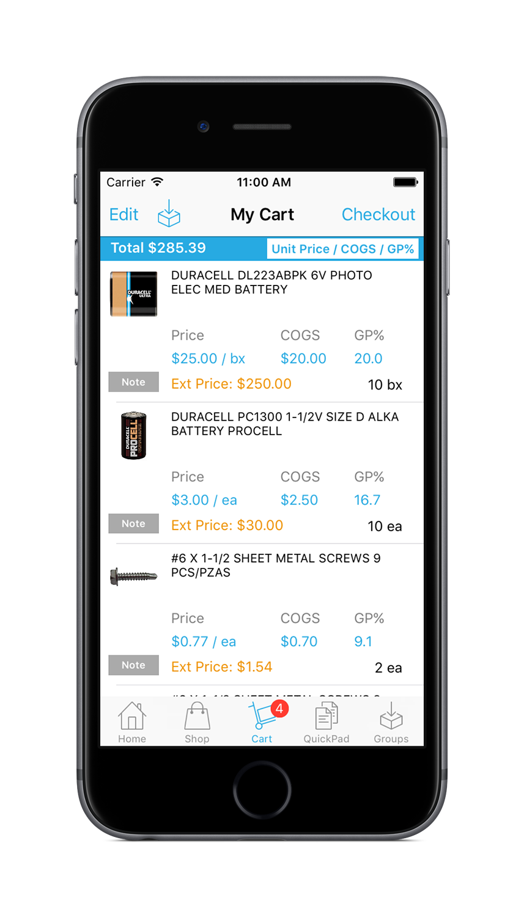
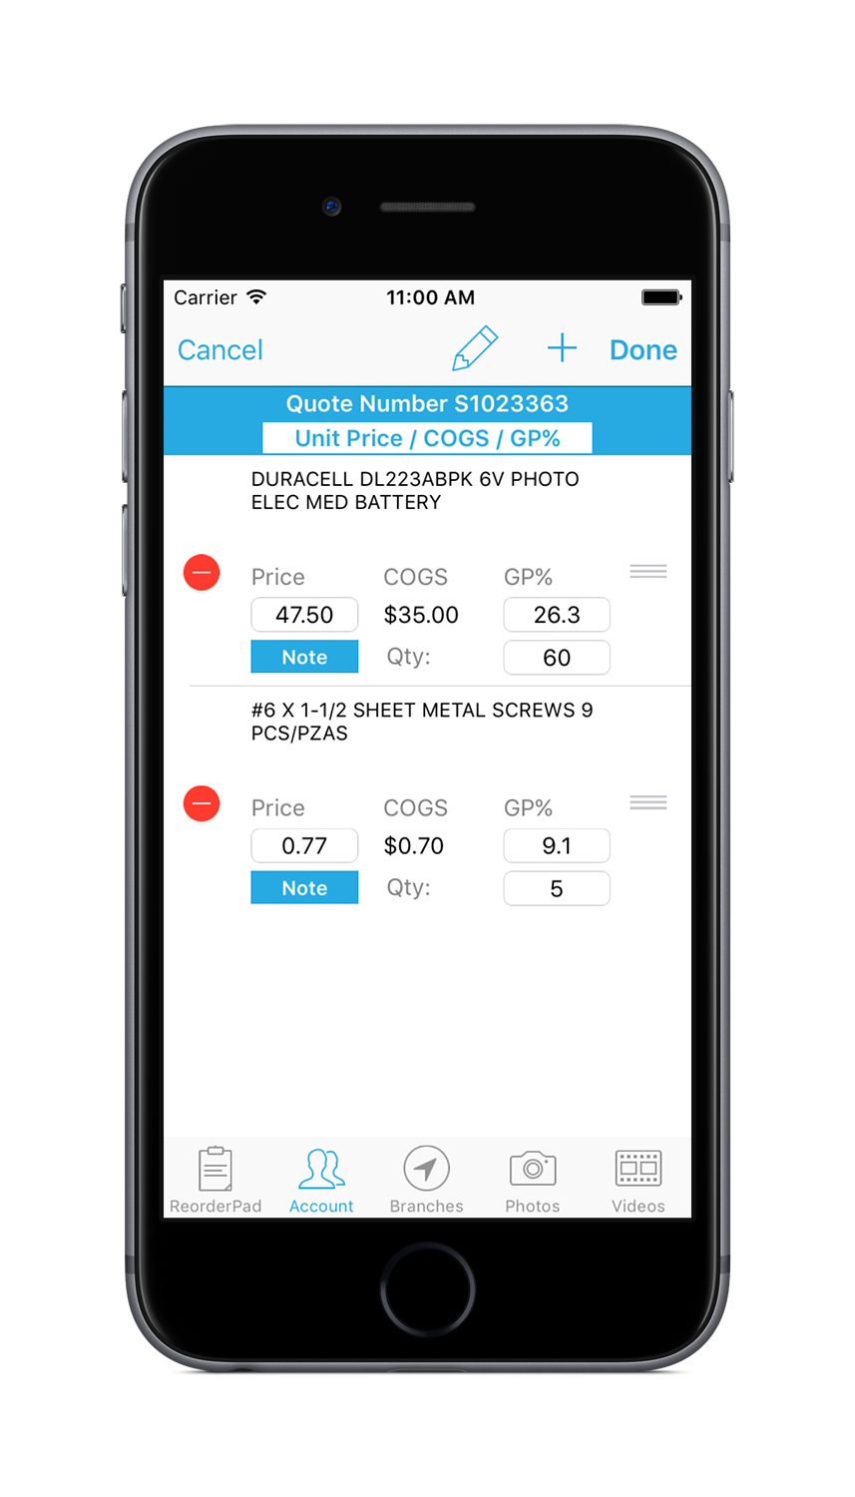
OE Touch Features

Slide 3
OE Touch 3.4.0 What’s New!
For Employees
Edit Price and See Cost in Shopping Cart, if Authorized
Edit Existing Quotes, if Authorized
Ability to send Bids to Bid Followup Queue
For All Users
Added support for Ship-On / Call-On Order Statuses
Ability to search for existing Order by Barcode
Added “Share” button to Product Specs and Images
For Customers
Added auto-refresh for settings without needing to re-log
Added Green/Yellow/Red to Order Approval checkout

Slide 4
OE Touch 3.4.0 Eclipse Settings
User Maintenance – Innovo User Defined Screen
Disable Credits
Sales Source
Order Views
Templates Hotkey (Showroom only)
Available Order Views
Unit Price / COGS / GP%
Unit Price / Cost / GP%
Unit Price / Formula
NOTE: If you authorize a user for an order view but they don’t have authorization to change price, see cost, etc., the app will not let them! Also, if you don’t authorize users for any order views, the app will continue to work as it does today. This will allow you to do a controlled roll-out.

Slide 5
OE Touch 3.4.0 Eclipse Settings
Authorization Keys required for OE Touch
SOE.OPEN.PRICE.EDIT – ability to change price and edit quote
COGS.VIEW – ability to see COGS
COST.VIEW – ability to see COMM Cost
SOE.COST.EDIT – ability to see basis fields Order COGS/Comm
Changing price in OE Touch respects the following Auth Keys
SOE.EDIT.IAO.INV.PRICE
SOE.OVRD.NO.PRC.CHANGE
PRICE.CHANGE.OVRD
SOE.MIN.GP
SOE.MAX.DISC
SOE.MIN.SELL.PRICE

Slide 6
OE Touch 3.4.0 Eclipse Settings
Customer Maintenance – Innovo User Defined Screen
Product Status hotkey – allows you to limit or extend what product statuses a customer can see
Note: Control File, Valid WOE Product Statuses is where you set the product statuses a customer/employee can see in the app
Tip: If you only want customers to see Stock products but you want employees to see Stock and NonStock products, you can enable this by setting Valid WOE Product Statuses to just Stock and then setting control file, Innovo OE Touch Display NonStock Products for Employees to Yes.
Catalog products can also be displayed for employees only!

Slide 7
OE Touch 3.4.0 Eclipse Settings
New Control Files
Innovo OE Touch Customer Email Override
Innovo OE Touch Display Default Shipping Instructions
Innovo OE Touch Show Consignment Availability
Innovo OE Touch Default Qty Break List to Largest
Innovo OE Touch Valid User Order Views
Showroom Control Files (just wanted to point them out)
Innovo Document Overrides for Printing
Innovo OE Touch Sales Source for Showroom
Innovo OE Touch Showroom Comment Type for Room Tag

Slide 8
OE Touch 3.4.0 Eclipse Settings
Innovo User Defined Utility
We have four Innovo User Defined files where we store information relative to just the Innovo apps.
NOVO_CUSTOMER_AUTH
NOVO_CONTACT_AUTH
NOVO_USER_AUTH
NOVO_BRANCH_HOURS
Currently, there is no way to mass load to these files for all of your customers, contacts, users, etc. unless the record for the associated parent file already exists in our UD file.
The only way to create a record is to edit the associated Innovo User Defined screen.

Slide 9
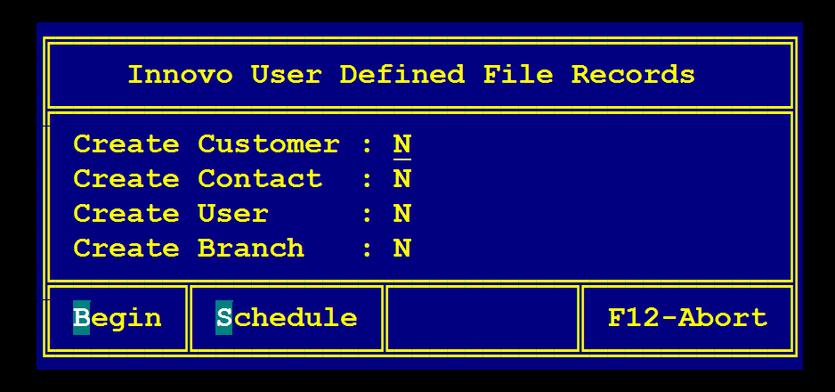
OE Touch 3.4.0 Eclipse Settings
Innovo User Defined Utility
We have created a new utility where you can create blank records in any of our files in order to enable mass loads.
This can be scheduled or run manually and will not interfere with any existing records in our files.
This is ETERM only and you will need to add the program to a custom menu.
Program name – NOVO.DVR.ADD.UD.RECS

Slide 10
OE Touch 3.4.0 Additional Features
Added Last Payment Amount to A/R Inquiry
Added Release# to Order Approval Checkout / Web
Always display Eclipse Product ID# displays in Product Detail
Added Serial # to NonStock Request form
Added Unit Price for all users in Shopping Cart
Added ability to search for customer by order # or by barcode
Enlarged Phone Button in Branch Detail
Enlarged Add to Cart button in Product Group Detail
Going back to product list in Product Group Detail will no longer scroll to top of page

Slide 11
OE Touch 3.4.0 Shopping Cart
The “Delete Cart” feature has been changed for all users
You will no longer see the trash can icon
You will see a new “Delete Cart” button when enabling Edit mode

Slide 12
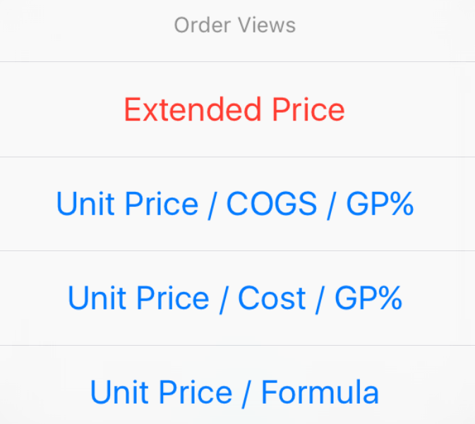
OE Touch 3.4.0 Shopping Cart
Added “Order Views” for Employees
If at least one Order View has been enabled for your user in Eclipse, you will now see a white Order Views button in the header
Note: Customers and any employee without order views assigned will see the above

Slide 13
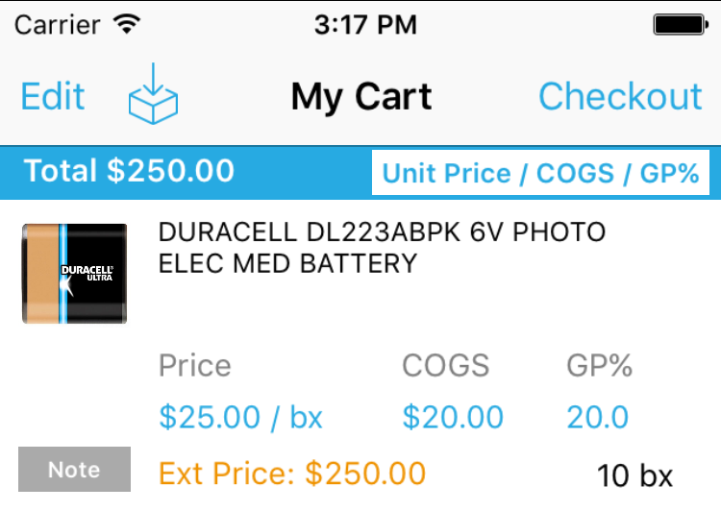
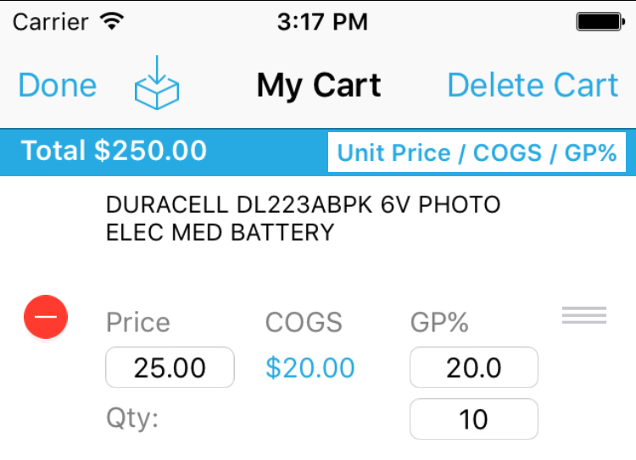
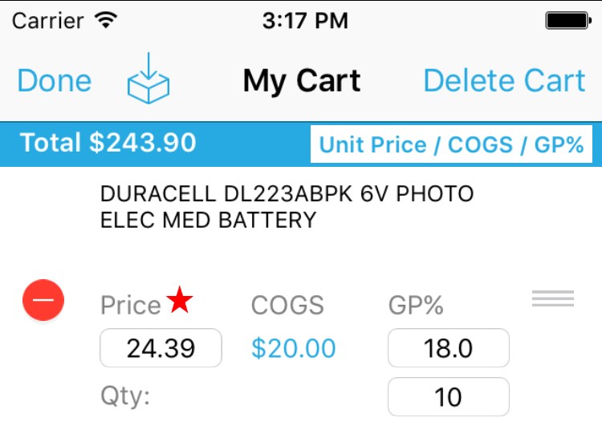
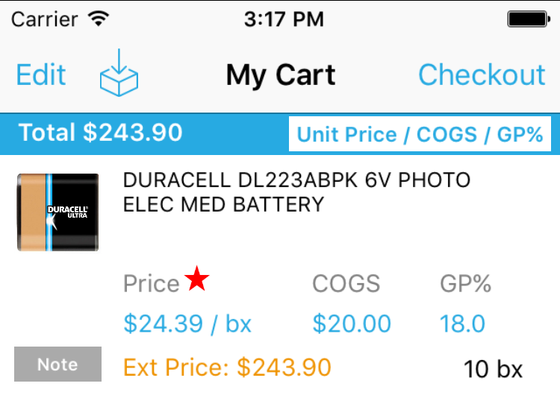
OE Touch 3.4.0 Shopping Cart
Change price or GP%
Price changes will show with override in an Order View but not in Extended Price view
Clear price to remove override

Slide 14
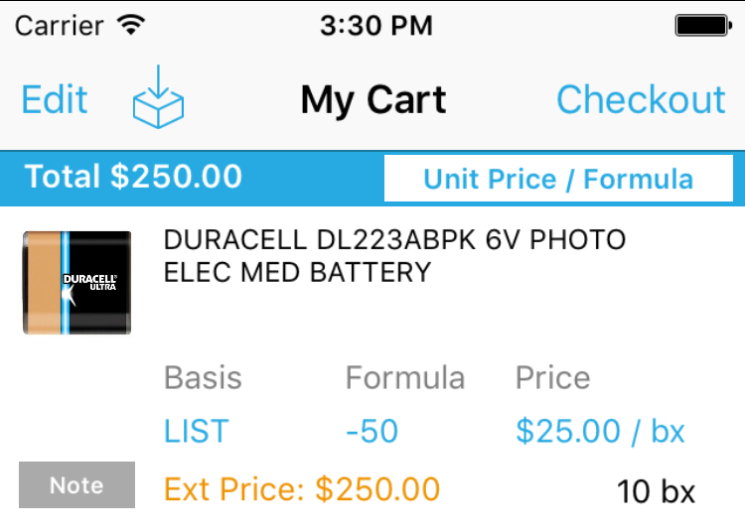
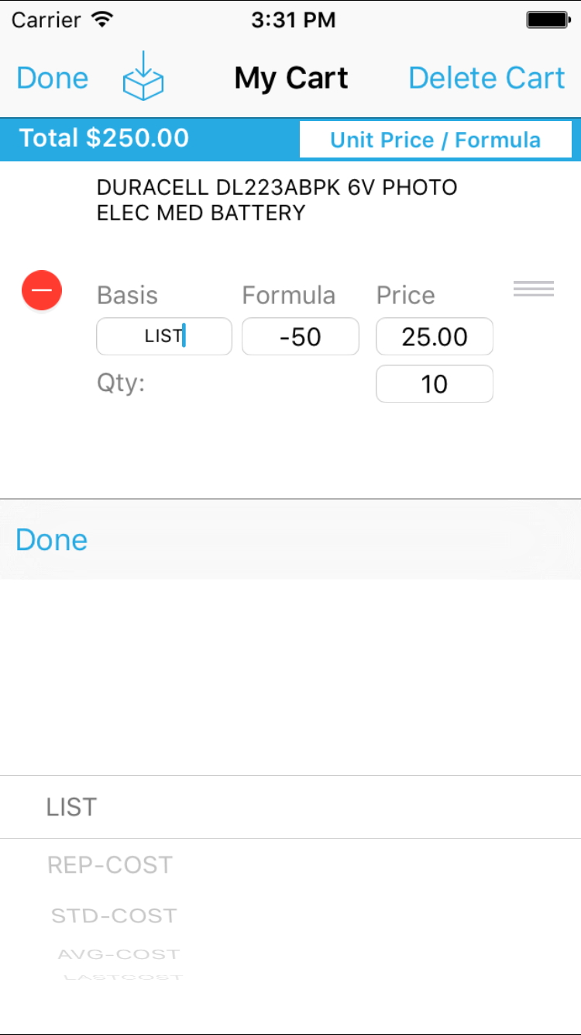
OE Touch 3.4.0 Shopping Cart
Change Price or Basis/Formula
Formula view will allow you to see the same price basis fields as you can in Eclipse
Authorizations needed for Order COGS and Order Cost - SPA views available if site is authorized

Slide 15
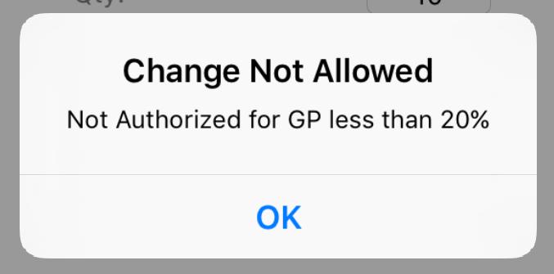
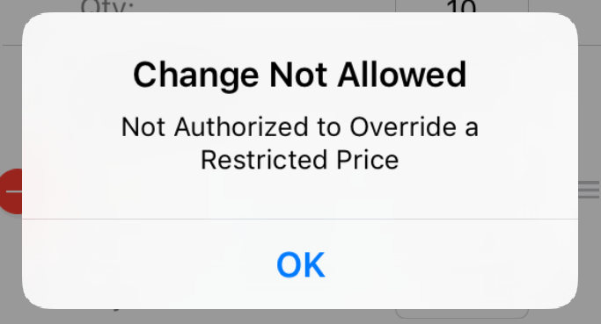
OE Touch 3.4.0 Shopping Cart
If you are not authorized to change price by a certain GP% or if you don’t have the authorization to change a restricted product, customer or matrix, you will receive an error message when trying to change price with the reason.
For example:
If you have a minimum GP of 20% and try to go lower
If you are not authorized to change price on a product, customer, or matrix

Slide 16
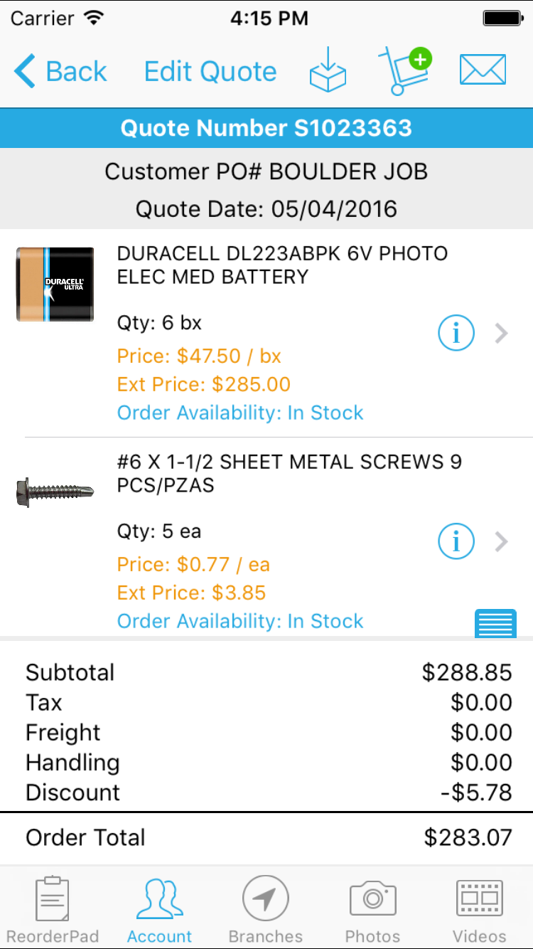
OE Touch 3.4.0 Edit Quote
To edit an existing quote, the following must be true:
Order Views are assigned to user
User has authorization key, SOE.OPEN.PRICE.EDIT
Quote is not expired
The following can be changed in an existing quote:
Change price
Change quantities
Add products / order comments
Add / remove line item comments
Delete products
Re-sequence products
Update Order Header information
Convert Bid to Order

Slide 17
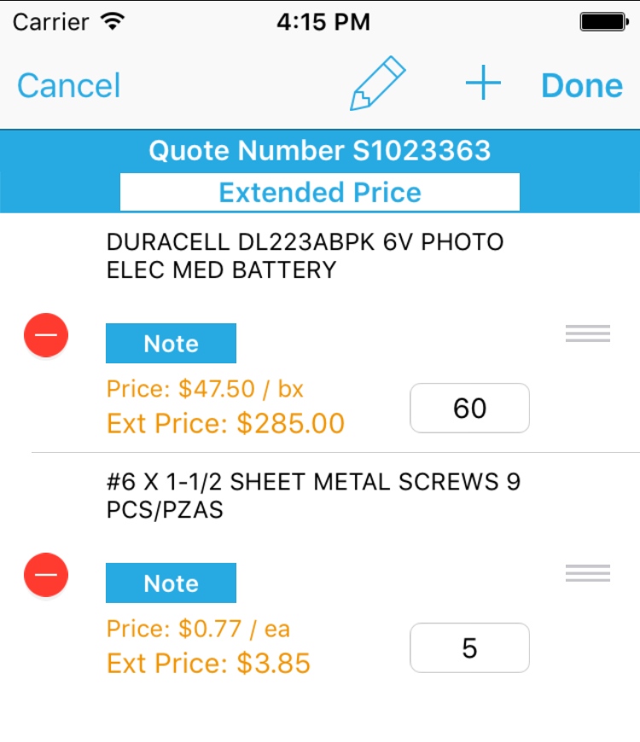
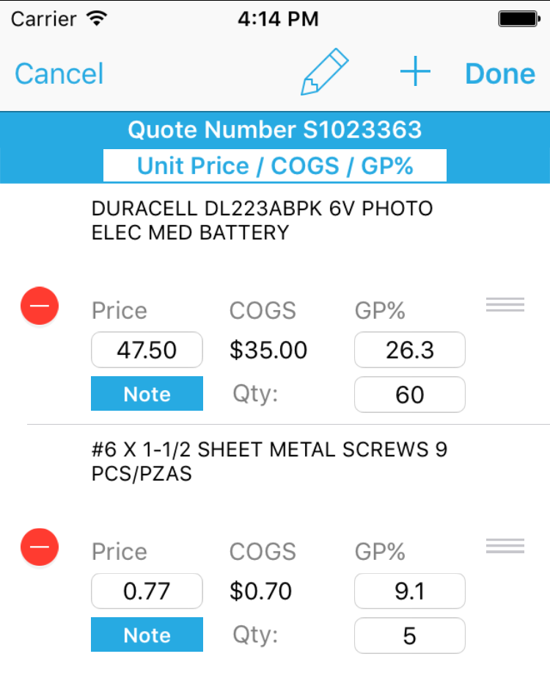
OE Touch 3.4.0 Edit Quote
Use the Order Views button to change view
To delete a product, tap on the red icon to the far left
To re-sequence products, tap on the icon to the far right and drag the product up or down
Use the Pencil icon to edit Order Header info
Use the Plus icon to add a Product or Order Comment
To save changes, press on the “Done” button

Slide 18
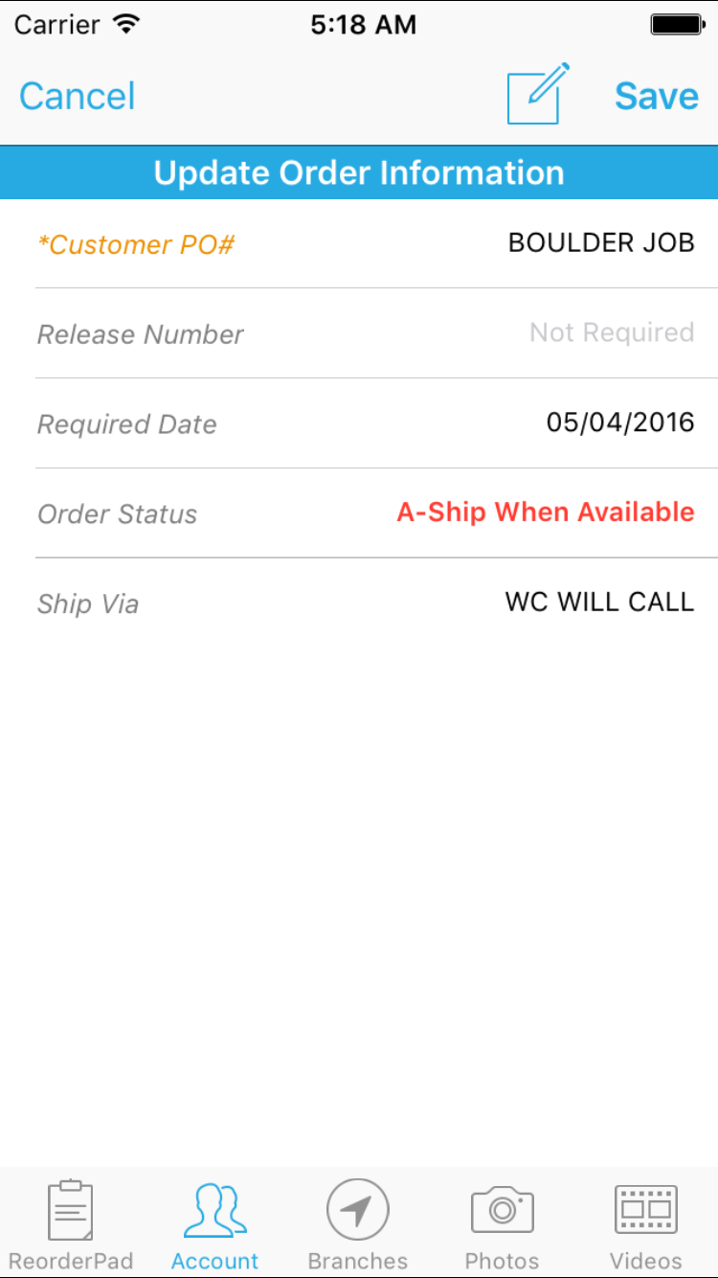
OE Touch 3.4.0 Edit Quote
The following Order Header fields can be updated:
Customer PO
Release Number
Required Date
Ship Via
Shipping Instructions
Internal Notes
Convert Bid to Order

Slide 19
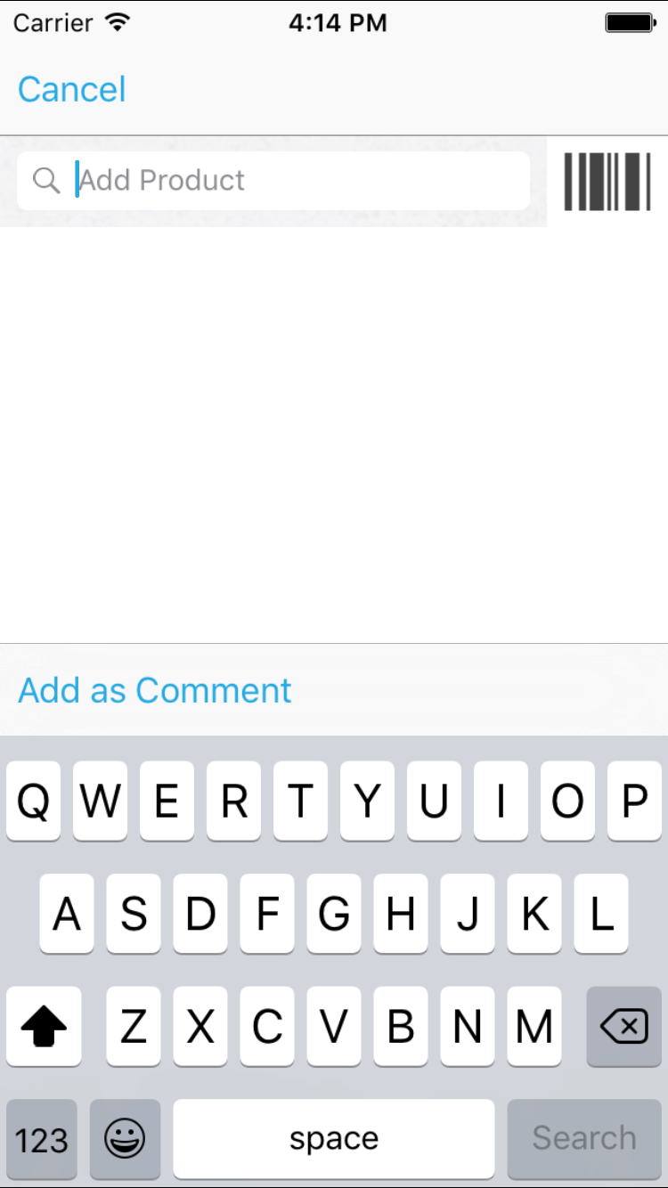
OE Touch 3.4.0 Edit Quote
Search for Product
Add to Order from Product Detail
Or add text as Order Comment

Slide 20
OE Touch 3.4.0 Edit Quote
Order Change Log
When a product is added, deleted, price changed and any header information changes a change log message will be added
When updates happen through the app, the change log message will always happen under user PHANTOM
Because of this, an additional change log message is posted with the following message:
User USER NAME updated order from MOBILE

Slide 21
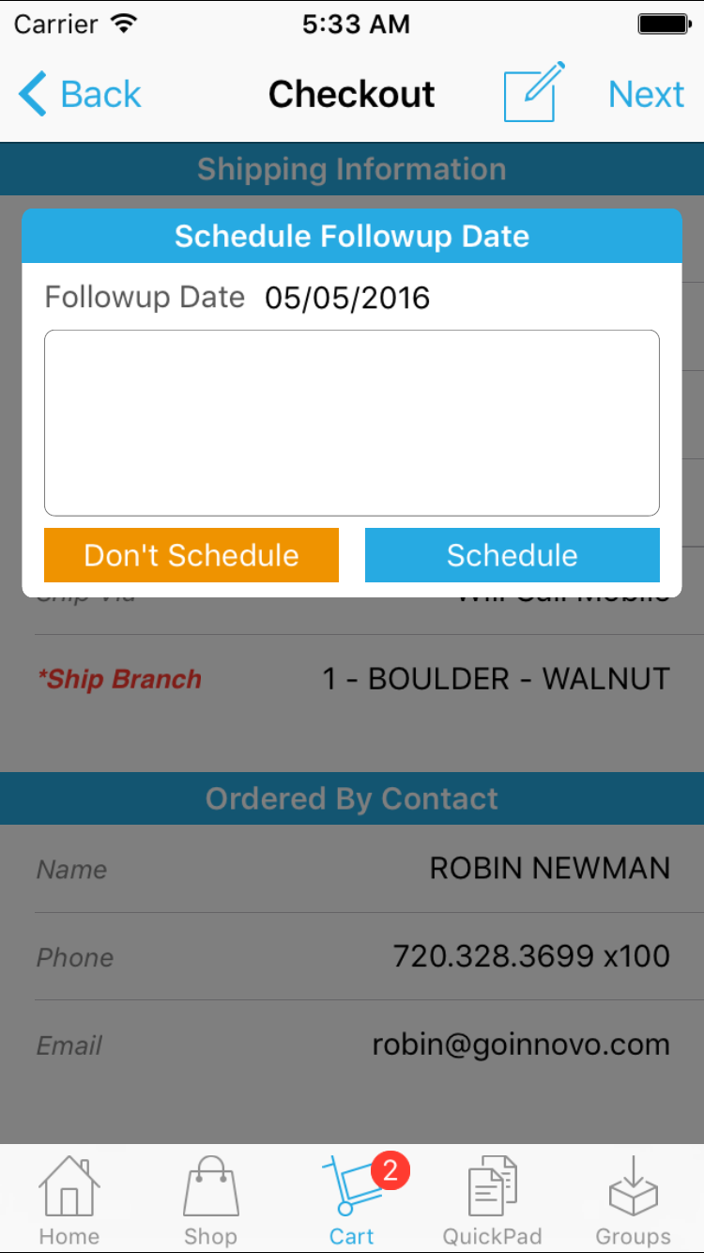
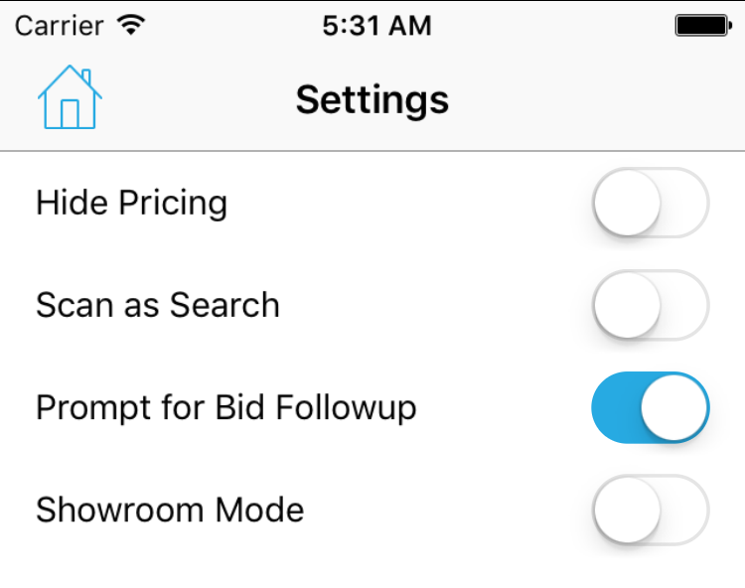
OE Touch 3.4.0 Bid Followup
New Setting in Employee Mode to send bid to Bid Followup Queue in Eclipse
Schedule Followup Date prompt will display during checkout and you can select “Don’t Schedule” or “Schedule” after changing date and adding in optional notes

Slide 22
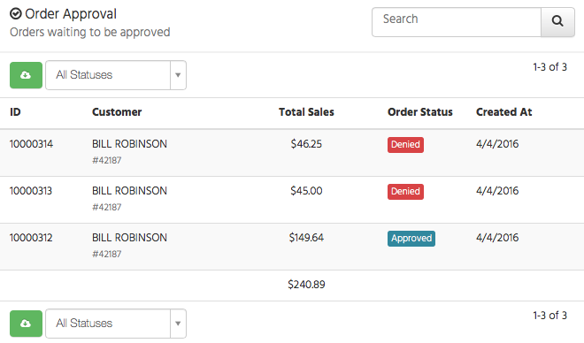
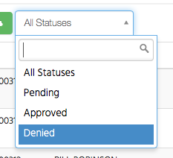
OE Touch 3.4.0 Discover Updates
Order Approval Analytics
Added Order Approval section to Customers Page
You can filter by status to see totals for what was Approved, Denied, and Pending

Slide 23
OE Touch 3.4.0 Discover Updates
Shopping Cart Analytics
Future -> Send push notification to customers with products left in cart over X days!

Slide 24
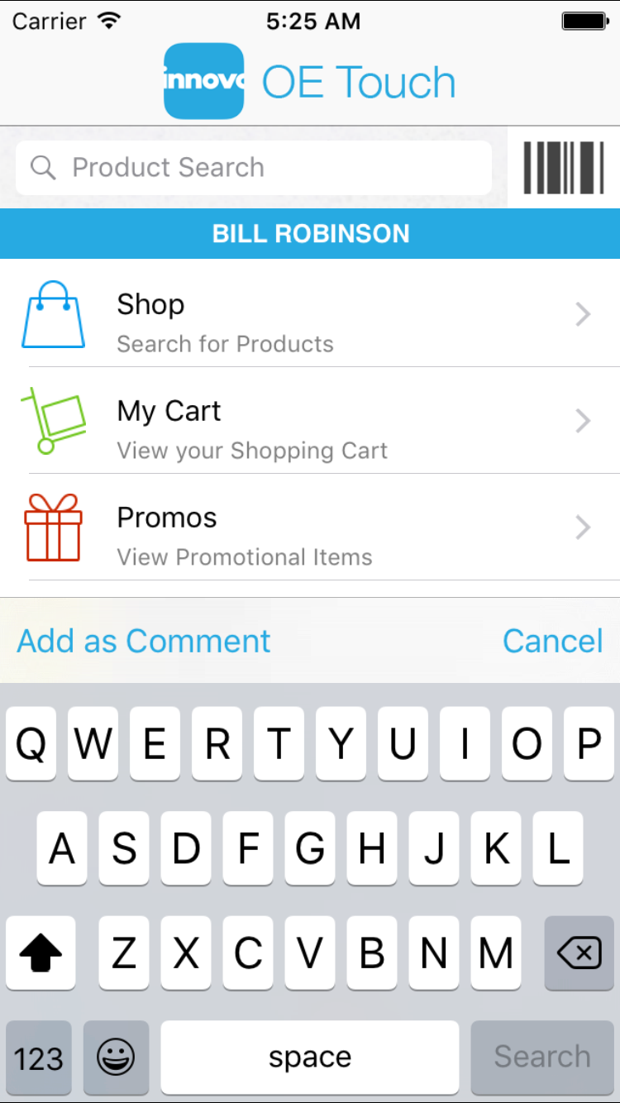
OE Touch 3.4.0 Notes
Product Search fields have been changed to add buttons “Add as Comment” and “Cancel” on the keyboard toolbar
Home screen search
Shop screen search
Quick Pad screen search
Customers will only see “Cancel”

Slide 25
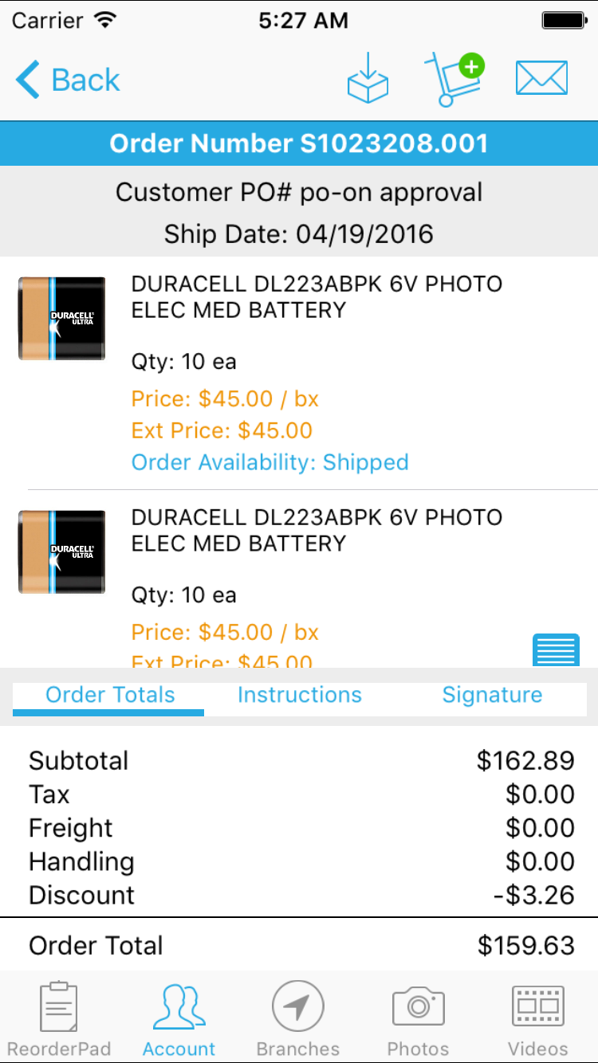
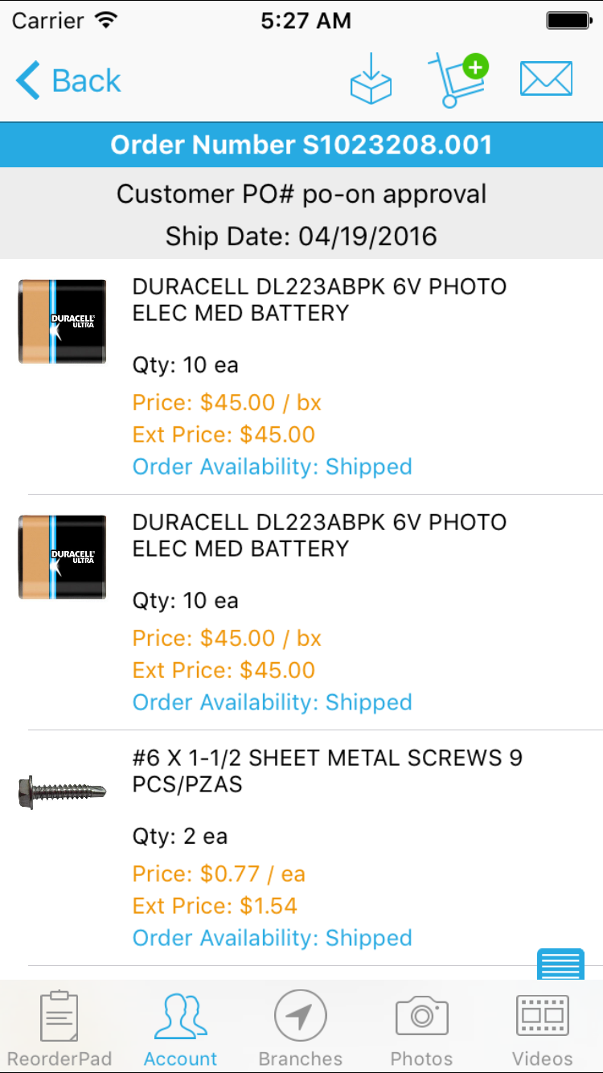
OE Touch 3.4.0 Notes
Dismiss button added to Order Detail in order to see more products and hide totals, instructions, and signature box

Slide 26
OE Touch Common Questions

Slide 27
OE Touch
User Cannot Login:
Wrong username or password
No connectivity to our Portal – Device must be able to reach portal.goinnovo.com to login
Contact-level settings are not working:
Contact must have WOE username in Eclipse
User’s “ERP” info in Portal must match WOE Username (incl. case)
How to submit a quote and retain any special pricing?
Using the Add to Cart button in a quote will recheck pricing and availability
Use the Edit Quote feature instead to alter an existing bid and retain any special pricing

Slide 28
OE Touch
How can I setup a specific customers or employees to see different order statuses in the App?
For Customers, use the Valid Stats hotkey in Customer Remote Maintenance, or our contact-level Valid Stats hotkey in the Innovo Mobile Contact Authorizations user defined screen
For Employees, use the Innovo OE Touch Valid User Order Statuses control file for all employees, or our User-level Valid Order Stats setting in the Innovo Mobile User Authorizations user defined screen

Slide 29
OE Touch
How can I setup specific customers or employees to see different Ship Vias in the app?
For customers, use the Ship Vias hotkey off of Customer Remote Maintenance
For employees, use the Innovo OE Touch Valid User Ship Vias control file for all employees, or use the Valid Ship Vias setting in our Innovo Mobile User Authorizations user defined screen

