Slide 1
Signature Touch 2.6.0 Webinar
Robin Merrion
Drew Mapplebeck
January 24, 2017

Slide 2
What’s New in 2.6.0
New User Interface (UI) Design
Larger signature box in all modes
Display your Terms & Conditions
Display the staging location in will-call mode
Ability to select printer when signing in will-call
Ability to consolidate stops in truck mode
Ability to add a lunch break
Ability to send a text message and/or email when delivery is complete

Slide 3
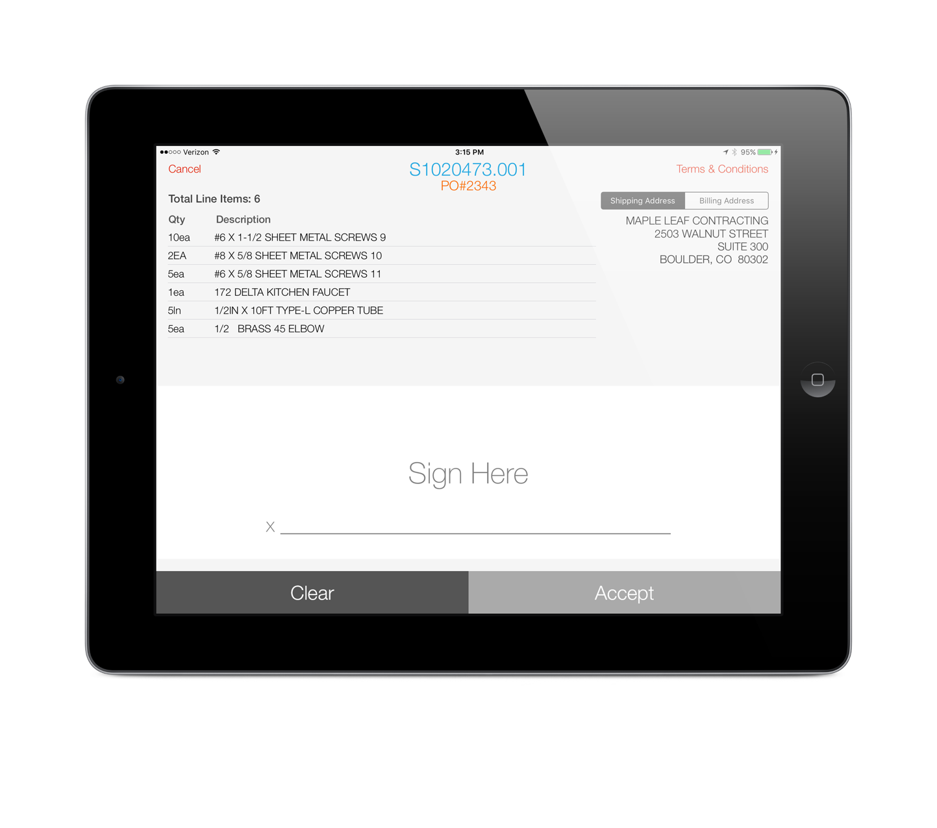
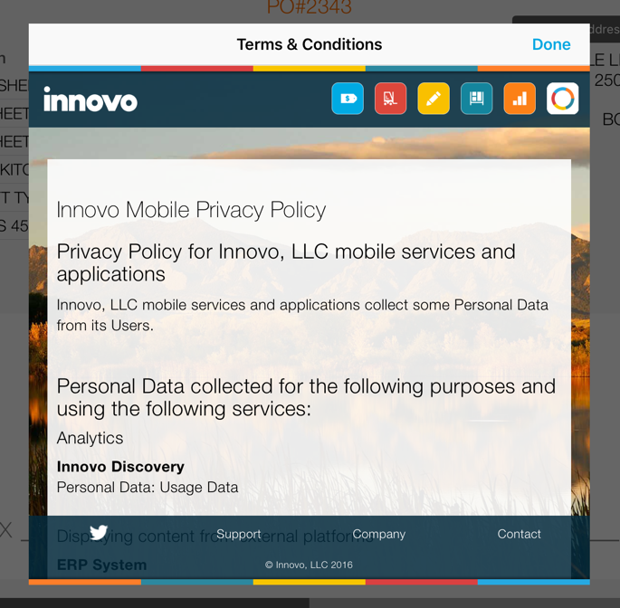
Counter Mode

Slide 4
Terms & Conditions URL
New branch specific control file, “Innovo SigTouch Terms & Conditions URL”
In Counter and Will-call modes we use the price branch of the order when checking the control file
In Truck mode we use the manifest branch

Slide 5
Banner Color Theme
New setting under Banner section
Applies to both Counter and Will-Call (if the Enable Banner setting is enabled for Will-Call)
If Banner Type is set to Text, the new banner color theme will apply to the background, the sign order button, and the settings button
If Banner Type is not set to Text, the new banner color theme will apply just to the sign order button and settings button

Slide 6
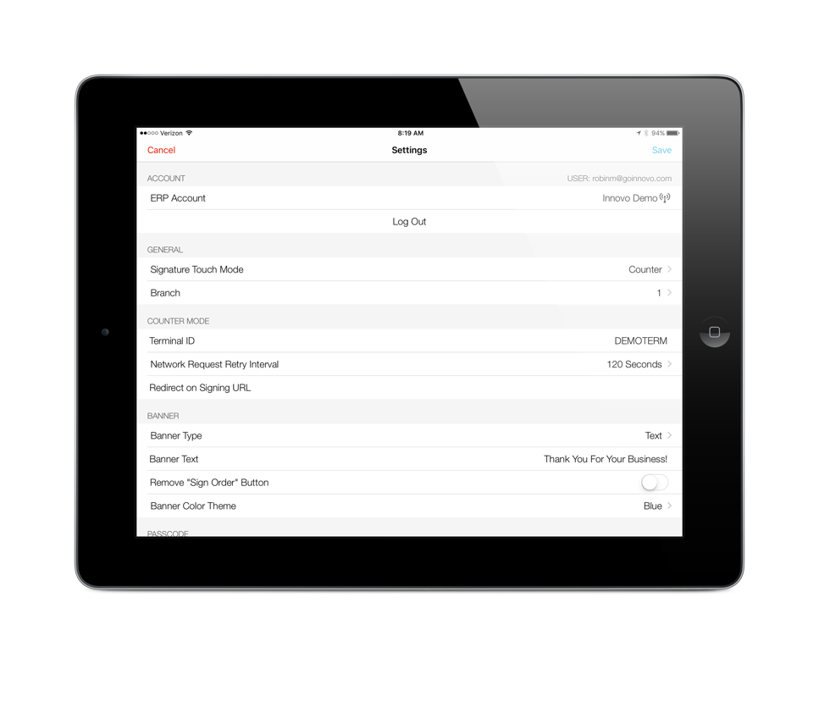
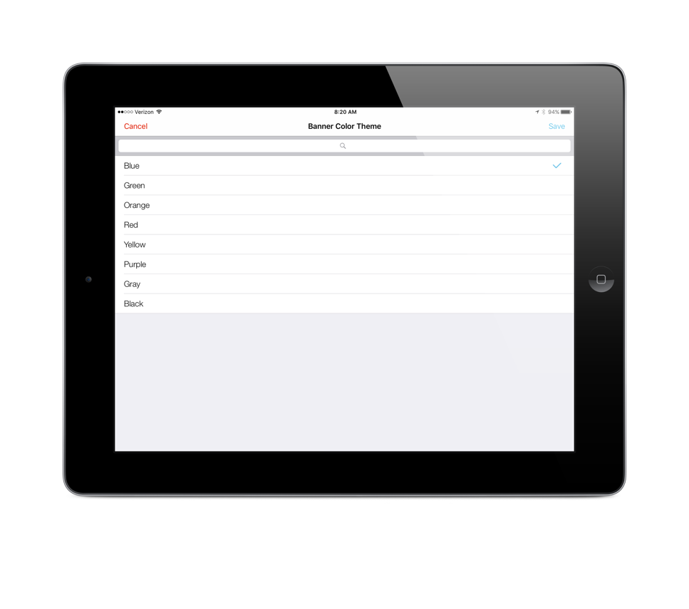
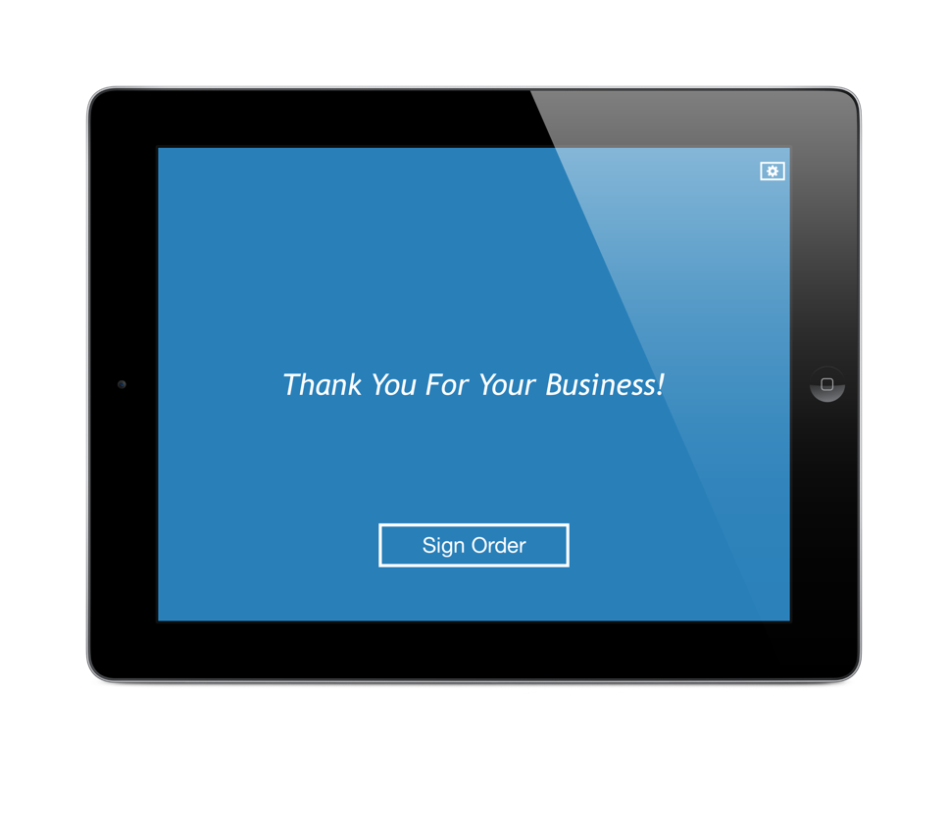
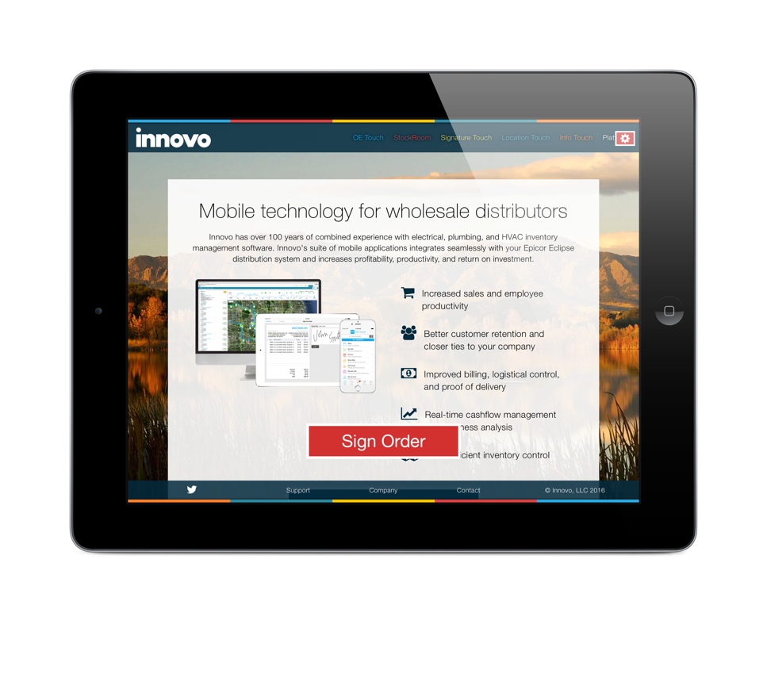
Banner Color Theme
Banner Type is URL and Color Theme is Red

Slide 7
Will-Call Mode
Ability to display staging location and package quantities for each order
New control file, “Innovo SigTouch Display Staging Location in Will-Call Mode”
Ability to select printer after customer signs
New setting, Enable Printer Select at Signing

Slide 8
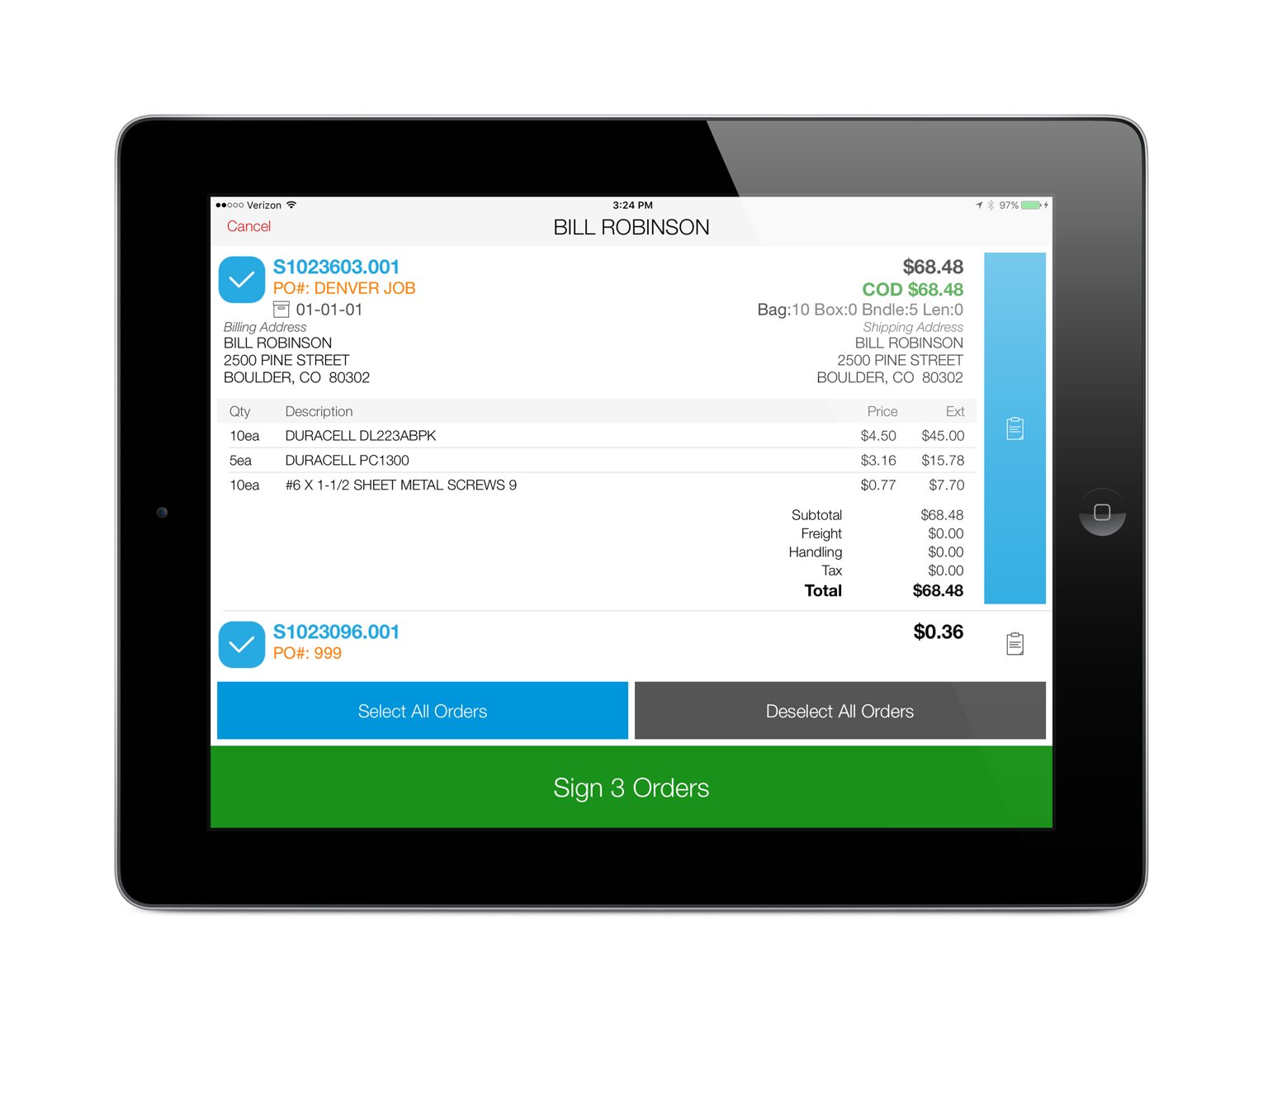
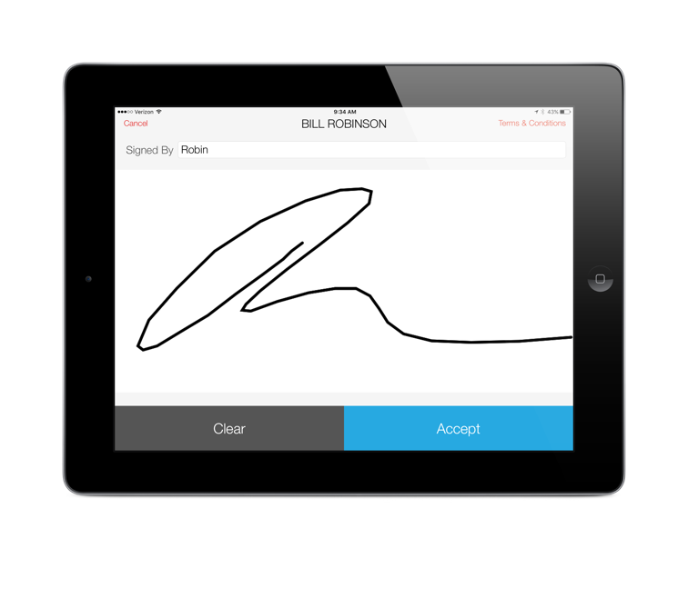
Staging Location
Here is an example of the large signing screen in will-call mode.
One change to note here, if you require a signed-by, the Accept button will not highlight from gray to blue until you enter in the signed-by

Slide 9
Enable Printer Select at Signing
The new setting is only available if current setting Enable Printing is set to either “Printing Enabled – Default Yes” or “Printing Enabled – Default No”
If you want users to have access to multiple printers within a single printer location, set the Printer Locations setting to that single printer location and set the Printer setting to the printer in that location used more often

Slide 10
Enable Printer Select at Signing
If you want users to have access to multiple printer locations, the Printer Locations setting now allows you to select multiple locations that the user will select from after the customer signs
You will still need to set a default printer in the Printer setting and printers across all of the printer locations selected will be available

Slide 11
Enable Printer Select at Signing

Slide 12
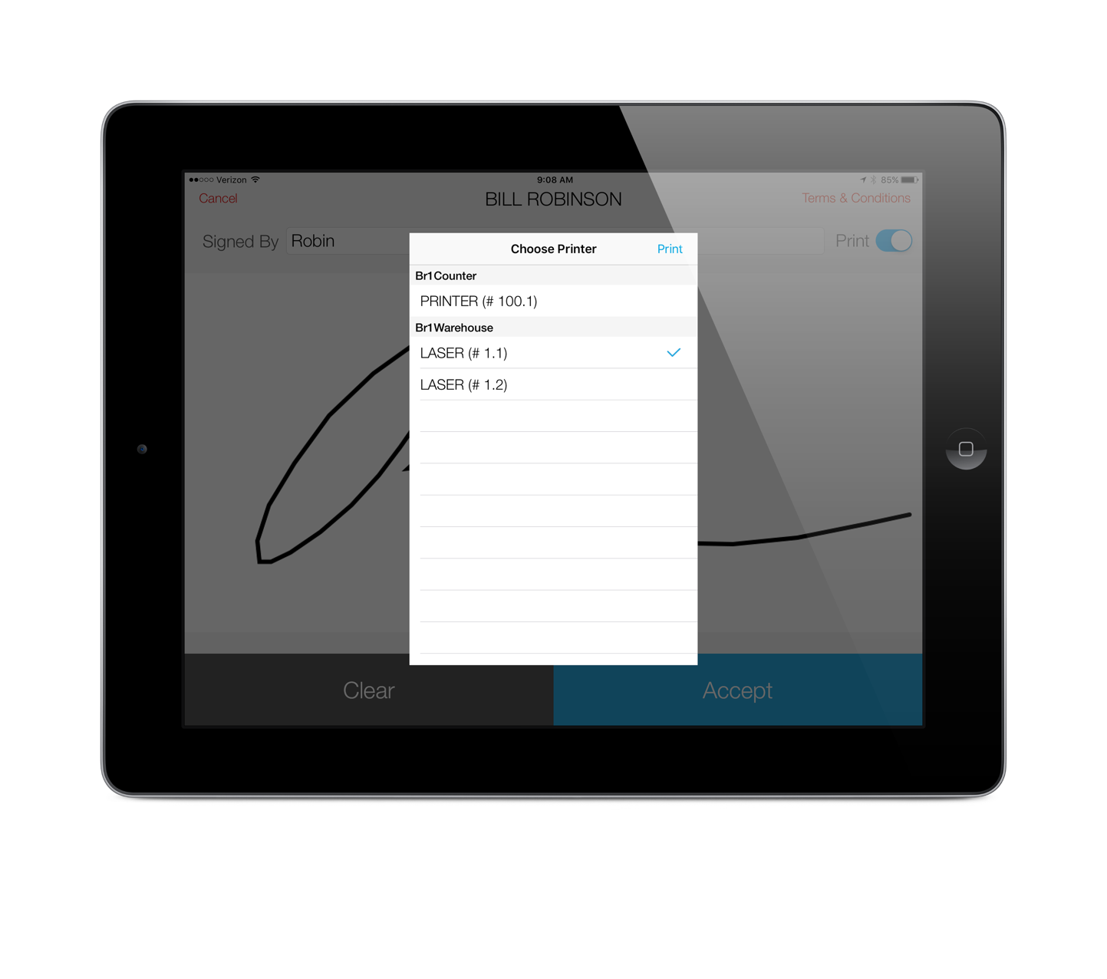
Enable Printer Select at Signing
The default printer will be selected – to use that printer, just press the Print button. To use a different printer, select that printer from the list and then press the Print button.
If the user does not press the Print button, the ship ticket will automatically print in 15 seconds and the next customer’s orders will be available for selection

Slide 13
Note on Settings
Some settings will not display by default. For example, if you do not enable printing in will-call mode, you will not see the settings to select a printer or printer location.

Slide 14
Truck Mode
New Settings
Use Login Account as Default Driver
Enable Log Out from Select Menu
Enable Stop Consolidation/Grouping
Enable Address Matching
Enable Break Times
Enable Take Me Home

Slide 15
Truck Mode
Use Login Account as Default Driver
If you have drivers share iPad’s
If each driver logs in with their own login
If the driver login is assigned to the driver’s eclipse user ID that is used on the manifest
If all of the above is true, enable this setting so when a driver logs in, only their manifests will display in the select manifest screen

Slide 16
Truck Mode
Enable Log Out from Select Menu
If the previous setting applies to you, also enable this setting so you don’t have to give the user access to settings to log out

Slide 17
Enable Stop Consolidation/Grouping
The Eclipse manifest will only place orders for the same ship-to customer with the same address on a single stop. This could result in your customer signing multiple times for their delivery.
This setting allows you to consolidate all stops across the manifest for those ship-to’s rolling up to the same bill-to

Slide 18
Enable Stop Consolidation/Grouping
Enable Address Matching
If you only want to consolidate stops for ship-to’s rolling up to the same bill-to that have the same shipping address
By same shipping address, we literally mean the address must match exactly.
Example: ST does not equate to STREET
The next version of Sig Touch will allow the driver to manually group stops

Slide 19
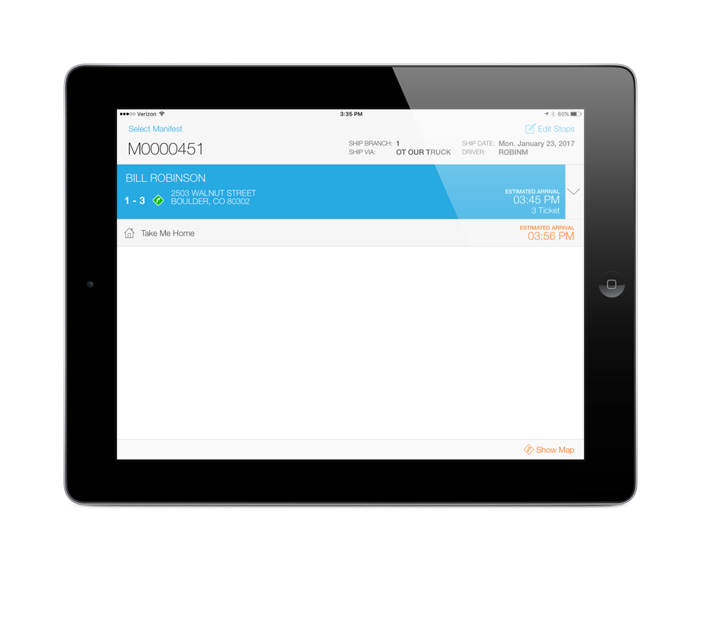
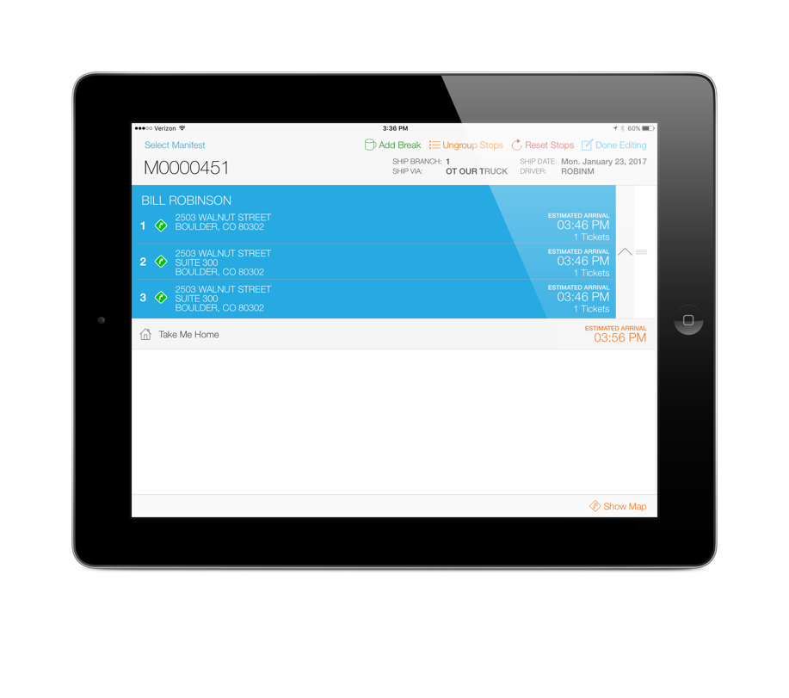
Enable Stop Consolidation/Grouping
In this example, all three stops roll up to the same bill-to and have similar but not exact addresses.
The Eclipse manifest shows these as three separate stops.
Enable Address Matching is not currently set so all three stops will be consolidated, by default.
If Enable Address Matching was set, only stops 2 and 3 would be grouped.
Also note when stops are grouped, the estimated delivery times do not include stop time padding.

Slide 20
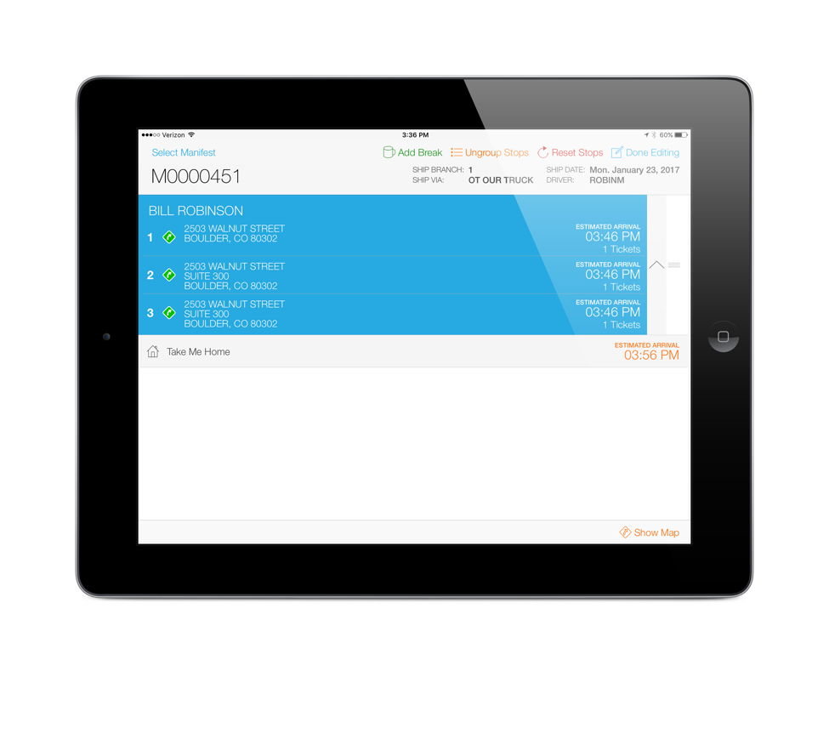
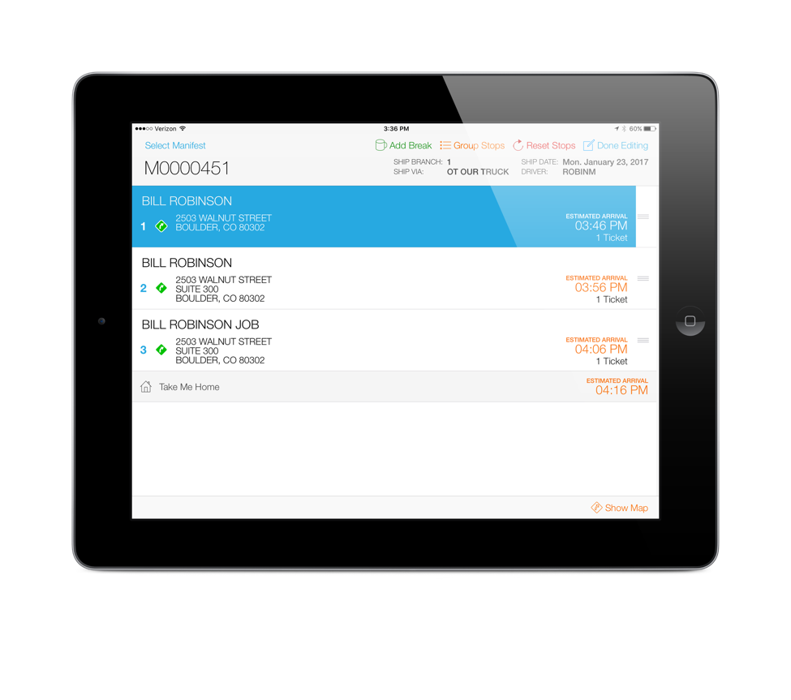
Enable Stop Consolidation/Grouping
The Edit Stops button has a new option, Ungroup Stops.
If the driver chooses to ungroup the stops, the stops will be ungrouped and the padding times will be added back to each stop.
Note, to ensure the stops match the Eclipse manifest exactly, have the driver press the “Reset Stops” button after ungrouping.

Slide 21
New Mapping Features
In order to provide better estimated delivery times per stop and on the entire route, we’ve added two new settings:
Enable Break Times
Enable “Take Me Home”
In order to take advantage of all the mapping features, including the calculation of estimated delivery times, you must be subscribing to our Google API service

Slide 22
Enable Break Times
Setting Enable Stop Editing must be enabled
Pressing the Edit Stops button will display a new button called Add Break
You can add multiple break times during the route or a break before returning back to the branch
Break times default to 30 minutes but can be adjusted and will be calculated into the estimated delivery times

Slide 23
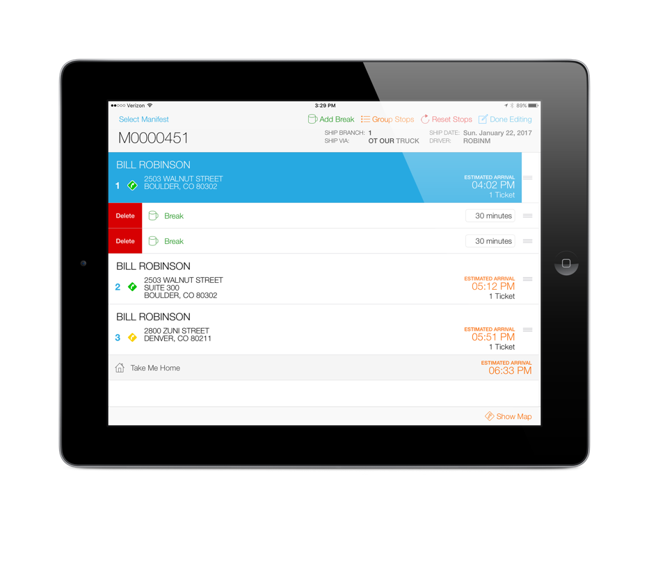
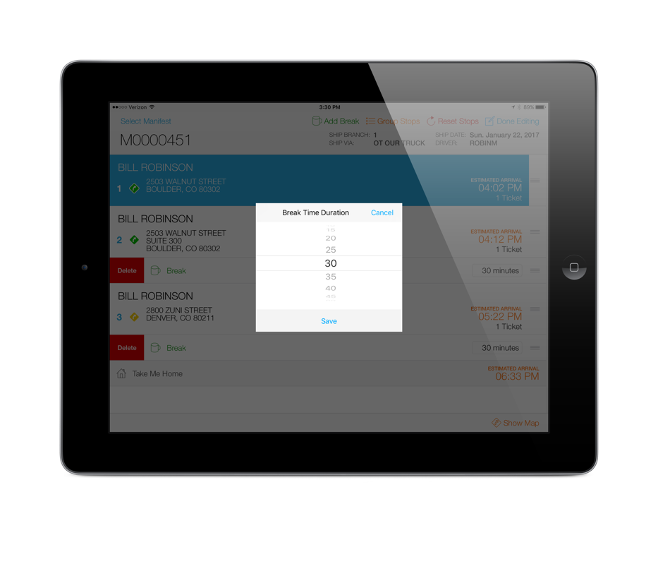
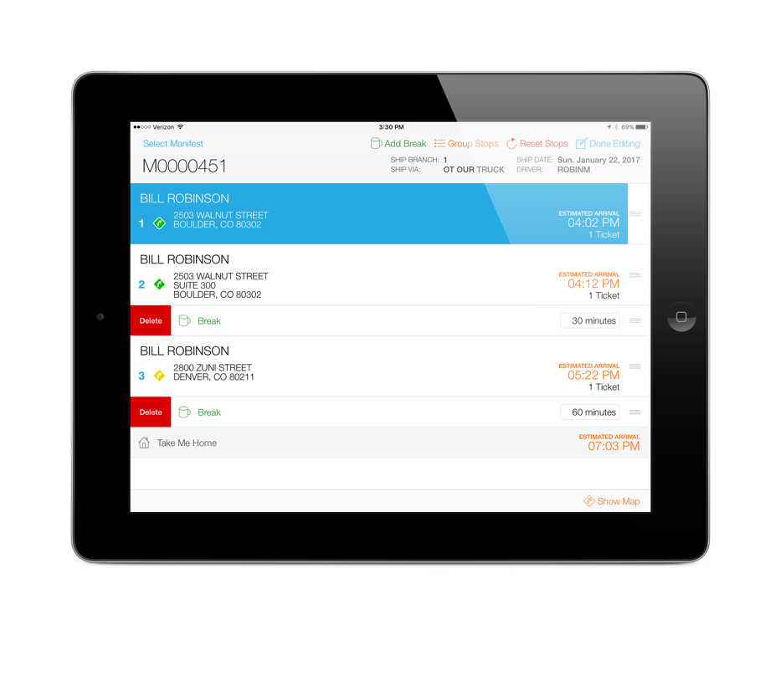
Enable Break Times
When a break is added, it will be inserted below the current stop but can be moved to the appropriate stop position
To change the duration of a break time, tap on the break time label in Edit mode

Slide 24
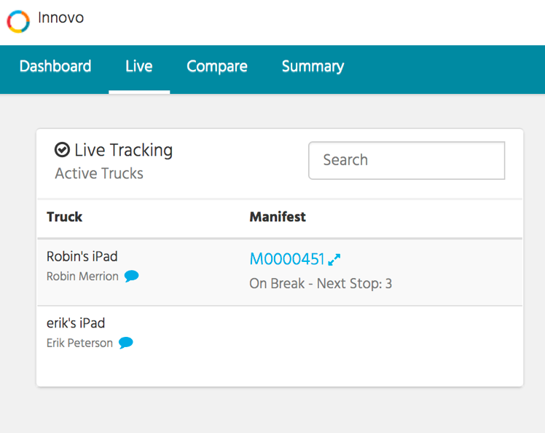
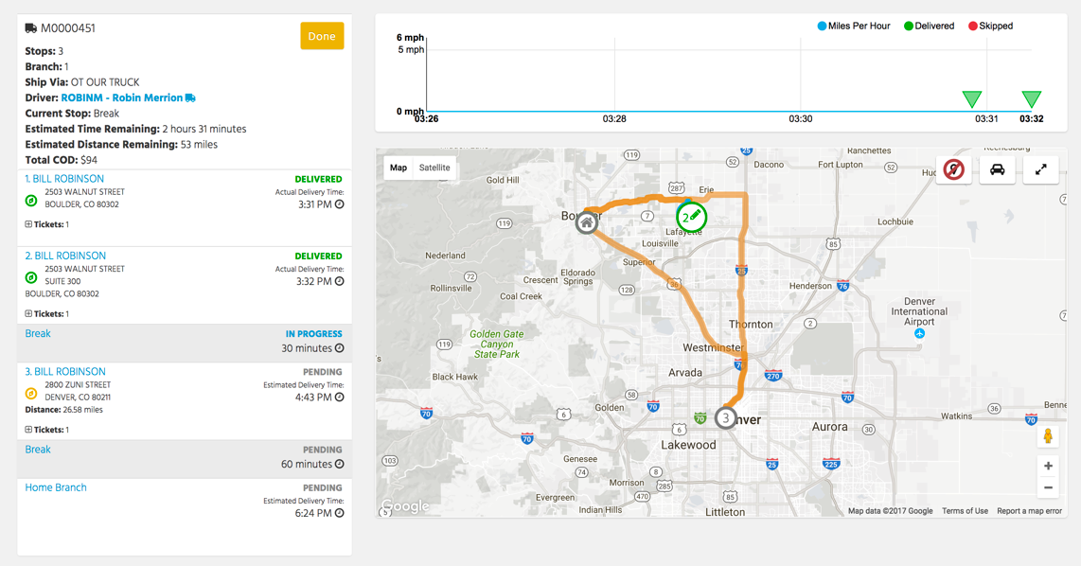
Enable Break Times
During the break, Deliver will display the break in progress

Slide 25
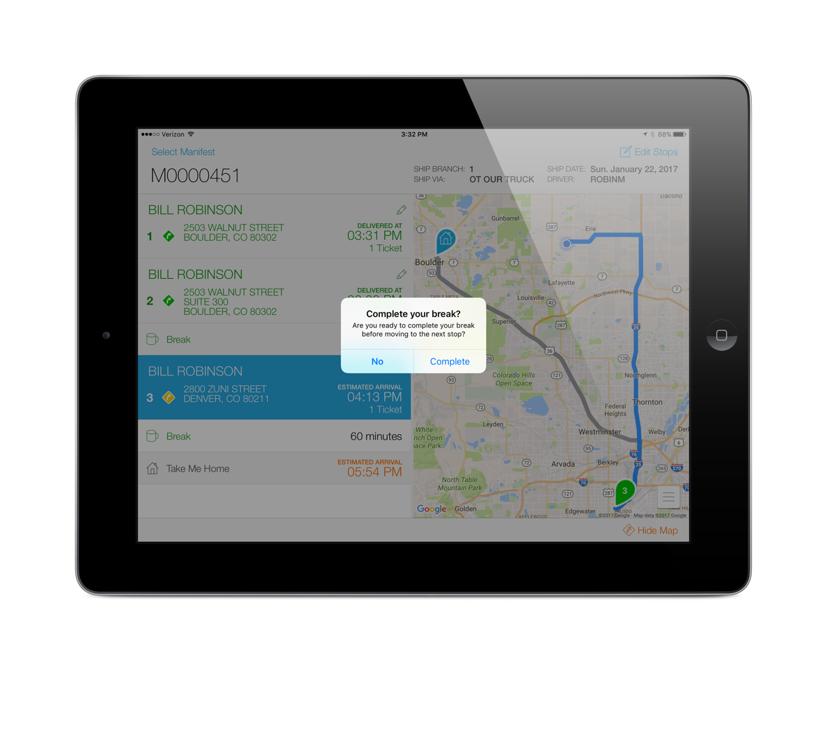
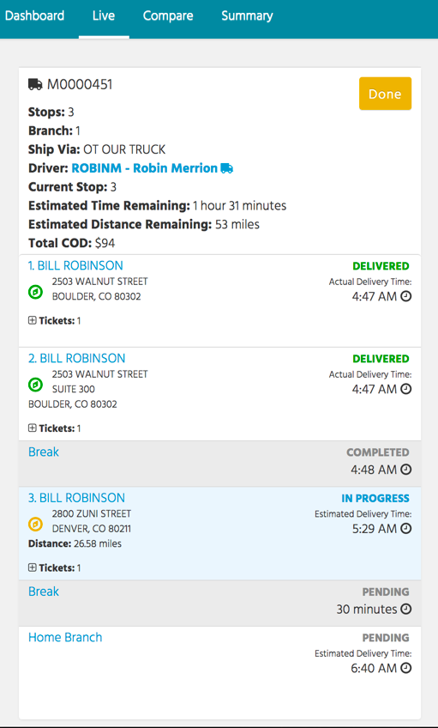
Enable Break Times
To complete the break, tap on the next delivery and you will be prompted to complete. If you answer No, the break will auto-complete once the next stop is completed.
The completed delivery time will display in Deliver

Slide 26
Enable “Take Me Home”
The current app store version does not automatically track the truck on it’s way home unless the driver waits to complete the manifest when he returns home
And, Deliver does not currently include the estimated miles and time remaining for the trip back to the branch
This setting attempts to address those issues

Slide 27
Enable “Take Me Home”
When this setting is enabled, a new stop will be added to the end of each route and just like a regular stop, will provide the driver turn-by-turn directions back to the originating branch
Some drivers may want to even add a break before returning back to the branch
Note, the driver will be prompted to complete and close the manifest after the last actual delivery

Slide 28
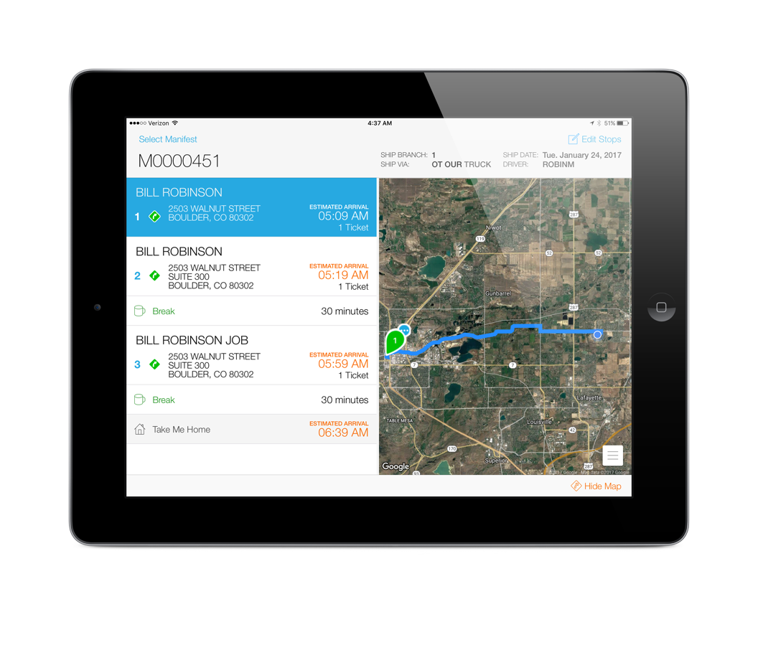
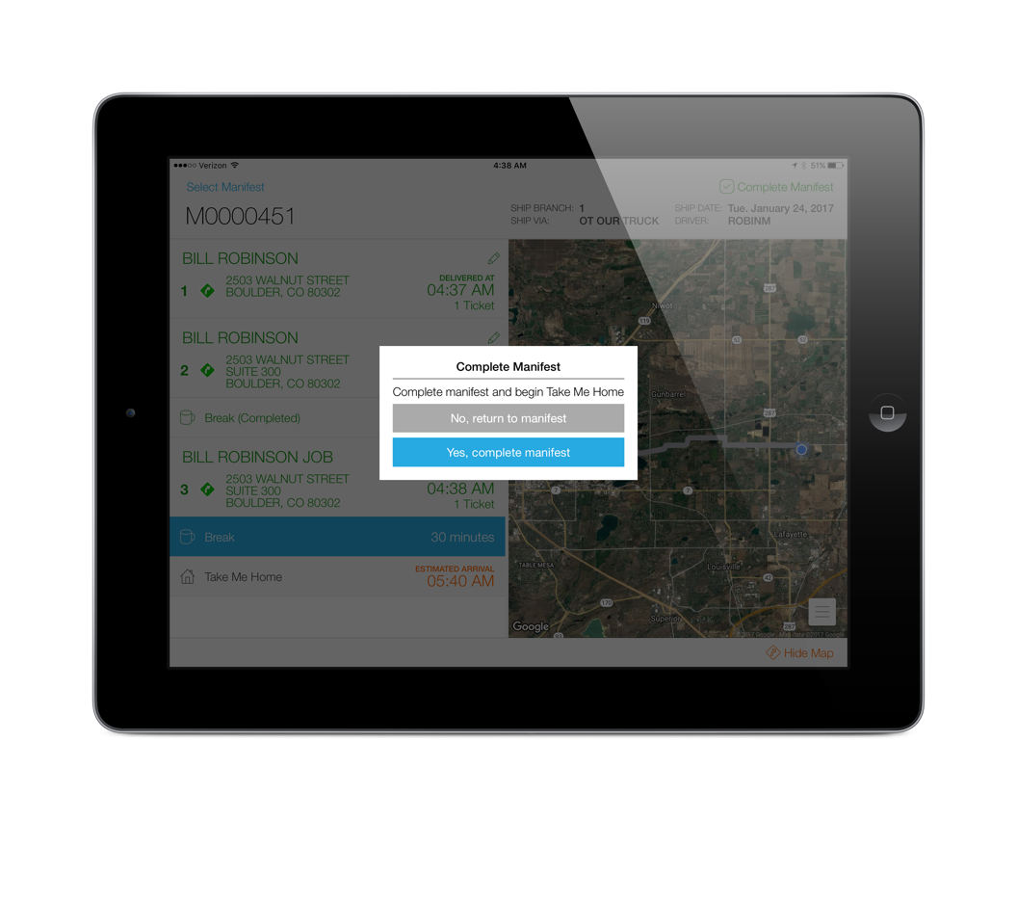
Enable “Take Me Home”
A new stop will be added to each manifest
The last delivery is stop 3 so when that is completed, the driver will be prompted to complete the manifest

Slide 29
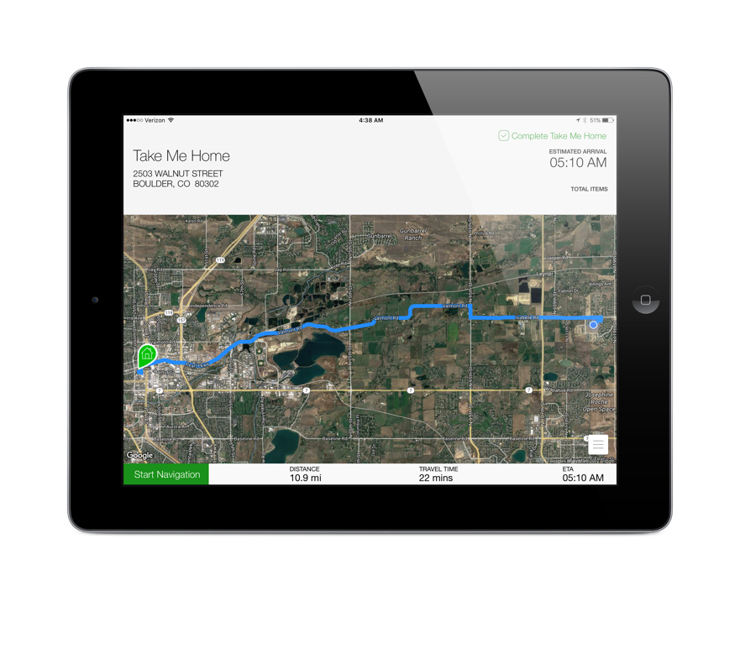
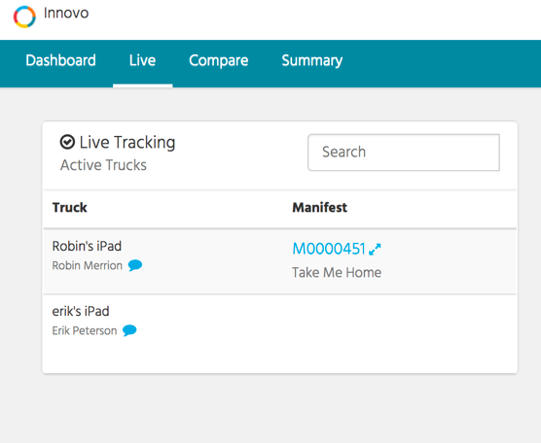
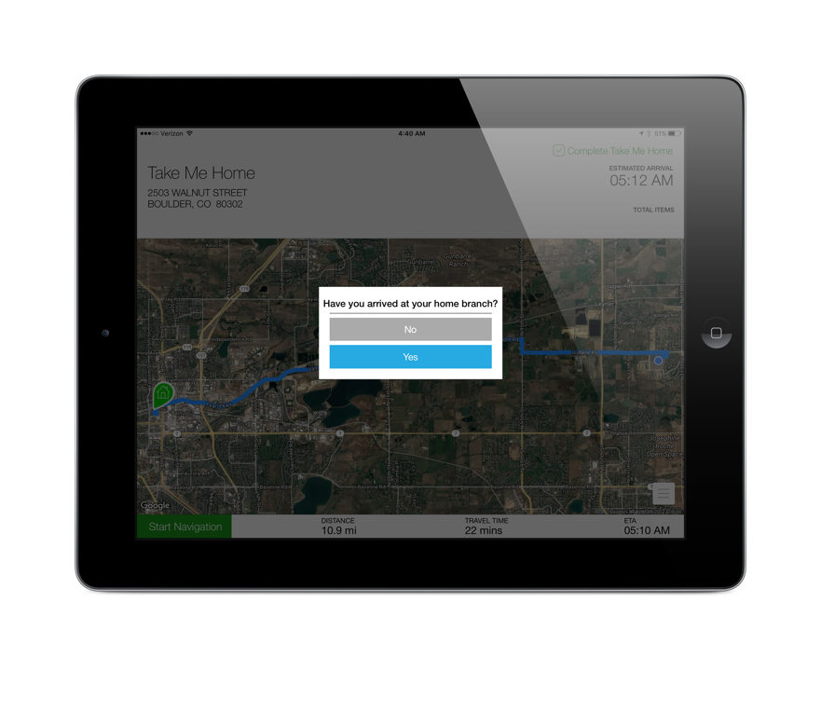
Enable “Take Me Home”
Deliver will show the driver is on their way home
After the last delivery / break, the driver will be taken to the “Take Me Home” map that provides turn-by-turn directions back to the originating branch
When the driver is back at the branch, they will press the “Complete Take Me Home” button

Slide 30
Delivery Notifications
There are now three types of notifications you can enable once a stop has been completed
Push
Text
Email
You can set up your customers to receive all three, a combination, or only their preferred type
Push notifications are only available to those customers that have OE Touch

Slide 31
Push Notifications
To send your customer a push notification when their order has been delivered,
Enable the contact to receive ”Delivery Notifications”
Ensure device is enabled for Push Notifications

Slide 32
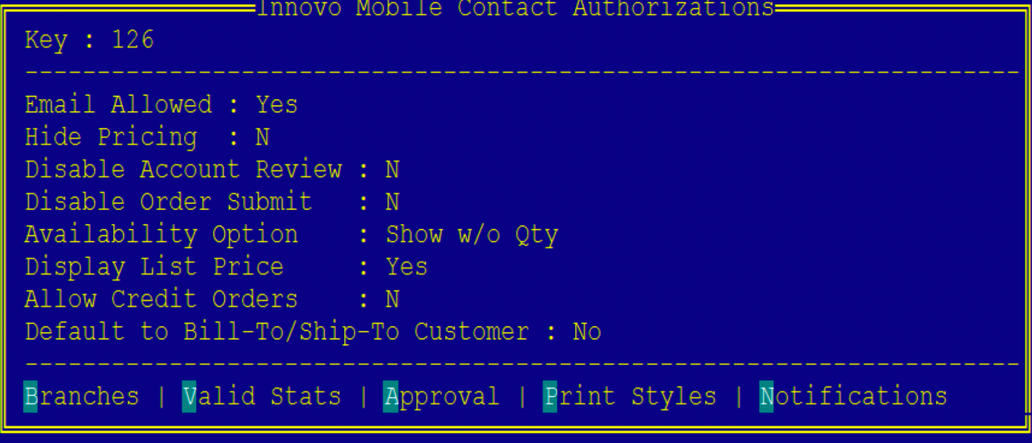
Push Notifications
Enable the contact to receive ”Delivery Notifications”

Slide 33
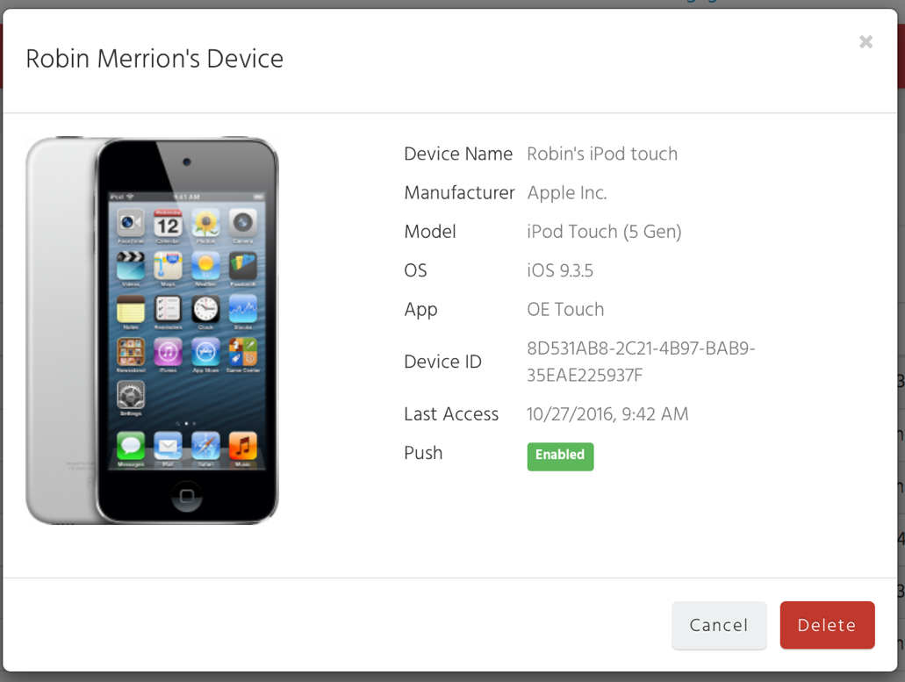
Push Notifications
Ensure device is enabled for Push Notifications in the Customer Portal
Manage > Devices

Slide 34
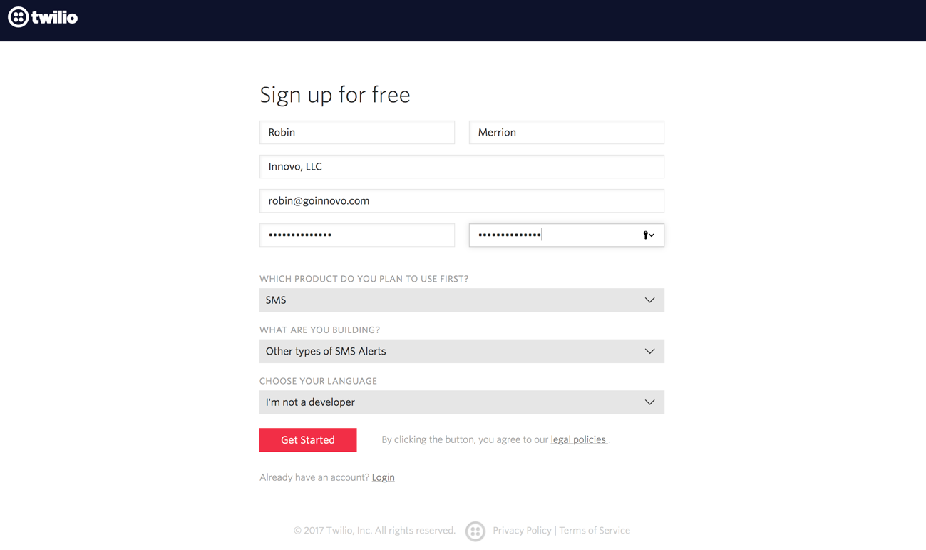
Text Notifications
In order to send text notifications, you will need to create a Twilio account
https://www.twilio.com/try-twilio

Slide 35
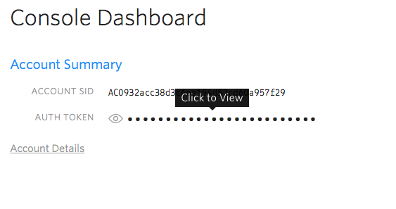
Text Notifications
Get Started with SMS
Get your first Twilio number and follow steps
From your Console Dashboard, find your Account SID and Auth Token

Slide 36
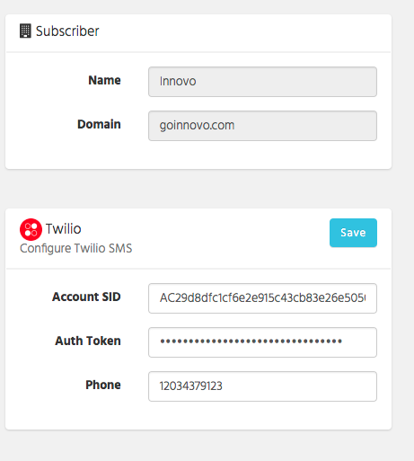
Text Notifications
You will enter the Account SID, Auth Token, and phone number in the Customer Portal
Manage > Settings

Slide 37
Pricing
$1.00 / month per local phone number
$.0075 per SMS message
$.02 per MMS (picture – future)
If you have branches across multiple area codes, you may want to set up multiple local phone numbers in Twilio
There is no restriction in use of a single number but your customers may like to receive the notification from an area code they recognize

Slide 38
Pricing
If you want to utilize a different phone number per branch or territory, use new control file, ”Innovo SigTouch SMS Override for Delivery Notification”
We use the ship branch of the order to determine if there is an override
You must still enter a phone number in the Customer Portal – this can be the most frequently used number

Slide 39
Pricing
Monthly fee = $1.00
If you had 10 trucks & 25 deliveries, that would equal 10 * 25 * .0075 = $1.875 / day
If you deliver 22 days of the month, that would equal 22 * 1.875 = $41.25 + $1.00 = $42.25 / month
If you had 4 trucks, the cost would be $17.50 / month

Slide 40
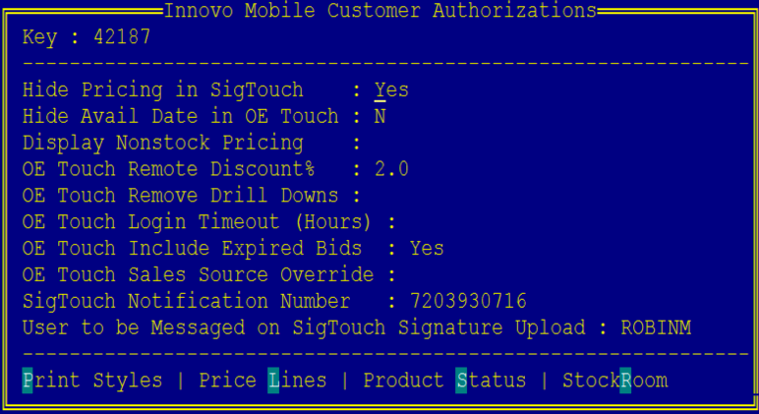
Text Notifications
In Eclipse, you will store the customer’s cell phone number in the Innovo Mobile Customer Authorization UD screen located in Customer Maintenance

Slide 41
Text Notifications
We do provide a UD screen that you can assign to Sales Order Entry to allow users to override the customer’s cell number at the order level
You will need to manually add this to an F-Key in Eterm or Solar
From the SOE screen (body, status, or header), invoke the Alt-F12 (Eterm) or Ctrl-F12 (Solar) keys and assign the UD screen and Pass ID

Slide 42
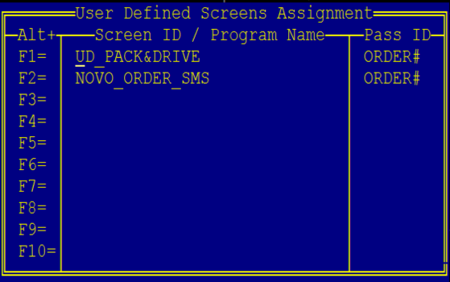
Text Notifications
In this example, the user will invoke Alt-F2 (Eterm) or Ctrl-F2 (Solar) while in the order
Enter the phone number (you can enter the 1 but it is not required)
You can also disable an order from text messaging if the customer has a default cell assigned

Slide 43
Email Notifications
New Activity Trigger, Innovo Delivery Notification that you will assign at the customer level (normal hierarchy rules respected for checking ship-to and then bill-to)
Enter in all email header information
To, CC, BCC, Subject
Body of email will be defined in the portal

Slide 44
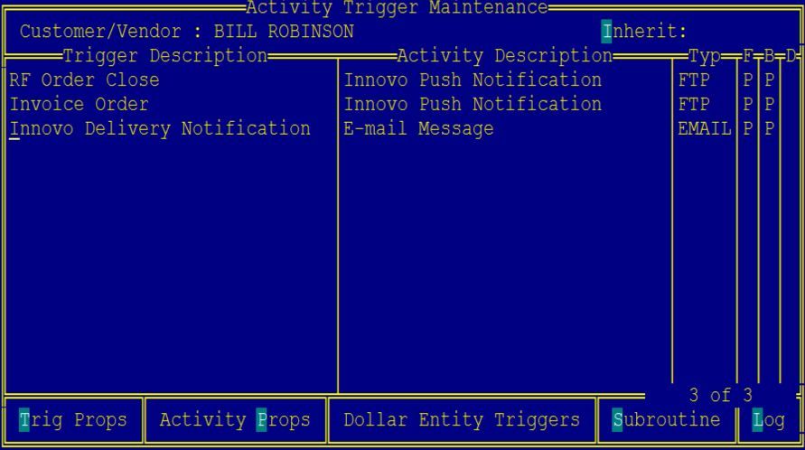
Email Notifications

Slide 45
Email Notifications
Define body of email in the Customer Portal
Manage -> Content
Create an Email Template called DeliveryNotification that will be used for all notifications unless you have a branch override
If you want to create branch / territory specific override templates, define the template names in new control file, “Innovo SigTouch Template for Delivery Notifications”

Slide 46
Email Notifications
If the system cannot find the appropriate template name defined in the Customer Portal, a delivery notification email will not be sent.
We use the ship branch of the order to determine if there is an override.

Slide 47
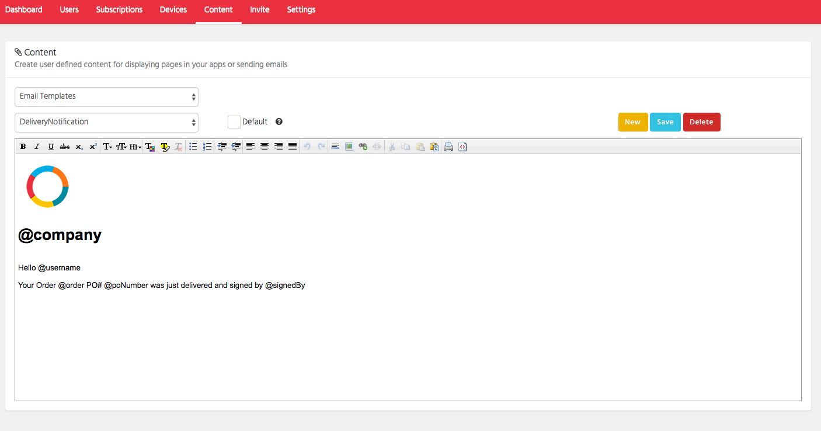
Email Notifications
The following tokens are supported in the template:
@company (name of your company)
@username (name of the ship-to customer defined in Eclipse)
@order (order.invoice)
@poNumber (purchase order number)
@signedBy (signed by user entered in Signature Touch)
@signedAt (address where the order was signed, if connected at signing)

Slide 48
General Notes
In order to troubleshoot connectivity, we’ve added an icon next to the account name in settings that will show you if the iPad is able to reach our service
Connected
Not Connected

Slide 49
General Notes
We removed the Begin Delivery button from Truck mode as the delivery begins when either of the following happens – this is true in the current app store version as well
Driver has selected a manifest and tapped on any stop
Driver has selected a manifest and started driving

Slide 50
Next Steps
Version 2.6.0 will be available for download on the App Store on Sunday, February 12
We will be upgrading the Innovo code on your server on the morning of Sunday, February 12
If you have any concerns about the upgrade, please email robin@goinnovo.com ASAP

Slide 51
What’s Next
iPhone support for Truck mode (2017)
Android support for Truck mode (2018)
Deliver PRO
Subscription based add-on to Signature Touch
Aggressive timeline for 2017
Beta ~ August
G/A ~ November (phased delivery)
FMCSA mandate = December 18, 2017

Slide 52
Deliver PRO
Support for OBD-II devices (GoPoint Technology)
Idle time, hard breaking, speeding, acceleration
Driver Vehicle Inspection Reports (DVIR)
Compliance
Electronic Logging (ELD) – FMCSA mandate December 18, 2017 – when trucks go across state lines or > 150 mile radius from the branch
IFTA reporting support
Truck Maintenance support w/ real-time alerts
Driver scoring / reward system

Slide 53
Deliver PRO
Fuel-card integration
Route planning support
Think of dragging and dropping sales orders in a web based tool to auto-build your manifests!
Geofencing based real-time arrival time updates to end-customer
Real-time admin alerts for Geofencing violations, speeding, etc.
End-customer Portal support to see where their delivery is and estimated time of arrival

Slide 54
Upcoming Events 2017
Johnstone Supply Spring Sales Meeting
March 6-9, Orlando, FL
Innovo Users Group Conference
April 19-20, Boulder, CO
Epicor Insights
May 22-25, Nashville, TN
UFO Encounter
September 10-12, Albuquerque, NM

Slide 55
Innovo Users Group Conference
April 19-20, 2017 at the St. Julien in Boulder, CO
Registration links can be found on our support site – Register Today!
Seminars and roundtables on all Innovo products hosted by Innovo and our customers
Session devoted to Deliver PRO

Slide 56
Thank you!
Questions?
The recorded webinar and power point will be posted on our support site later today

